Slide 1

Global Goals Go Local Project
Working together for a sustainable future
www.greenschoolsireland.org

Slide 2


Global Goals Go Local Project
Module 1 - Discover the Global Goals
Notes:
Module 1 Discover the Global Goals (40–60 minutes)
Children explore the 17 Sustainable Development Goals and decide as a team which goal they
want to focus on.
What to do
● Share the SDG flashcards with the class and give children time to read them in their teams.
● Watch one or two short SDG introduction videos if you have access to a screen (links are in
the presentation).
● As a class, discuss which goals feel most urgent to you? Which ones can you see in your
own town or community?
● Each team chooses the goal that matters most to them. Give them five minutes to discuss
and agree.
Teacher notes
There is no wrong answer here. Let children choose the goal they feel genuinely connected to.
Some goals will attract a lot of teams, and that is fine. The same goal can produce very different
solutions.
If your class has recently done Science Blast or another project, it is worth checking in advance
whether any goals overlap so children can make a fresh choice if they want to.

Slide 3
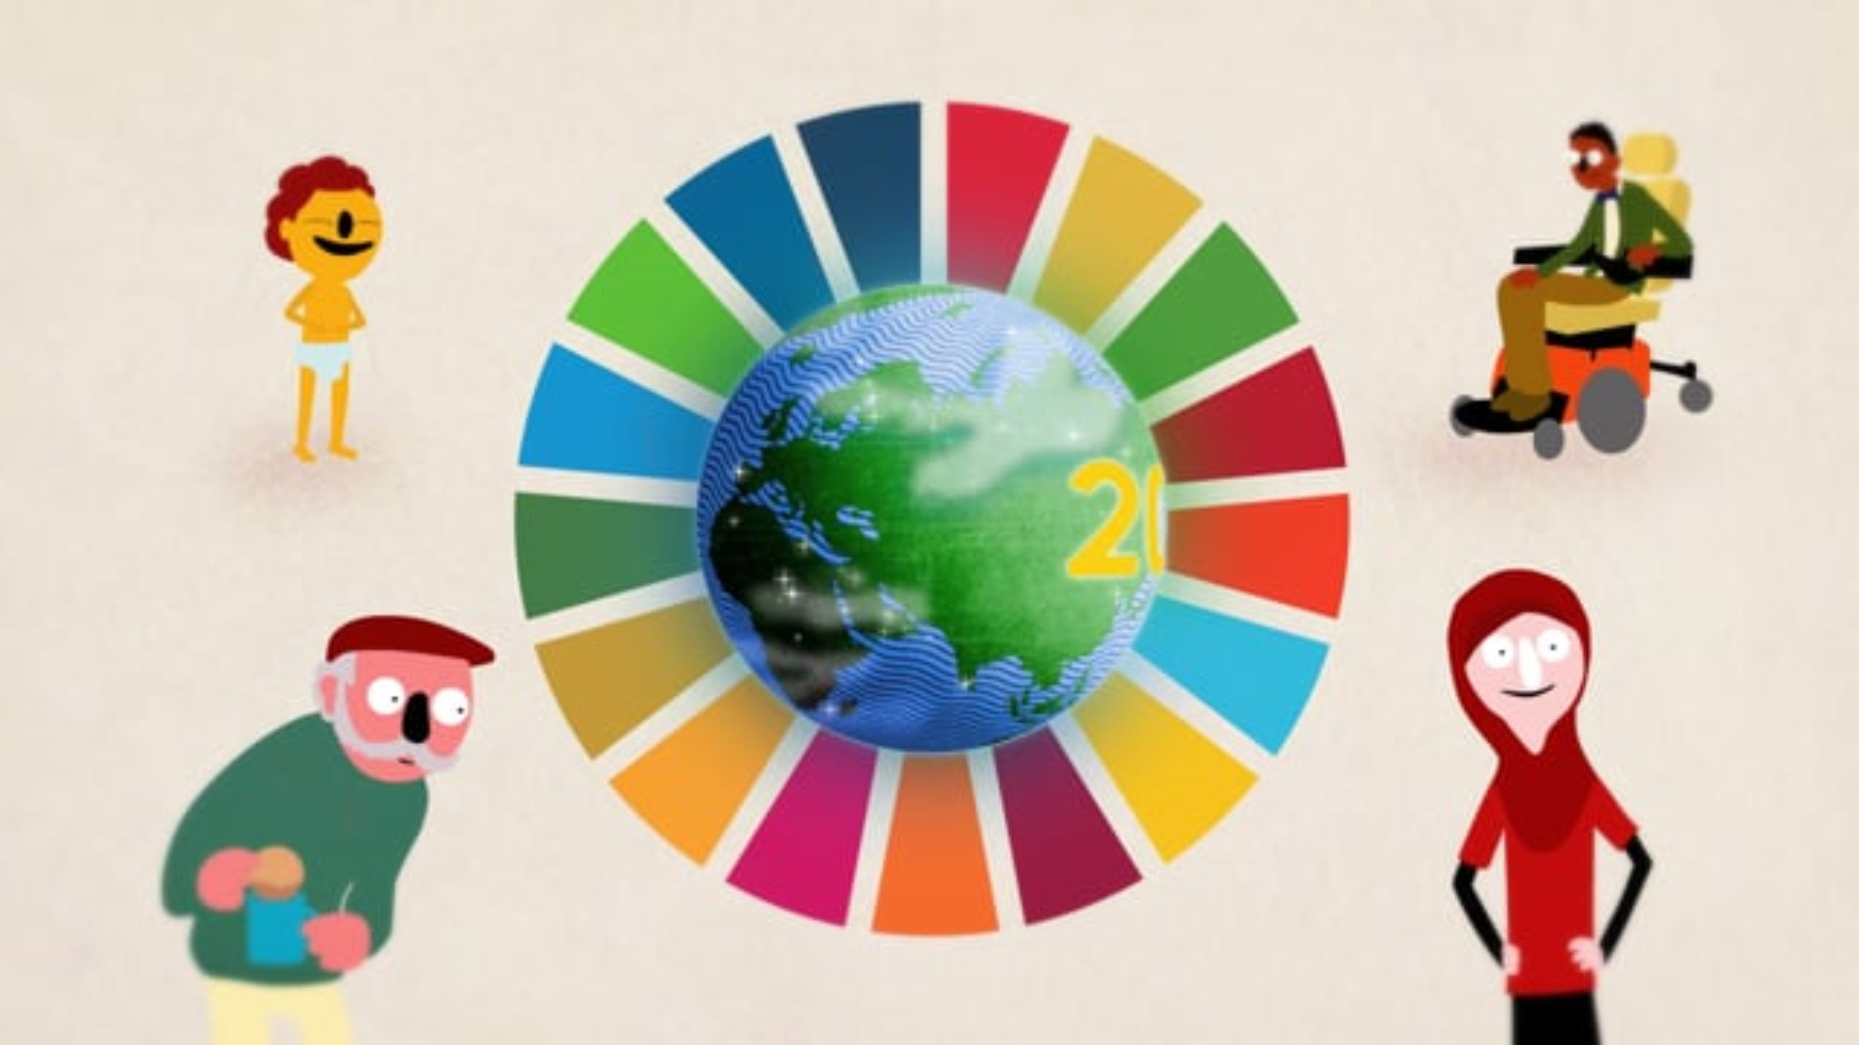
What are the Global Goals for
Sustainable Development?

Slide 4

What problems are we trying to solve?
End world poverty
Tackle global inequalities
Protect our environment
Stop climate change

Slide 5

















Your voices!
9. Industry, Innovation, and Infrastructure → Build a Better World
Description: Create things like roads, schools, and inventions that help everyone.
1. No Poverty → Everyone Has What They Need
Description: Make sure all people have enough food, clothes, and a safe place to live.
10. Reduced Inequalities → Be Fair to Everyone
Description: Make sure everyone is treated fairly, no matter who they are.
2. Zero Hunger → No One Goes Hungry
Description: Help everyone have enough healthy food to eat every day.
11. Sustainable Cities and Communities → Safe and Happy Places to Live
Description: Make towns and cities nice places where everyone can live safely.
3. Good Health and Well-being → Stay Healthy and Happy
Description: Help people stay safe, healthy, and feel good in their bodies and minds.
12. Responsible Consumption and Production → Use Wisely, Waste Less
Description: Don’t waste food or things we use - reuse and recycle instead!
4. Quality Education → Learn and Help Others Learn
Description: Make sure all kids get a chance to go to school and learn.
13. Climate Action → Protect the Earth
Description: Help stop climate change by taking care of our planet.
Gender Equality → Boys and Girls Are Equal
Description: Make sure boys and girls are treated the same and have the same chances.
14. Life Below Water → Keep Oceans and Rivers Clean
Description: Take care of fish and all the animals that live in water.
6. Clean Water and Sanitation → Clean Water for Everyone
Description: Make sure all people have clean water to drink and toilets to use.
15. Life on Land → Care for Plants and Animals
Description: Help protect forests, animals, and all nature.
Affordable and Clean Energy → Energy That’s Good for the Earth
Description: Use power that doesn’t harm the planet, like sunlight and wind.
16. Peace, Justice and Strong Institutions → Be Kind and Fair
Description: Help everyone live in peace and follow fair rules.
Decent Work and Economic Growth → Good Jobs for Everyone
Description: Help make sure people can work in safe jobs and earn enough money.
17. Partnerships for the Goals → Work together to make a difference
Description: People around the world need to team up to help each other.

Slide 6
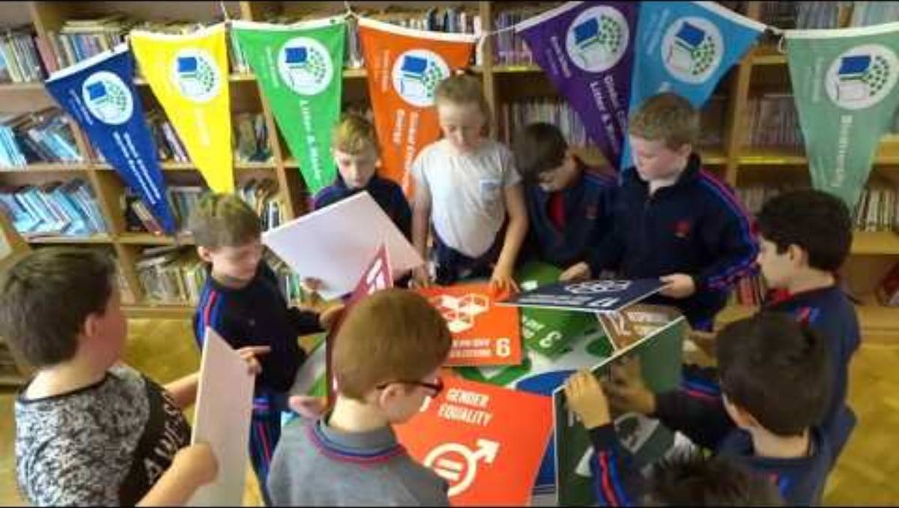
Your voices!

Slide 7
Global Goals Go Local Project
Module 2 - Choose and get to know your character
Notes:
Module 2 Choose and get to know your character (30–40 minutes)
Each team chooses one character whose life is affected by the problem linked to their goal. They
then make the character their own before doing anything else.
What to do
● Give each team the character stories sheet. Ask them to read through all the characters
and decide together which one they want to focus on.
● Once they have chosen, each team fills in the character profile worksheet (slide 9). Encourage them
to give the character their own name, appearance, and personality - this is important! The
character should feel like someone they invented, not someone from a list.
● Teams can also sketch their character on the character profile sketch sheet (slide 10) and present/
act out their character to the rest of the class (drama link).
Teacher notes
This is the most important module for engagement. Pilot experience showed that when all teams
were assigned the same character without getting to choose, solutions became less varied and
children felt less ownership of the process. Each team should choose their own character, and
personalising the character - their name, how they look, what they like - makes a big difference to
how deeply children connect with the problem they are solving.
Do not give too much input at this stage. The goal is for children to imagine and build on the
character themselves and connect to the character, not to get it right.

Slide 8

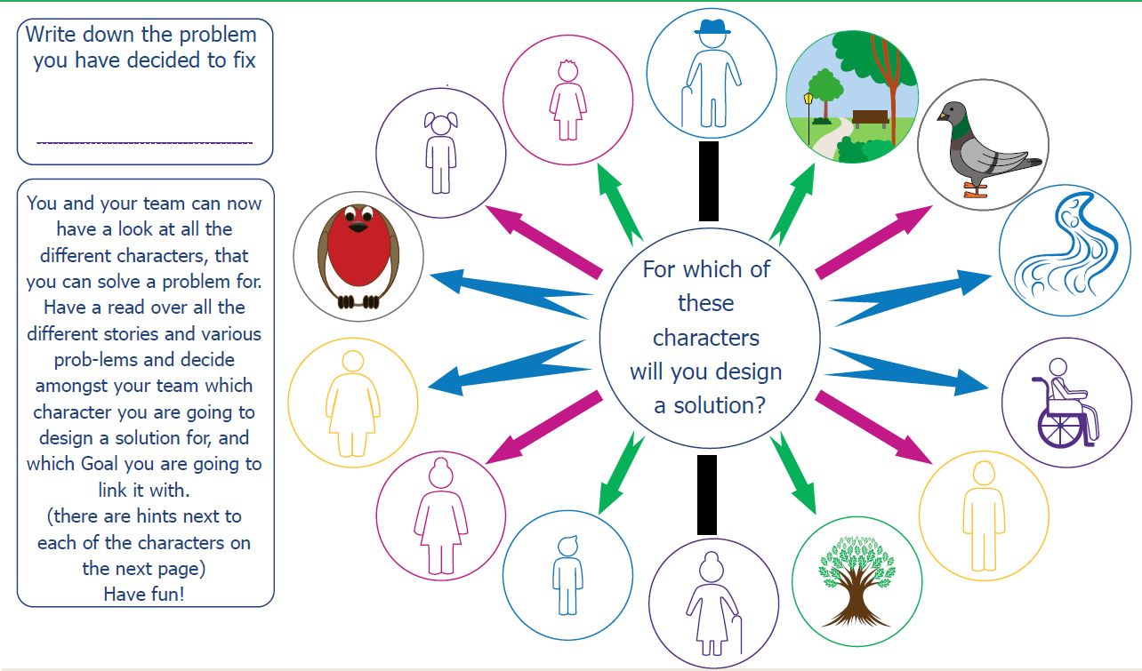

Slide 9
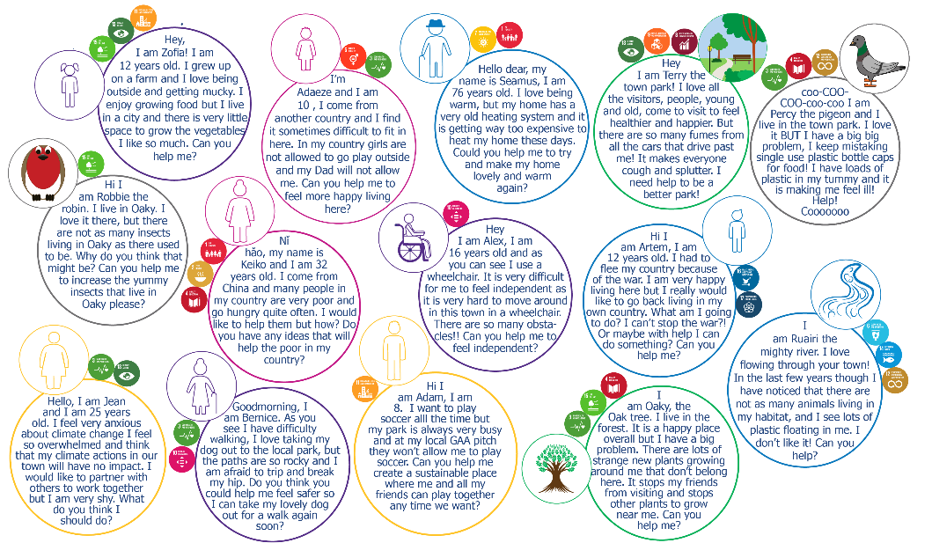

Slide 10
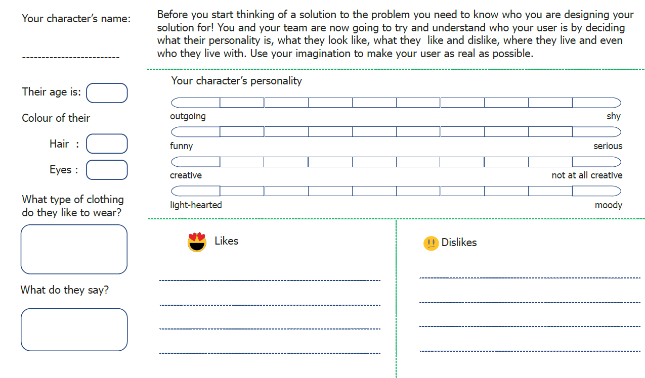
Who is your Character?

Slide 11


Character Profile Sketch
Notes:
Now it is time to share your character with the rest of the groups, you can use a bit of drama to act out your character

Slide 12
Global Goals Go Local Project
Module 3 – Define the problem
Notes:
Module 3 Define the problem (20–25 minutes)
Each team writes a clear problem statement that captures exactly what their character is struggling
with and why.
What to do
● Give each team the problem statement template (slide 12).
● Ask them to complete each section - who their character is, what their character's problem
is, why they cannot solve it on their own, and how they will feel when there is a solution.
● Encourage teams to be as specific as possible. A good problem statement names the
character, names the problem, and says something about why it is hard to fix.
Teacher notes
Keep this short. The problem statement is a thinking tool, not a piece of writing to perfect. If a
team is spending more than 20 minutes on it, prompt them to move on, the brainstorming and prototyping stages
will help them refine their thinking anyway.
Do not give too much input into what the problem should be. If a team's problem statement is a bit
vague, that is fine. They will sharpen it as they start generating ideas.

Slide 13

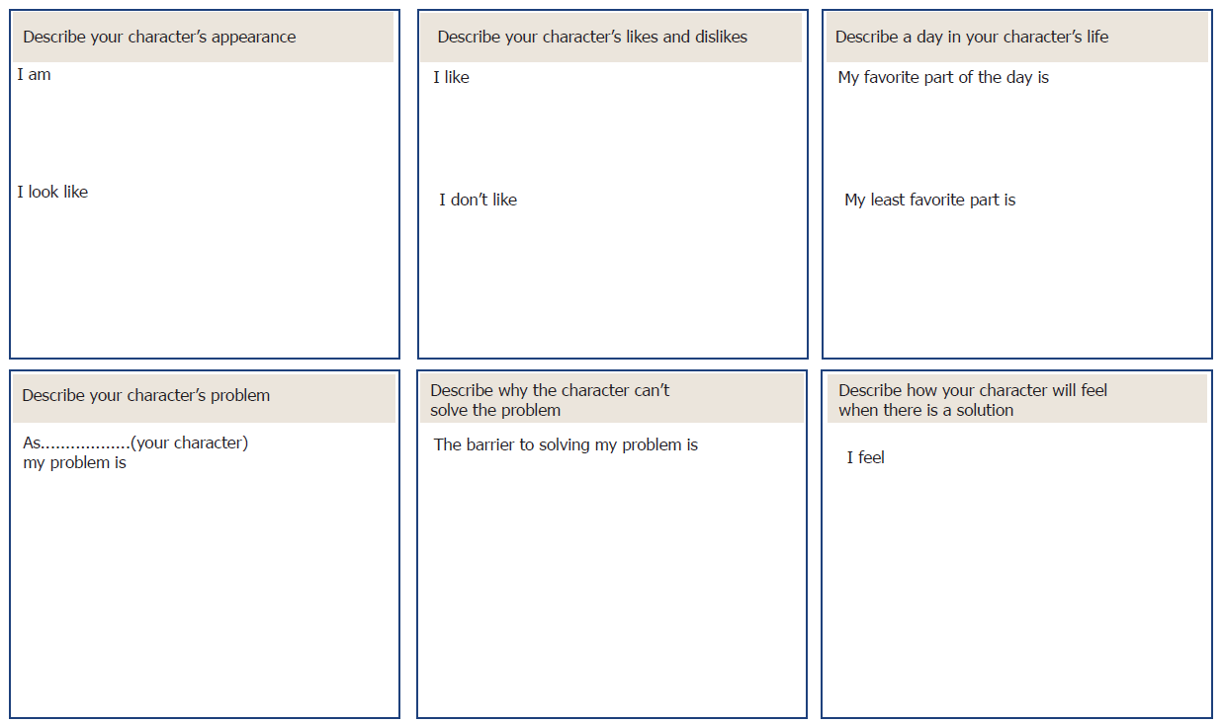
What’s your problem?
Tell your character’s story and discover what their exact problem is!

Slide 14
Global Goals Go Local Project
Module 4 – Generate and choose a Solution
Notes:
Module 4 Generate and choose a solution (45–60 minutes)
Teams generate as many ideas as possible, then work together to develop their best one.
What to do
● Start with the A–Z ideation sheet. Give teams five minutes to write one solution idea for
each letter of the alphabet. Speed matters here so there is no time to overthink, encourage ‘silly’
ideas.
● Then move to the Flower Power sheet. Teams write one idea in each petal. Give ten
minutes.
● Gather all ideas (on the worksheets or on sticky notes) and display them so the whole team
can see everything. Give the team ten minutes to look through and vote on their favourite.
● If it is hard to pick one, teams can combine two or three ideas. They then use the idea
brainwriting sheet (slide 16) to develop their chosen idea further (fill in the brainwriting sheet in a clockwise direction, following the arrows on the sheet!).
Ideation warm-ups (optional)
If your class needs to warm up their creative thinking before the A–Z activity, try one of these -
● Crazy 8s - fold a sheet of paper into 8 rectangles. Each child sketches a different idea in
each box, one minute per box, no talking.
● Yes, and - one child shares an idea, the next responds with "Yes, and..." and adds
something. Keep going around the team, building the idea together. No saying "no" or "but".
Teacher notes
The goal at the ideation stage is quantity, not quality. Silly ideas are welcome. The more ideas on
the table, the better the final solution is likely to be. Encourage children to keep going even when
they feel stuck.
The solution shopping step (reviewing all ideas together before picking one) is worth protecting.
Children often vote for the most familiar idea rather than the most interesting one. Encouraging
them to look for the surprising idea, or to combine two, tends to produce more inventive solutions.

Slide 15

Inspiration
Notes:
You may show this video as an inspiration that children can make a difference, not absolutely necessary.

Slide 16

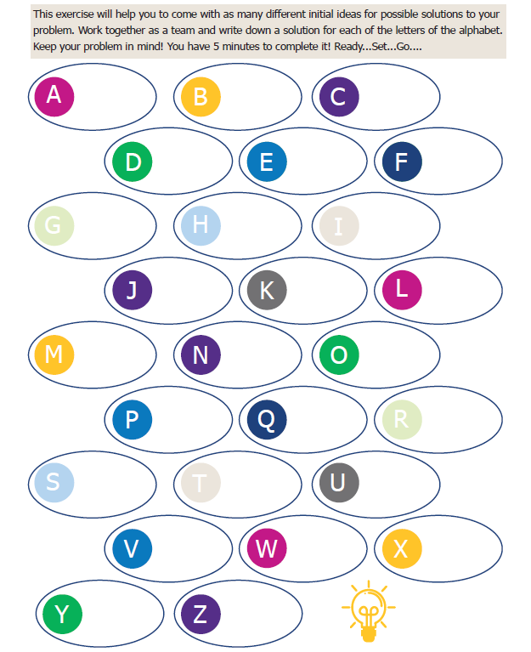
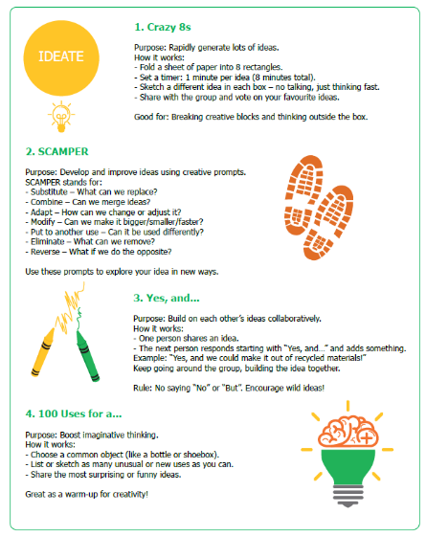

IDEATING A SOLUTION - Brainstorming
Pick one or two ideation methods to gather as many ideas as possible!

Slide 17
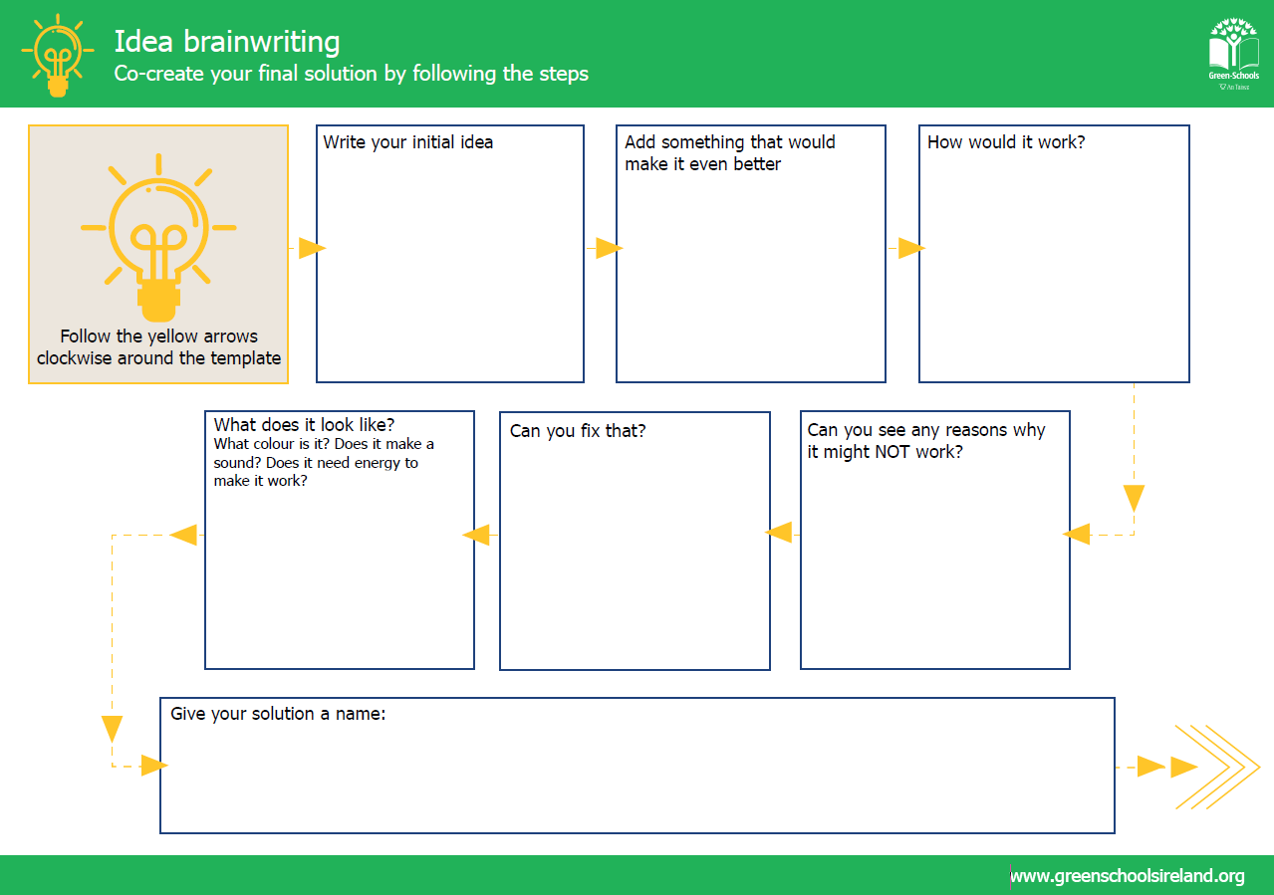

Slide 18
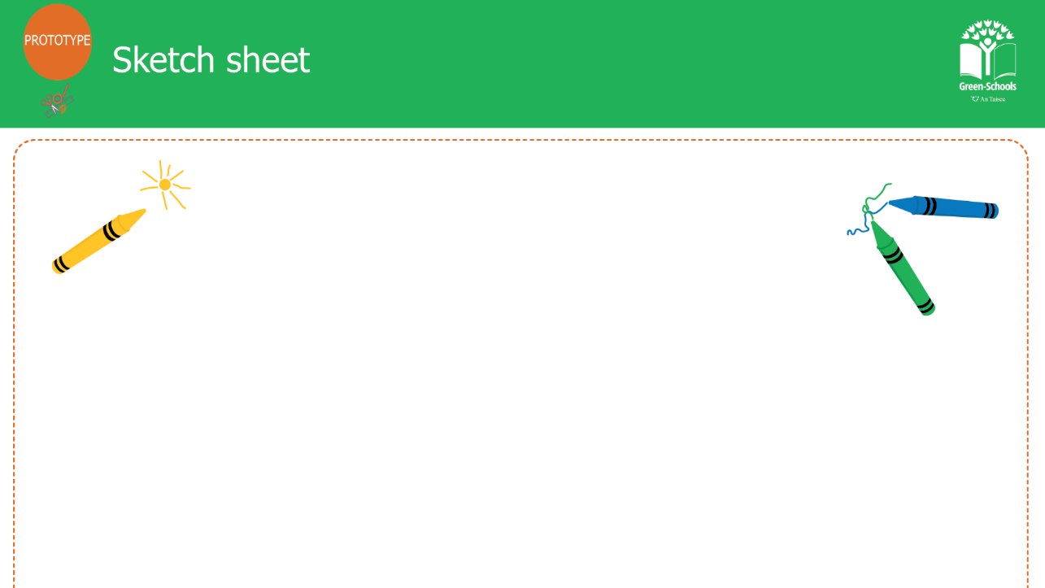

Slide 19
Global Goals Go Local Project
Module 5 - Build, present, and reflect
Notes:
Module 5 Build, present, and reflect (60–90 minutes)
Teams build a prototype of their solution, present it to the class, and complete a short individual
reflection.
What to do
● Give each team the prototype sketch sheet. Ask them to draw their solution first before
building anything - this helps them plan.
● Teams then build their prototype using whatever materials are available - recycled
cardboard, clay, LEGO, paper, fabric. If the solution is a campaign or an app rather than a
physical object, they can create a poster, a storyboard, or a simple sketch of how their campaign
would work.
● Each team presents their solution to the class and the Green-Schools Committee. They
should explain - who their character is, what problem they solved, what their solution is, and
how it works.
● The class gives feedback using two stars and a wish - two things they liked and one thing
they would suggest for improvement.
● Children then complete the student reflection survey individually. This takes about five
minutes.
Teacher notes
Children often want more time for prototyping than is available. It helps to set a clear time limit
at the start and to reassure them that a simple, well-explained prototype is just as valid as an
elaborate one. Pilot feedback showed that some children were surprised when their prototypes
turned out smaller than they had imagined, this is a good learning in itself.
The reflection survey (included separately) uses a simple before-and-after format. Children rate
themselves on five skills at the end of the project, thinking about how they felt before it started
and how they feel now. This takes about five minutes and gives you, and us, a record of what
children felt they gained from the experience.

Slide 20

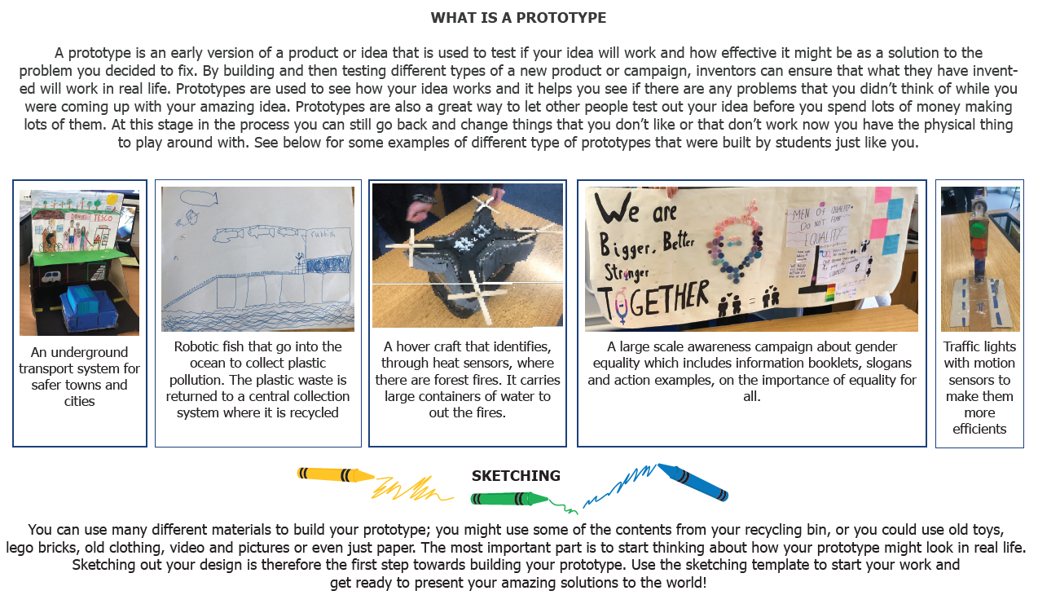
Prototyping

Slide 21
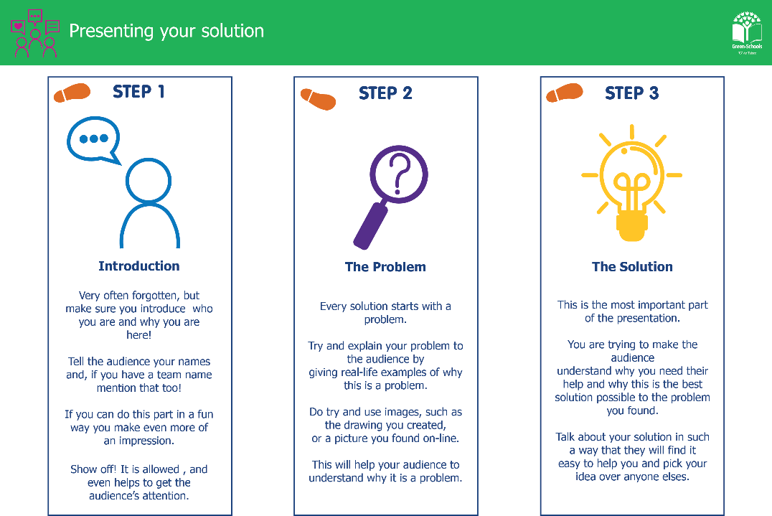
Notes:
Taking it further
Some classes will want to do something with their solution beyond the classroom. Here are a
few ideas -
● Share prototypes at a school assembly or with parents at an open afternoon.
● Write to a local councillor, business, or community organisation about the problem the
class identified.
● Choose one solution to actually try to implement - even a small version of it - in the
school or local area.
● Share the project with your Green-Schools Committee and see whether it connects to any
of your current flag topics.

Slide 22


Global Goals Go Local Project
Well Done!!!!
This resource is funded by Irish Aid at the Department of foreign affairs and trade. Irish Aid is the Government’s overseas
development co-operation programme which supports partners working in some of the world’s poorest countries.

