Slide 1
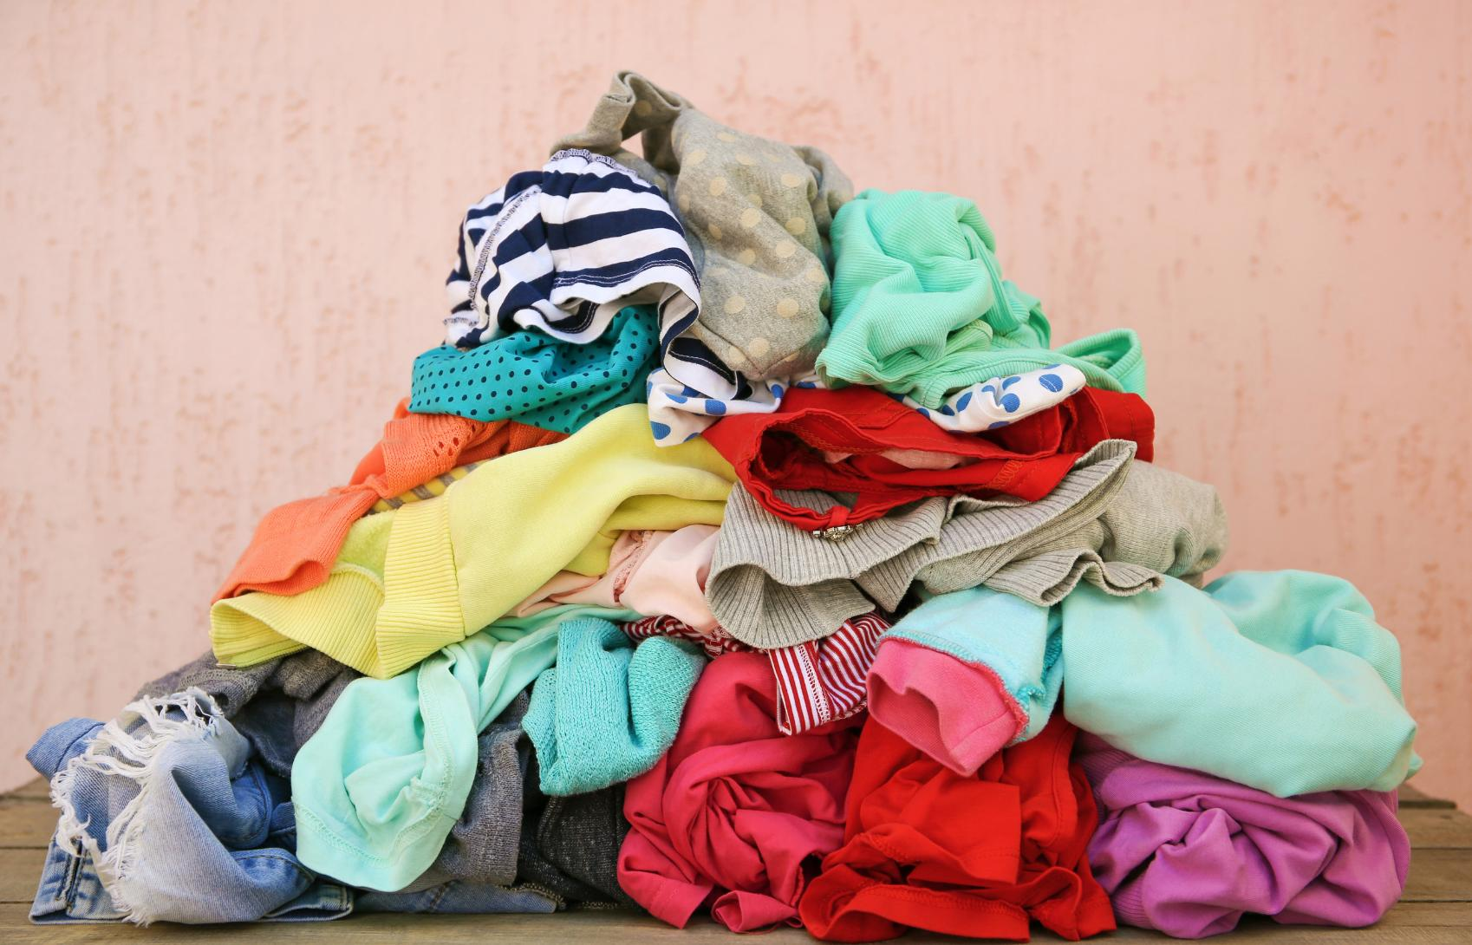


Sraith Foghlama Uisce (Cuid 3)
Uisce faoi Cheilt
An tUisce faoi cheilt a bhaineann le rudaí coitianta
Notes:
When we think about water use, we often picture taps, showers and toilets. But there is another, much bigger part of our water footprint hiding behind the things we buy, eat and use every day.

Slide 2
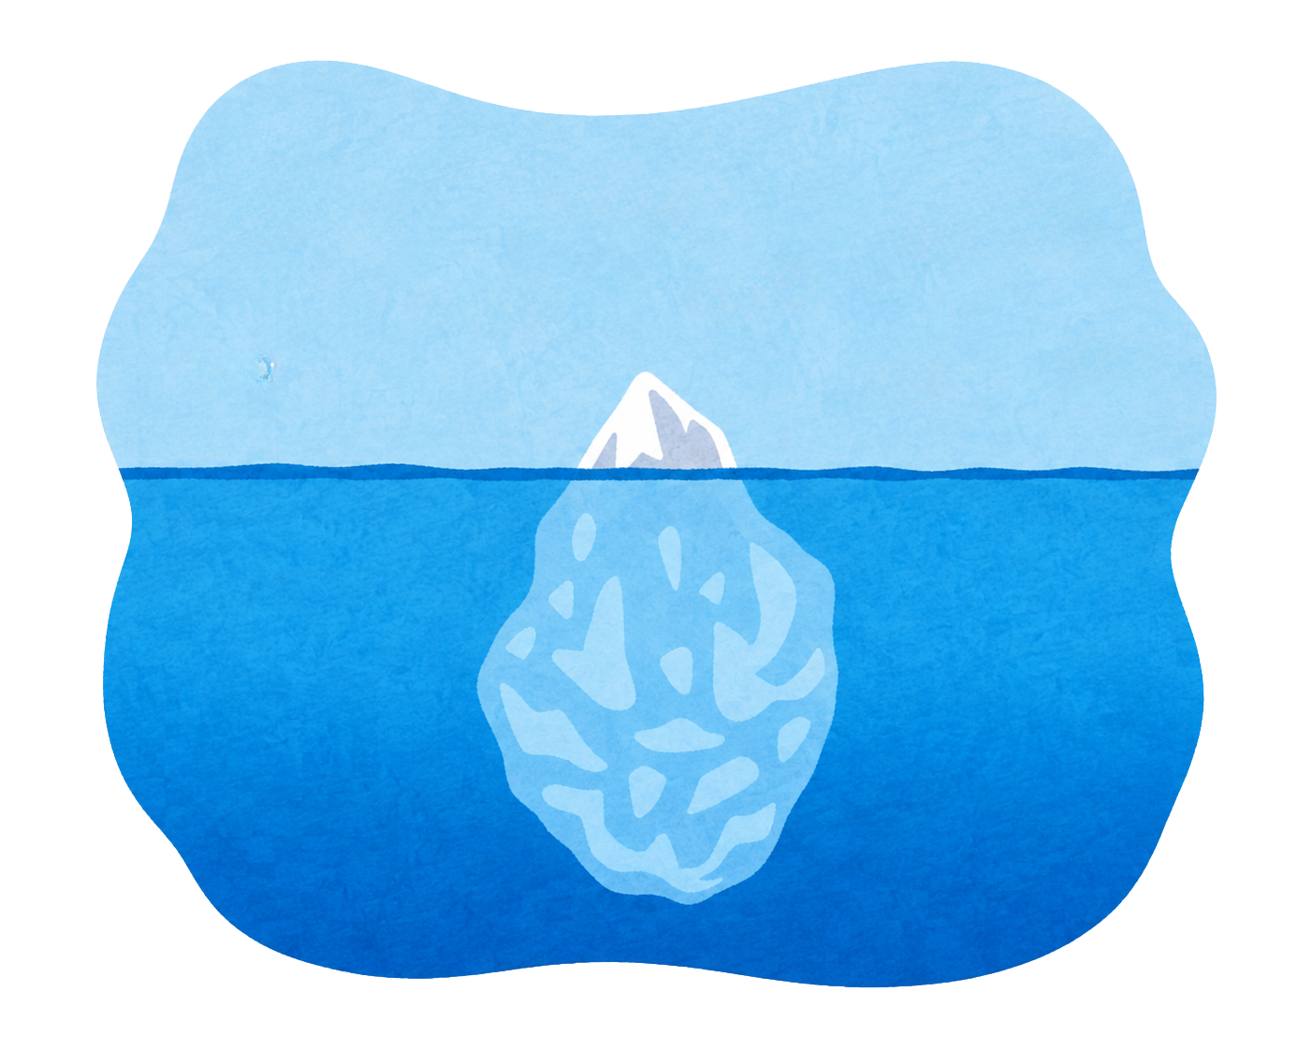








Céard é uisce faoi cheilt?
ag scuabadh na fiacla
ag ól uisce
Uisce soiléir
ag tógaint ceatha nó folcadáin
ag nigh éadaigh
Ciallaíonn “uisce faoi cheilt” (nó “uisce fíorúil” nó “uisce rúnda”) an t-uisce a úsáidimid gan fhios dúinn.
Is é sin an t-uisce a úsáidtear ag gach céim den phróiseas chun na rudaí a cheannaímid, a ithimid agus a úsáidimid gach lá a tháirgeadh agus a iompar.
ag fás bia
ag táirgeadh éadaigh
ag fuarú ionaid sonraí (data centres)
Uisce faoi cheilt
ag táirgeadh gutháin phóca
ag táirgeadh plaistigh
ag táirgeadh cairr
ag táirgeadh = producing
Notes:
Start by asking: when you use water, what do you picture? Most of us probably think about drinking, showering or brushing our teeth.
Hidden Water, also called Virtual Water or Secret Water, is the water used to make and transport the things we buy, eat and use every day. It is there from when the resources are first extracted to when we buy and use a product.
So, a T-shirt is not just a T-shirt. Food is not just food. Each product has a water story behind it.
As we go through this presentation, think about where our water drop might be travelling to make the things in our lives.

Slide 3
Uisce soiléir
(100-150 litre)
3%
Uisce faoi cheilt ó lá go lá
Úsáid uisce an duine in aghaidh an lae
Uisce faoi cheilt
3,600 litre
(suas go 3,500 litre)
97%
Bíonn “Uisce faoi Cheilt” mar fhormhór na húsáide uisce ó lá go lá
Notes:
You might remember from our last presentation that each person in Ireland uses 133 litres of water every day. In reality, that is only a person's direct water use.
The majority of our daily water use can be hidden water.
When we take into account Hidden Water, a person uses 3,600 litres of water a day. 97% of that is Hidden Water and only about 3% is from direct water use.
That means the water we see coming from a tap is only a small part of the story.

Slide 4
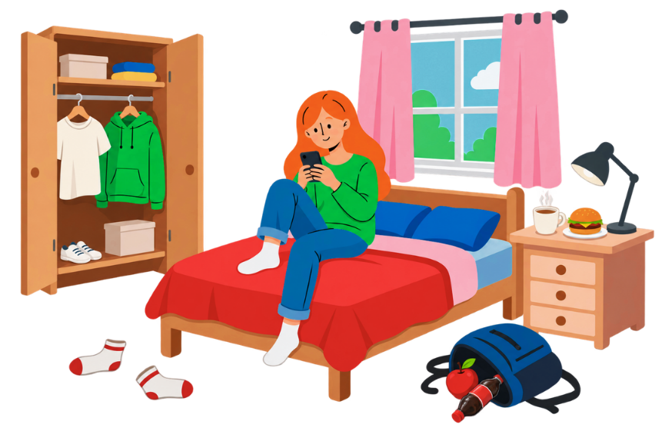
An mó uisce atá faoi cheilt inár rudaí?
cupán caife
Geansaí
250 litre
3,350 litre
T-léine cadáis
burgar
2,498 litres
2,700 litre
bríste géine
úl
7,250 litre
95 litre
Péire stocaí
deoch fiosaí
375 litre
98 litres
Tá níos mó ná leath don aos measartha óg ag ceannach éadaí nua nach caitear ach cúpla uair sa mhí “ar a laghad”, de réir taighde nua ón EPA.
Measann an EPA gur chuir teaghlaigh na hÉireann 200,000 tona de dhramhaíl bia amú i 2024.
Notes:
A lot of our water footprint is connected to the products we choose to buy and consume.
Let’s look at some everyday items and imagine the water behind them. A cup of coffee, a pair of socks, jeans, a hamburger, an apple or a cotton T-shirt all have different water footprints.
The important point is not to memorise every number. It is to notice that ordinary things can require surprisingly large amounts of water to produce.
[Ask the group]: Which item surprised you most? What might happen to the water used to make something if we buy it and then barely use it, or throw it away?

Slide 5








Méadaíonn an líon uisce a úsáidtear le méadú ar thomhaltas ginearálta
CEANNAIGH ANOIS!
tomhaltas = consumption
Notes:
Hidden Water gives us another way to think about consumption. The more things we buy and replace, the more water is needed somewhere along the production chain.
This is not about never buying anything. It is about becoming more aware of what sits behind our choices and asking whether we really need something, whether we can use it for longer, or whether we can get more use from something we already have.

Slide 6
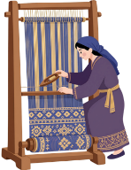

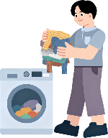





Faisean
Is é an earnáil fhaisin an dara earnáil is déine ar uisce sa domhan i ndiaidh na feirmeoireachta.
Cén fáth go bhfuil an oiread sin uisce á úsáid?
Feirmeoireacht na mbarr
Ag baint agus ag scaradh cadáis
Dáileadh amach timpeall an domhain
go dtí muileann sníomhacháin
ag sníomh, ag fí agus ag dathú
ag táirgeadh na n-éadaí
Úsáid agus cúram sa bhaile
Fadhb an truaillithe
Tagann
20%
d’uisce truaillithe na
ag sníomh = spinning
ag fí = weaving
tionsclaíocha sa domhan as coiréail agus dathú na n-éadaí
Notes:
Take clothing as an example.
Water is involved long before a jumper reaches a shop.
Cotton has to be grown and harvested. It is then processed, spun, woven and dyed. The garment is manufactured, transported around the world, and eventually washed and cared for at home.
There is also a pollution story here. A whopping 20% of global industrial water pollution is linked to textile treatment and dyeing
So when we think about a piece of clothing, we can ask not just ‘How much does it cost?’ but also ‘What resources and water went into making it?’

Slide 7
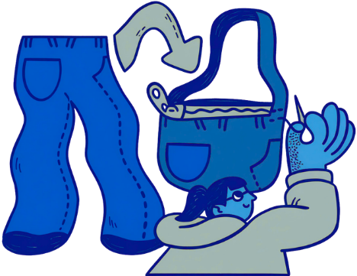

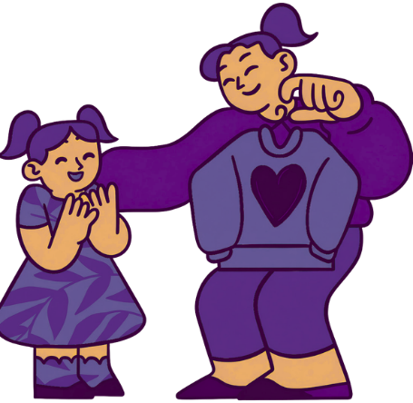
Ná chaithigí amach é...
Deisigí é
Roinnigí é
Athraígí go rud nua é!
Notes:
Before throwing something away, pause and ask: could someone else use it? Could I repair it? Could I turn it into something new?
Repairing, sharing and reusing all help us get more value from the resources and water already used to make something.
This is a simple shift in thinking: instead of seeing an item as waste, get creative and see it as a resource that might still have another life.

Slide 8
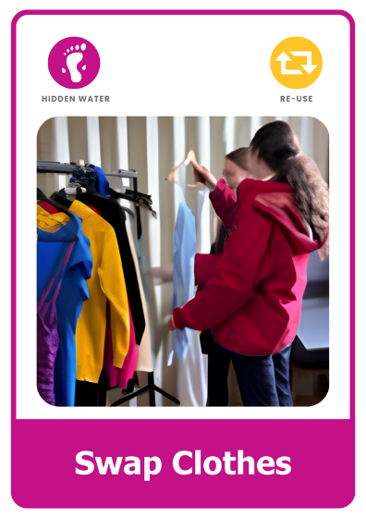
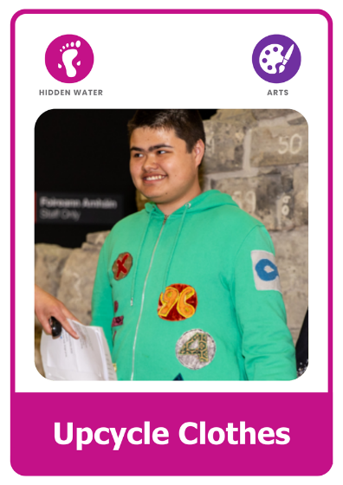

Céard a dhéanfá?
Téigh sa tóir ar na Cártaí Gnímh ar son Uisce.
Malartaigh Éadaí
Déan uaschúrsáil ar éadaí
Cur stop leis an dramhbhia
Roghnaigh gníomhaíocht. Misnigh daoine chun páirt a ghlacadh. Bíodh tionchar agat!
Notes:
Hidden Water can feel like a huge global issue, but our everyday choices can still make a difference.
Choose an action that feels achievable. Get other people involved, and think about how you can make the connection between everyday choices and water more visible.
The aim is not perfection. It is to notice, make a choice, and take action.

Slide 9


Foghlaim tuilleadh
Lean ort le ceachtanna eile sa tSraith Foghlama Uisce:
Uisce ar Domhan
Cuir tús le d’aistear Uisce
Uisce ó lá go lá
Foghlaim conas a úsáidimid uisce go laethúil
FiaUisce
Foghlaim faoi aibhneacha, lochanna, bogaigh agus fiadhúlra.
Aimsigh níos mó acmhainní, gníomhartha, comórtais, agus spreagadh ag:
greenschoolsireland.org/water.
An bhfuil tacaíocht ag teastáil nó an bhfuil ceisteanna agat? Téigh i dteagmháil linn ag:
water@greenschoolsireland.org

