Slide 1
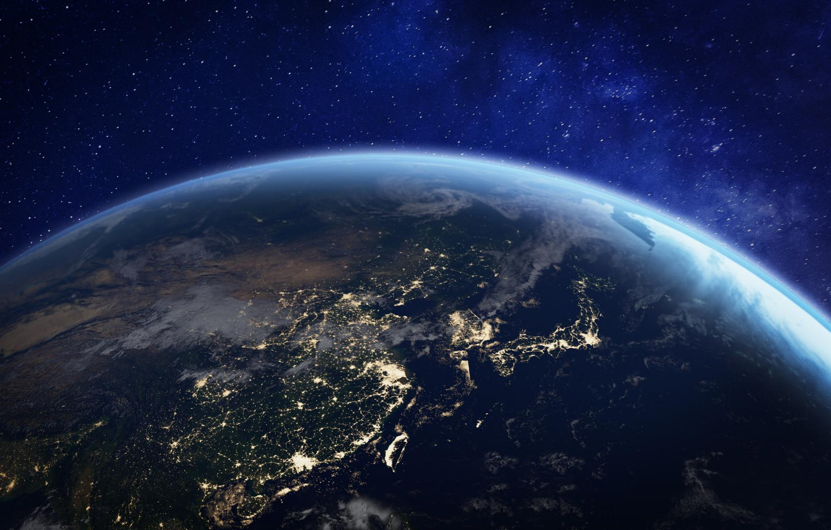


Sraith Foghlama Uisce (Cuid 1)
Uisce ar Domhan
Ag cur an acmhainn is luachmhara ar domhan in aithne

Slide 2
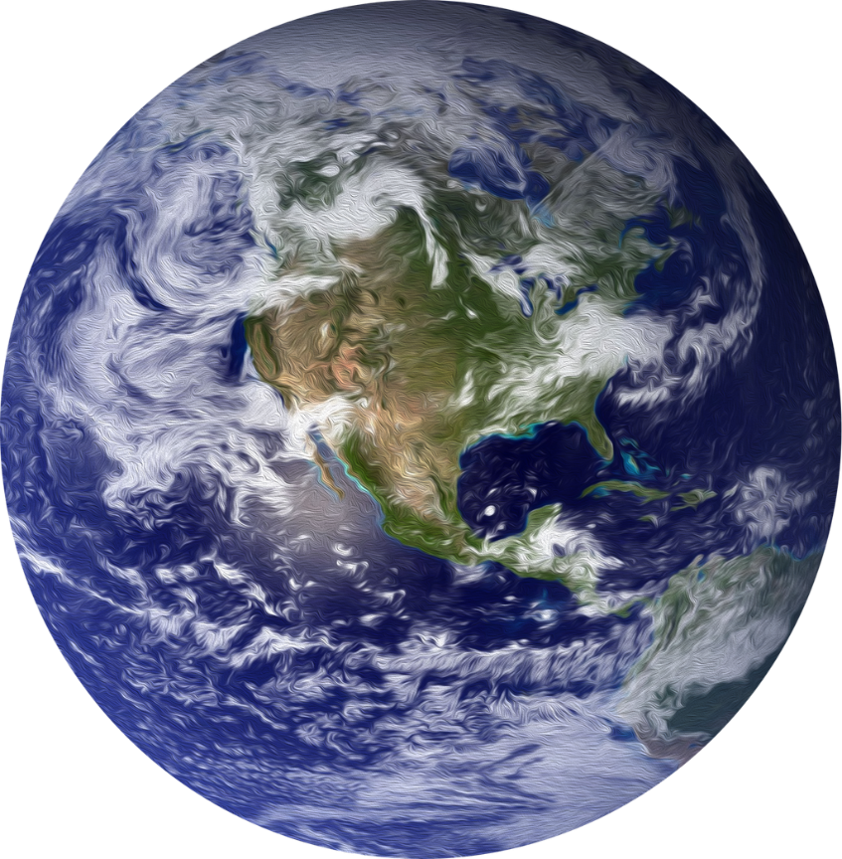
An Domhan Gorm
70%
Tá níos mó ná
de dhromchla an domhain clúdaithe in uisce.
Sin an fáth go bhfuil an leasainm
“An Domhan Gorm”
air.
Notes:
Imagine zooming out into space and looking back at Earth. What colour does it look like? Over 70% of Earth’s surface is covered in water, so people call it the Blue Planet.

Slide 3

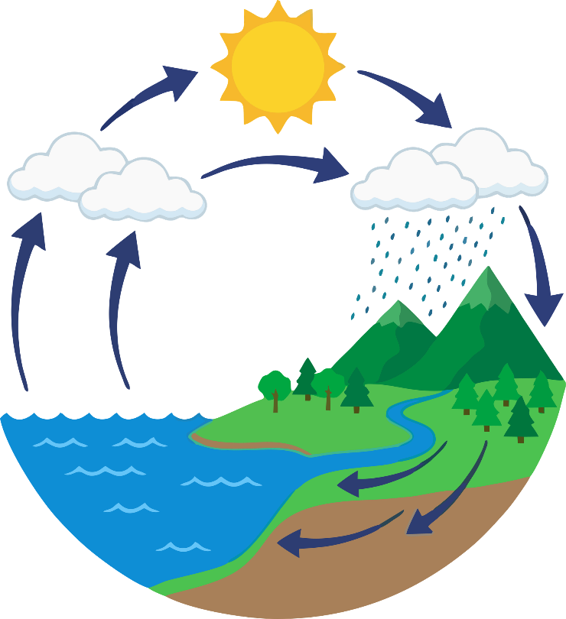



An Timthriall Uisce
Ní dhéanann an domhan uisce nua– déanann sé athchúrsáil air!
Tá an t-uisce a ólaimid inniu
4.5
billiún
bliain in aois
(Is é sin aois an domhain!)
Notes:
Now imagine a drop of water. That drop is as old as Earth itself, around 4.6 billion years. It has been travelling around our planet again and again in the water cycle.
Maybe, you could give the water drop a name?
On a sunny day, our water drop evaporates from the sea and floats up into the sky as part of a cloud. Later, it falls as rain, lands on a hill, runs into a stream, races through a river and finally returns to the sea.

Slide 4
Úruisce: Soláthar Srianta!
2.5%
Níl ach
d’uisce an domhain mar úruisce
97.5%
is ea sáile
Notes:
But here is a twist in the story: most of Earth’s water is salty ocean water. Only a tiny bit is freshwater, and even less is easy for us to reach. That small amount of freshwater is what we all rely on to drink, wash, grow food and make things. Every plant, every animal and every person depends on clean freshwater to stay alive.

Slide 5

Coimeádta in Oighear
...san úruisce atá againn,
70%
Tá timpeall
de coimeádta in oighearchaidhpeanna, oighearshruth, agus sneachta.
Notes:
Of the small amount of freshwater on Earth, most of it is locked away in ice: in ice caps, glaciers, and snow.

Slide 6
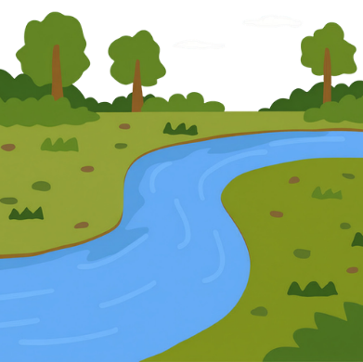
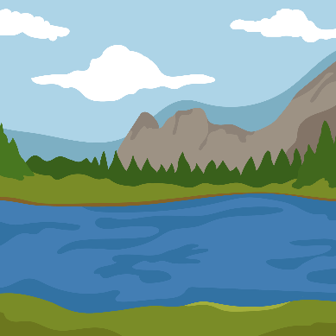
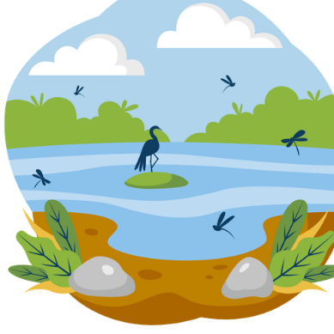
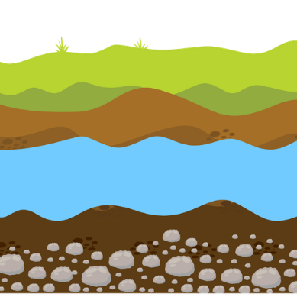
Úruiscí luachmhara
1%
Níl ach a bhíonn sna héiceachórais úruisce atá ríthábhachtach dúinn
Aibhneacha
Lochanna
Bogaigh
Faoi thalamh
Notes:
A freshwater drop might be in a river, a lake, a wetland, or hidden underground between rocks and soil.

Slide 7
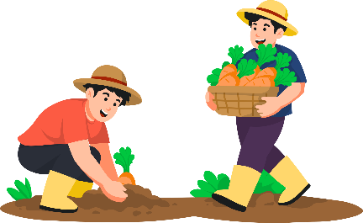



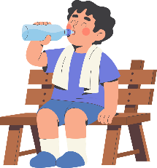



an tUisce faoi cheilt
Acmhainn Luachmhar
Tacaíonn méid beag úruisce le Saol ar Domhan – agus caithimid go léir é a roinnt.
An tUisce ó lá go lá
an Fiauisce
Notes:
Let’s take a moment to consider the preciousness of our freshwater resources.
The tiny amount of accessible freshwater we have is essential for all life on Earth. Despite how limited freshwater is, it supports everything from the smallest plants to the largest animals, including us. We have a responsibility to protect it for all living things.
[Pause for a moment to let this sink in.]
Think about how interconnected our lives are with this precious resource. Whether it's for drinking, growing food, or making clothes, every drop counts.
As we continue on our learning series, we will explore the water we use daily and uncover the hidden water we often overlook.

Slide 8


Foghlaim tuilleadh
Lean ort le ceachtanna eile sa tSraith Foghlaime Uisce:
an Uisce ó lá go lál
Foghlaim conas a úsáidimid uisce go laethúil
an Uisce faoi Cheilt
Bí ar an eolas faoin uisce nach bhfeicimid
Fiauisce
Foghlaim faoi aibhneacha, lochanna, bogaigh agus an fiadhúlra.
Aimsigh níos mó acmhainní, gníomhartha, comórtais, agus spreagadh ag:
greenschoolsireland.org/water.
An bhfuil tacaíocht ag teastáil nó an bhfuil ceisteanna agat? Téigh i dteagmháil linn ag:
water@greenschoolsireland.org

