Slide 1

FAST FASHION PROJECT
Working together for a sustainable future
www.greenschoolsireland.org

Slide 2


Fast Fashion Project
Module 1 - Discover Fast Fashion
Notes:
Module 1 Discover the Fast Fashion (40–60 minutes)
Children explore the problems surrounding the topic of Fast Fashion and decide as a team
which problem hey want to focus on.
What to do:
● Share the Fast Fashion Fact sheet with the class and give children time to read them in
their teams.
● Watch one short video and share the slides for discussion in the classroom if you have
access to a screen (see the project presentation).
● As a class, discuss which problem feels most urgent to you? Which ones can you see in
your own town or community?
● Each team chooses the problem that matters most to them. Give them five minutes to
discuss and agree.
Teacher notes
There is no wrong answer here. Let children choose the problem they feel genuinely connected
to. Some will attract a lot of teams, and that is fine. The same problem can produce very
different solutions.

Slide 3

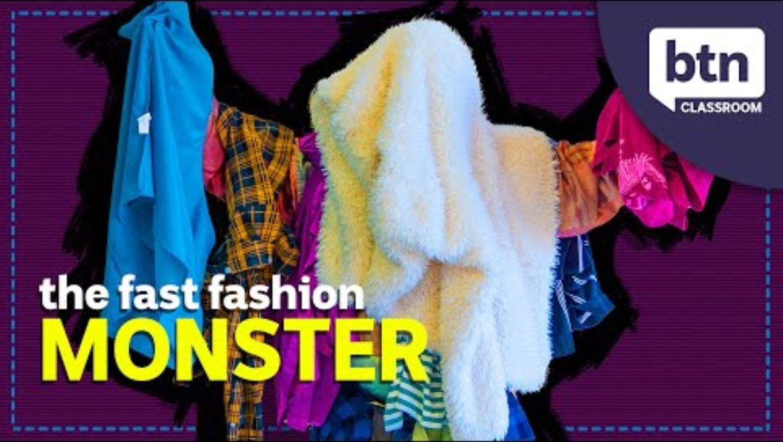
Fast Fashion Project - Discover

Slide 4
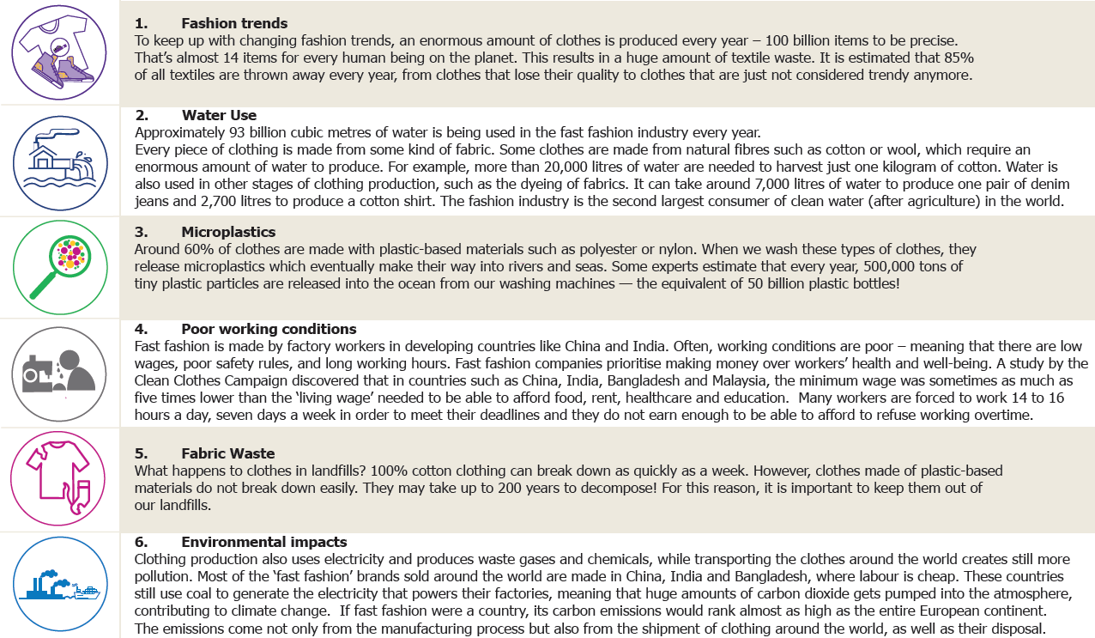
Fast Fashion Project – Fact Sheet
Notes:
Print out the fact sheet so students can have these on their desks when you talk through them according to the next few slides.

Slide 5
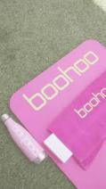




Fast Fashion Project - Discover
FACT Between July and December 2021, fast-fashion company, Shein added between 2,000 and 10,000
new styles to its app each DAY.
LET’S F X
Fashion trends
To keep up with changing fashion trends, an enormous amount of clothes are produced every year – 100 billion items to be precise.
That’s almost 14 items for every human being on the planet. This results in a huge amount of textile waste. It is estimated that 85% of all textiles are thrown away every year, from clothes that lose their quality to clothes that are just not considered trendy anymore.
FASHI N
Green-Schools
QUIZ QUESTION
On average how many times does a person wear an item of clothing that is in their wardrobe?
7
Notes:
https://goodonyou.eco/

Slide 6


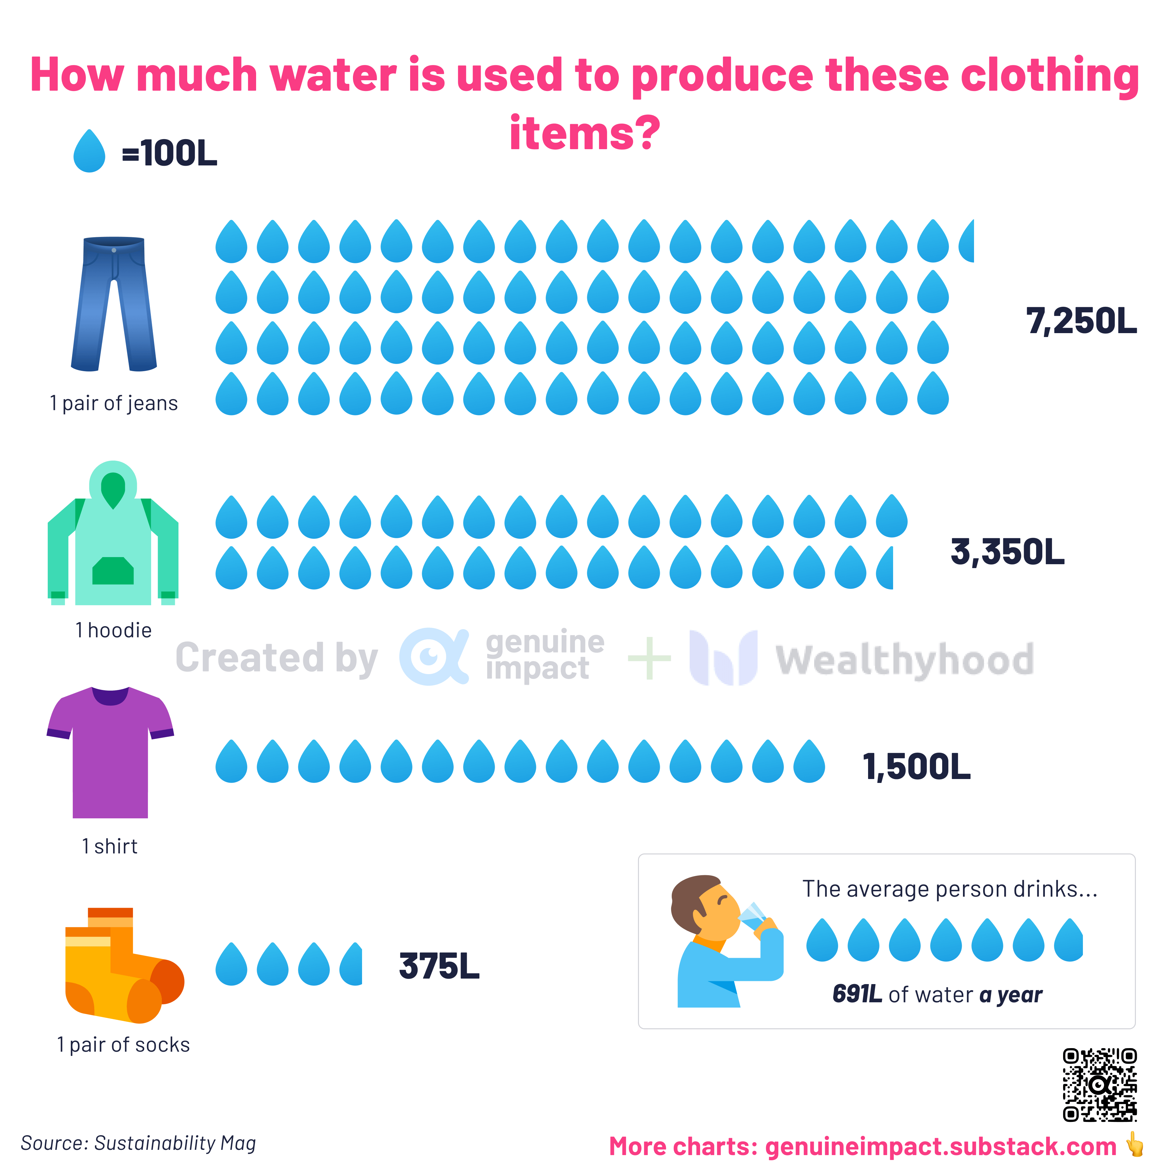
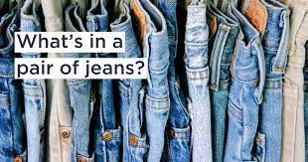
Fast Fashion Project - Discover
Water Use
Approximately 93 billion cubic metres of water is being used in the fast fashion industry every year.
Every piece of clothing is made from some kind of fabric. Some clothes are made from natural fibres such as cotton or wool, which require an enormous amount of water to produce. For example, more than 20,000 litres of water is needed to harvest just one kilogram of cotton.
Water is also used in other stages of clothing production, such as the dyeing of fabrics. It can take around 7,250 litres of water to produce one pair of denim jeans and 2,700 litres to produce a cotton shirt. The fashion industry is the second largest consumer of clean water (after agriculture) in the world.
QUIZ QUESTION
How much water is used to make one pair of jeans?

Slide 7

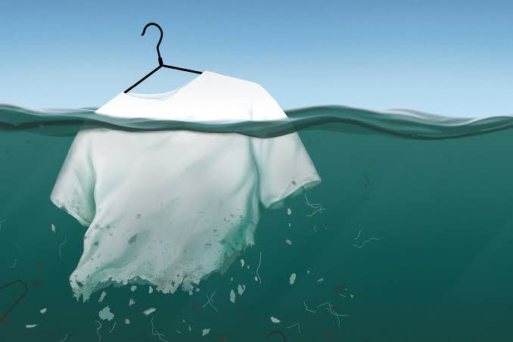
Fast Fashion Project - Discover
Microplastics
Around 60% of clothes are made with plastic-based materials such as polyester or nylon. When we wash these types of clothes, they release microplastics which eventually make their way into rivers and seas. Some experts estimate that every year, 500,000 tons of tiny plastic particles are released into the ocean from our washing machines - the equivalent of 50 billion plastic bottles!
35 % of ocean microplastics
comes from
synthetic clothing
Notes:
https://www.storyofstuff.org/

Slide 8
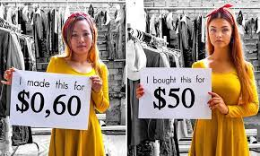
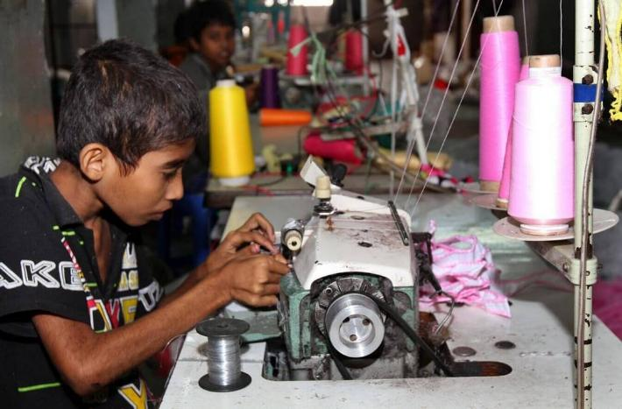
Fast Fashion Project - Discover
Poor working conditions
Fast fashion is made by factory workers in developing countries like China and India.
Often, working conditions are poor - meaning that there are low wages, poor safety rules, and long working hours.
Fast fashion companies prioritise making money over workers’ health and well-being.
A study by the Clean Clothes Campaign discovered that in countries such as China, India, Bangladesh and Malaysia, the minimum wage was sometimes as much as five times lower than the ‘living wage’ needed to be able to afford food, rent, healthcare and education. Many workers are forced to work 14 to 16 hours a day, seven days a week to meet their deadlines and they do not earn enough to be able to afford to refuse working overtime.

Slide 9
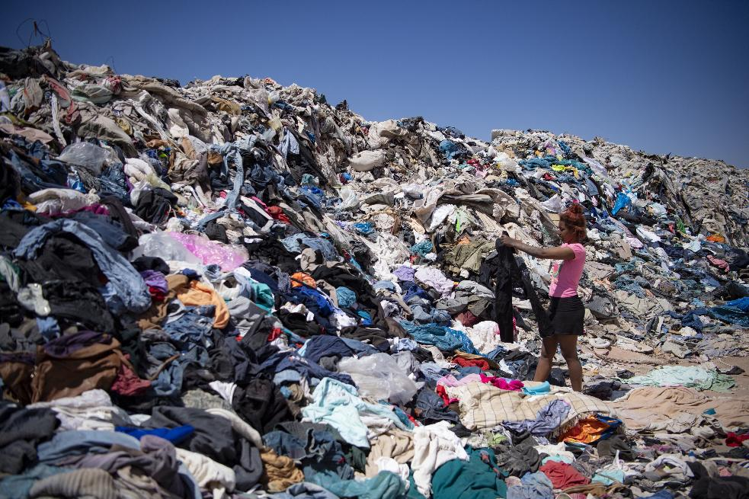
Fast Fashion Project - Discover
Fabric Waste
What happens to clothes in landfills? 100% cotton clothing can break down in as quickly as a week.
However, clothes made of plastic-based materials do not break down easily. They may take up to 200 years to break down! For this reason, it is important to keep them out of our landfills.

Slide 10


Fast Fashion Project - Discover
Environmental impacts
Clothing production also uses electricity and produces waste gases and chemicals, while transporting the clothes around the world creates still more pollution.
Most of the ‘fast fashion’ brands sold around the world are made in China, India and Bangladesh, where labour is cheap. These countries still use coal to generate the electricity that powers their factories, meaning that huge amounts of carbon dioxide gets pumped into the atmosphere, contributing to climate change.
If fast fashion were a country, its carbon emissions would rank almost as high as the entire European continent.
The emissions come not only from the manufacturing process but also from the shipment of clothing around the world, as well as their disposal.

Slide 11
Fast Fashion Project
Module 2 - Choose and get to know your character
Notes:
Module 2 Choose and get to know your character (30–40 minutes)
Each team chooses one character whose life is affected by the problem they have chosen to
work on. They then make the character their own before doing anything else.
What to do:
● Give each team the character stories sheet. Ask them to read through all the characters
and decide together which one they want to focus on.
● Once they have chosen, each team fills in the character profile worksheet. Encourage them
to give the character their own name, appearance, and personality - this is important! The
character should feel like someone they invented, not someone from a list.
● Teams can sketch their character on the character profile sketch sheet, and present their
character to the whole class.
Teacher notes
This is the most important module for engagement. Pilot experience showed that when all teams
were assigned the same character without getting to choose, solutions became less varied and
children felt less ownership of the process. Each team should choose their own character, and
personalising the character - their name, how they look, what they like - makes a big difference to
how deeply children connect with the problem they are solving.
Do not give too much input at this stage. The goal is for children to imagine and build on the
character themselves, not to get it right.

Slide 12

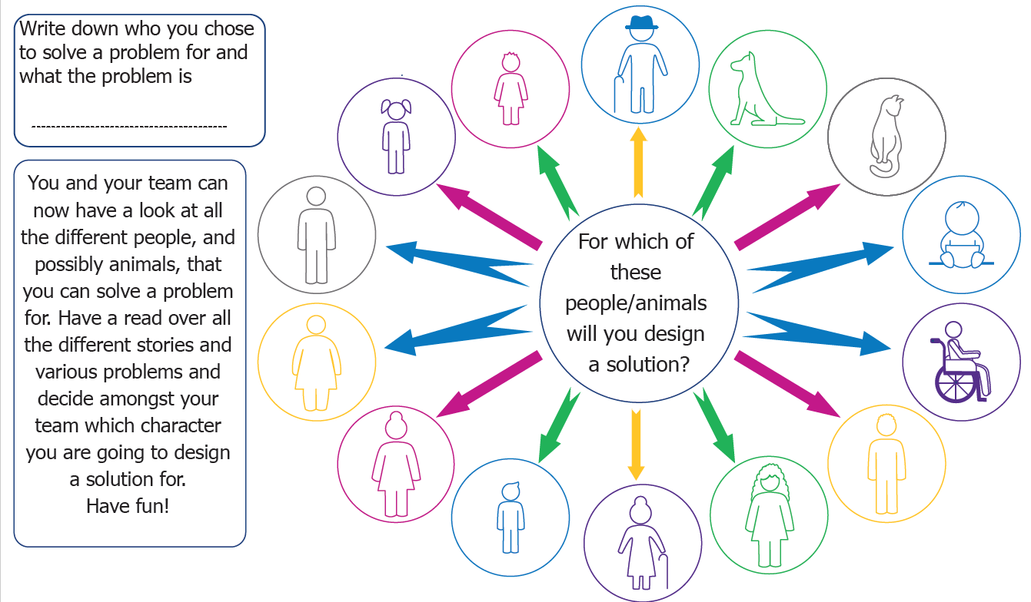

Slide 13
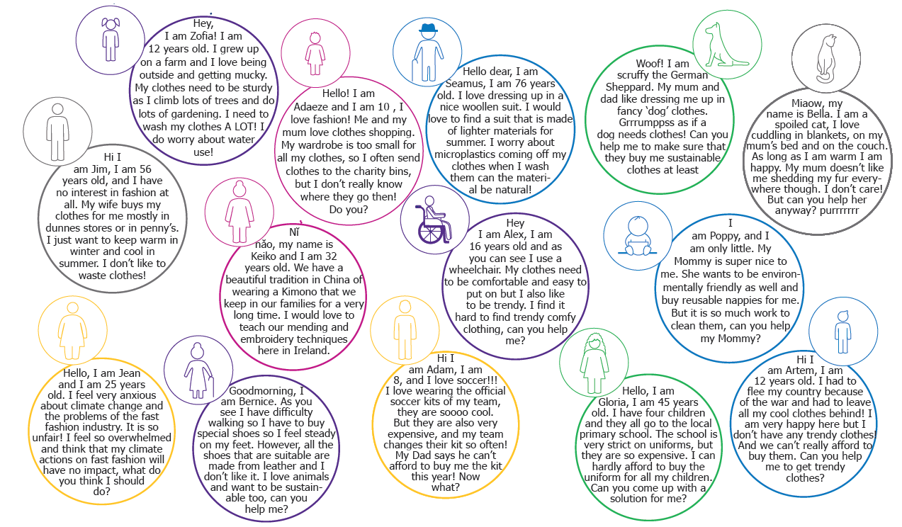
Fast Fashion Project – For which of these characters are we solving a problem?

Slide 14
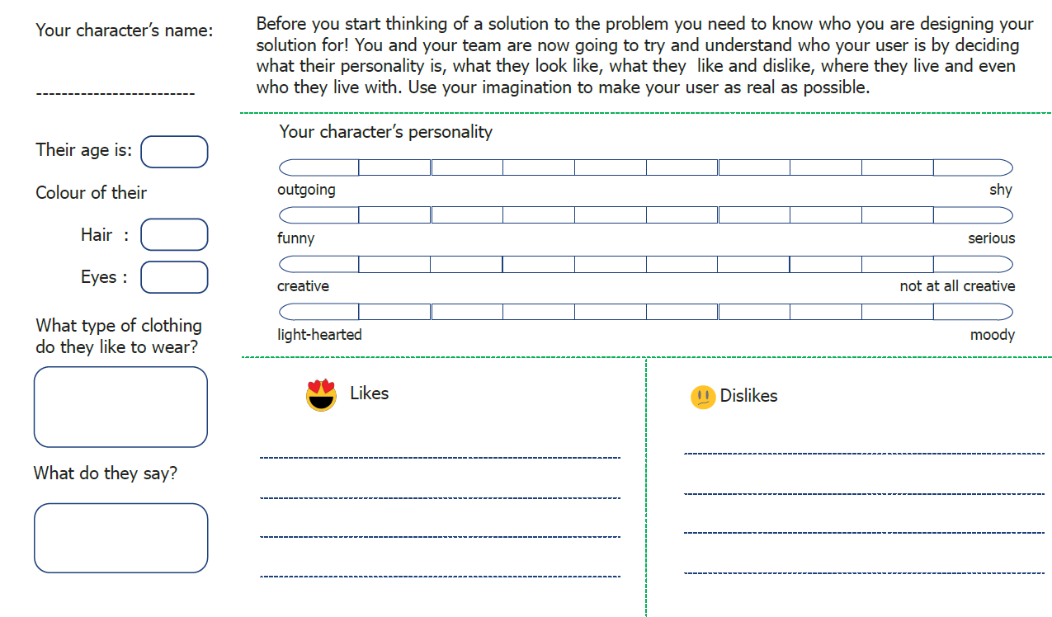
Who is your Character?

Slide 15

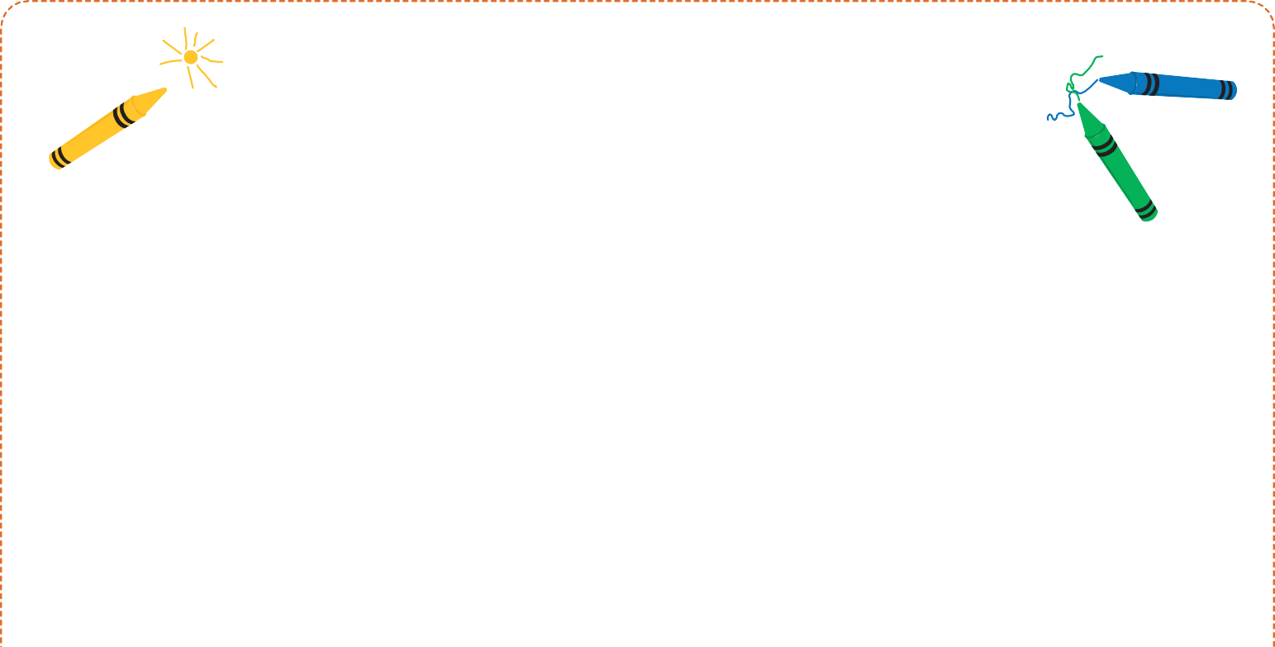
Character Profile Sketch
Notes:
Now it is time to share your character with the rest of the groups, you can use a bit of drama to act out your character

Slide 16
Fast Fashion Project
Module 3 – Define the problem
Notes:
Module 3 Define the problem (20–25 minutes)
Each team writes a clear problem statement that captures exactly what their character is struggling
with and why.
What to do:
● Give each team the problem statement template.
● Ask them to complete each section - who their character is, what their character's problem
is, why they cannot solve it on their own, and how they will feel when there is a solution.
● Encourage teams to be as specific as possible. A good problem statement names the
character, names the problem, and says something about why it is hard to fix.
Teacher notes
Keep this short. The problem statement is a thinking tool, not a piece of writing to perfect. If a
team is spending more than 20 minutes on it, prompt them to move on, the brainstorming stage
will help them refine their thinking anyway.
Do not give too much input into what the problem should be. If a team's problem statement is a bit
vague, that is fine. They will sharpen it as they start generating ideas.

Slide 17

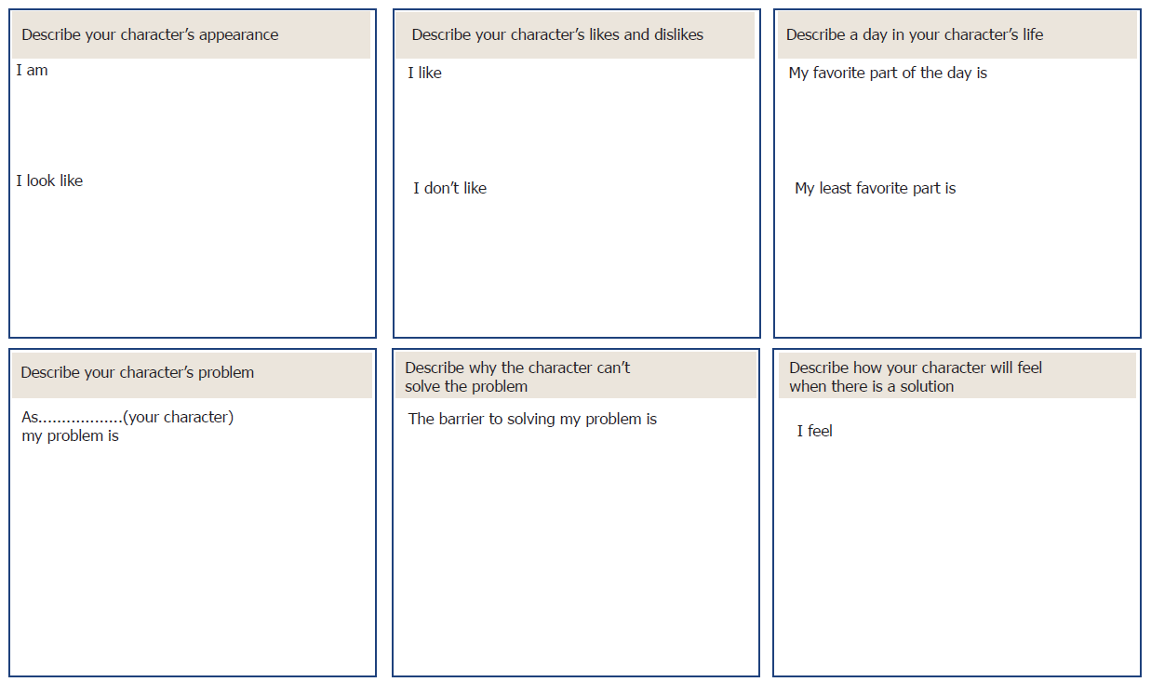
What’s your problem?
Tell your character’s story and discover what their exact problem is!

Slide 18
Fast Fashion Project
Module 4 – Generate and choose a Solution
Notes:
Module 4 Generate and choose a solution (45–60 minutes)
You may use slides 19, 20, 21, and 22 for some inspiration for the children if you feel they are stuck before they start ideating.
Teams generate as many ideas as possible, then work together to develop their best one.
What to do
You may start with the inspiration slides if you feel students might need that
Start with the A–Z ideation sheet. Give teams five minutes to write one solution idea for
each letter of the alphabet. Speed matters here so there is no time to overthink, encourage ‘silly’
ideas.
Then move to the Flower Power sheet. Teams write one idea in each petal. Give ten
minutes.
Gather all ideas (on the worksheets or on sticky notes) and display them so the whole team
can see everything. Give the team ten minutes to look through and vote on their favourite.
If it is hard to pick one, teams can combine two or three ideas. They then use the idea
brainwriting sheet (slide 24) to develop their chosen idea further (fill in the brainwriting sheet in a clockwise direction, following the arrows on the sheet!).
Ideation warm-ups (optional)
If your class needs to warm up their creative thinking before the A–Z activity, try one of these -
● Crazy 8s - fold a sheet of paper into 8 rectangles. Each child sketches a different idea in
each box, one minute per box, no talking.
● Yes, and - one child shares an idea, the next responds with "Yes, and..." and adds
something. Keep going around the team, building the idea together. No saying "no" or "but".
Teacher notes
The goal at the ideation stage is quantity, not quality. Silly ideas are welcome. The more ideas on
the table, the better the final solution is likely to be. Encourage children to keep going even when
they feel stuck.
The solution shopping step (reviewing all ideas together before picking one) is worth protecting.
Children often vote for the most familiar idea rather than the most interesting one. Encouraging
them to look for the surprising idea, or to combine two, tends to produce more inventive solutions.

Slide 19
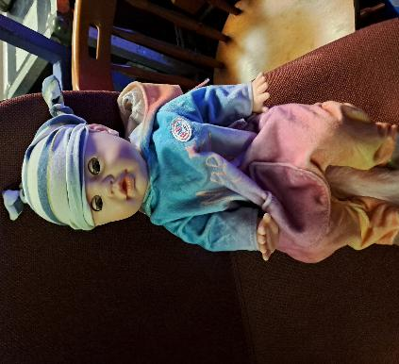
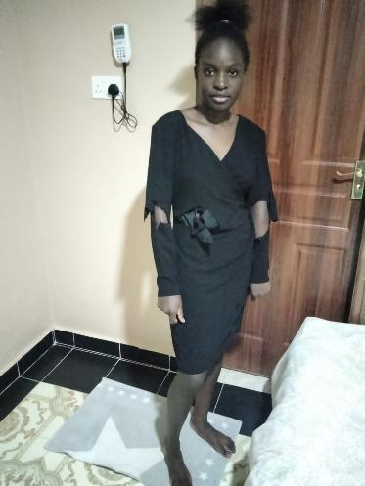
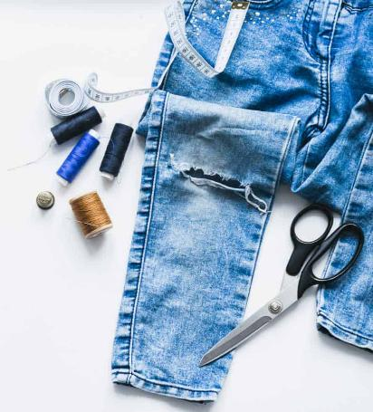
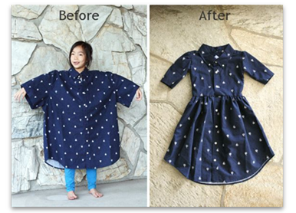
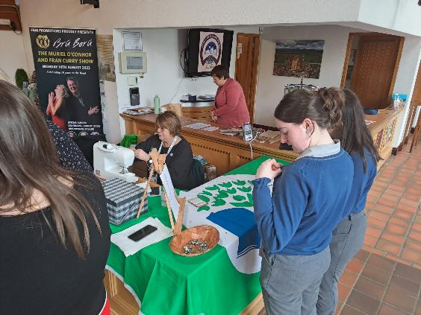
Inspiration
Upcycle or repair
Give clothing a new, longer life!
Beanie made from old T-Shirts for pre-mature babies

Slide 20
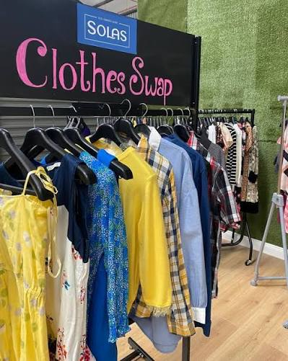
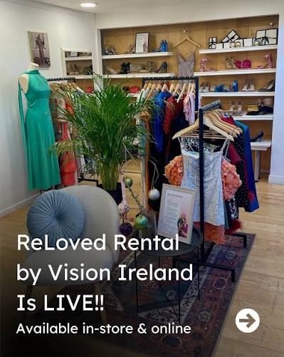
Inspiration
Swapping Clothes or Renting Clothes

Slide 21

Inspiration
Children in action:
Awareness campaigns
You could think of posters, flyers, writing letters to companies or governments, or making videos to share information or ask for changes to circular economy or to help tackle climate change

Slide 22

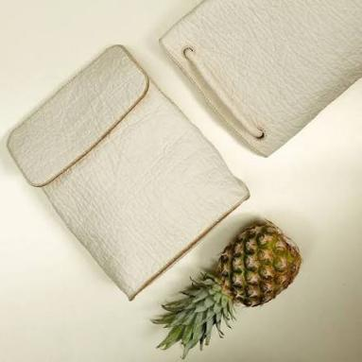
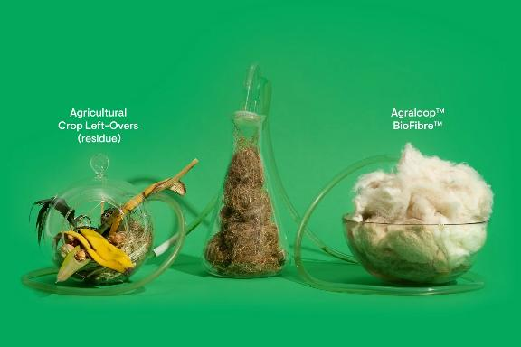

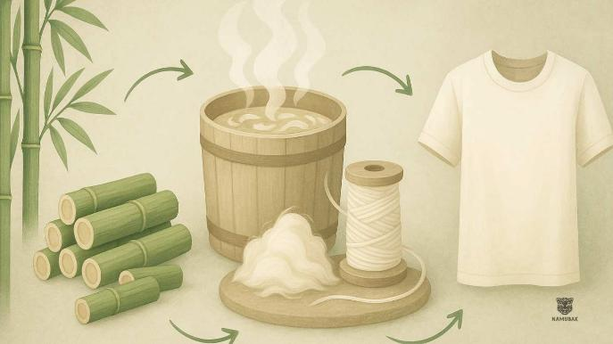
Inspiration
RETHINK DESIGN:
Use food waste to make clothing, instead of plants like cotton needing a lot of water and land.
Leather made from Pineapples
Fibres for clothing made from agricultural crop left-overs
Fibre for clothing made from Orange Peel
T-Shirts and other clothing made from Bamboo

Slide 23
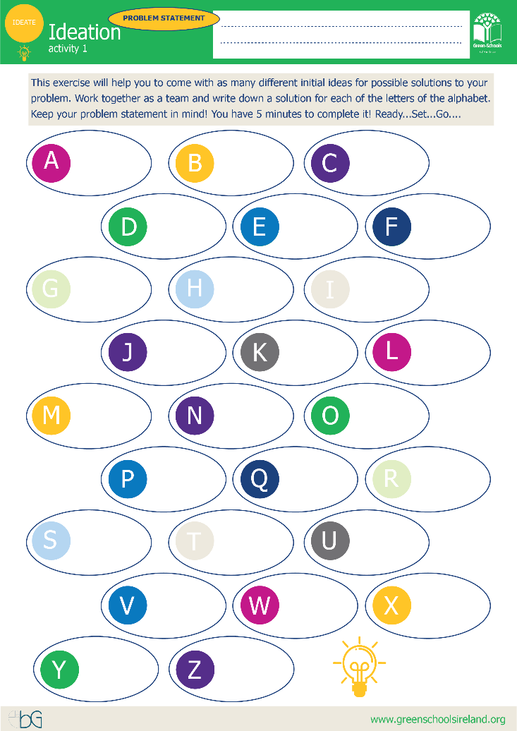

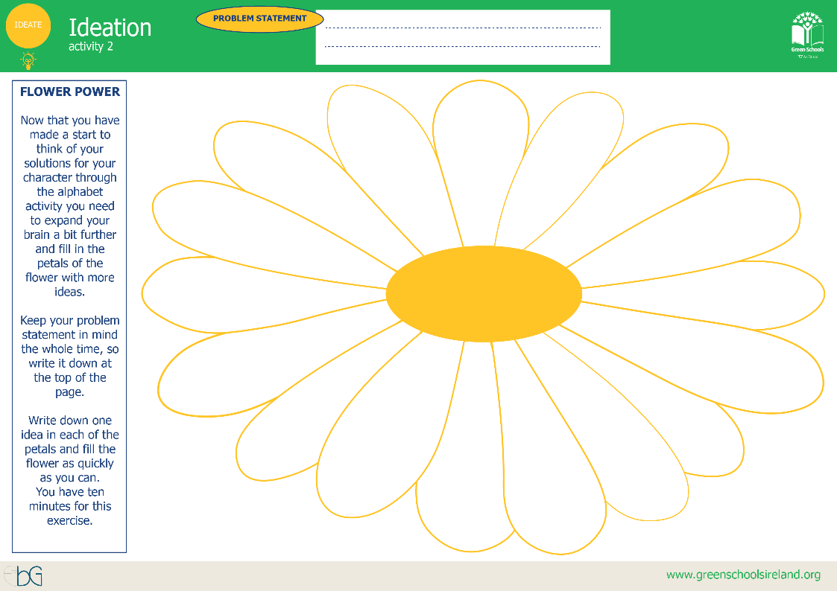
IDEATING A SOLUTION

Slide 24
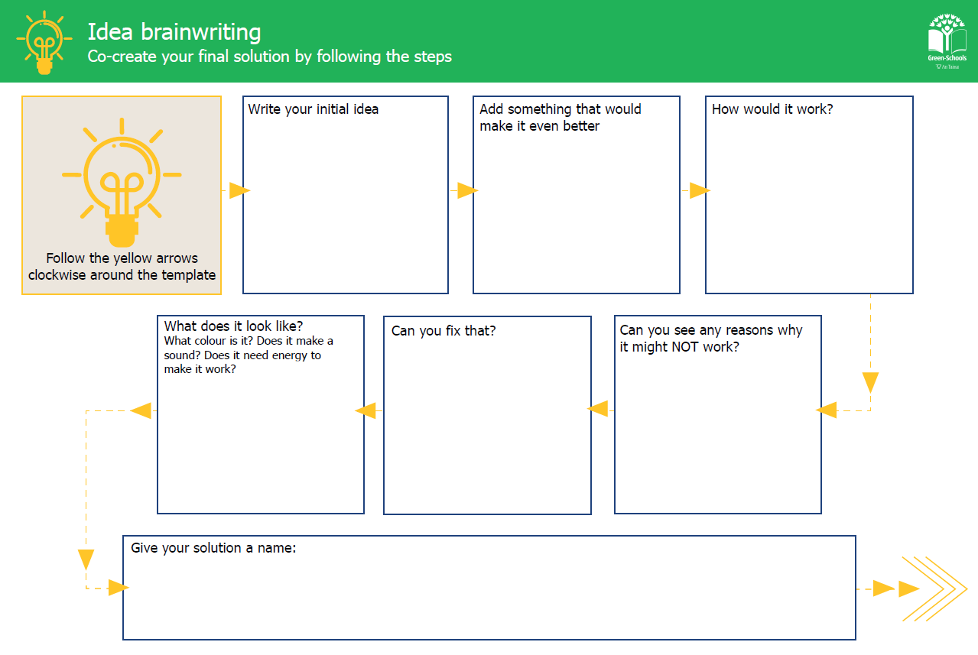

Slide 25
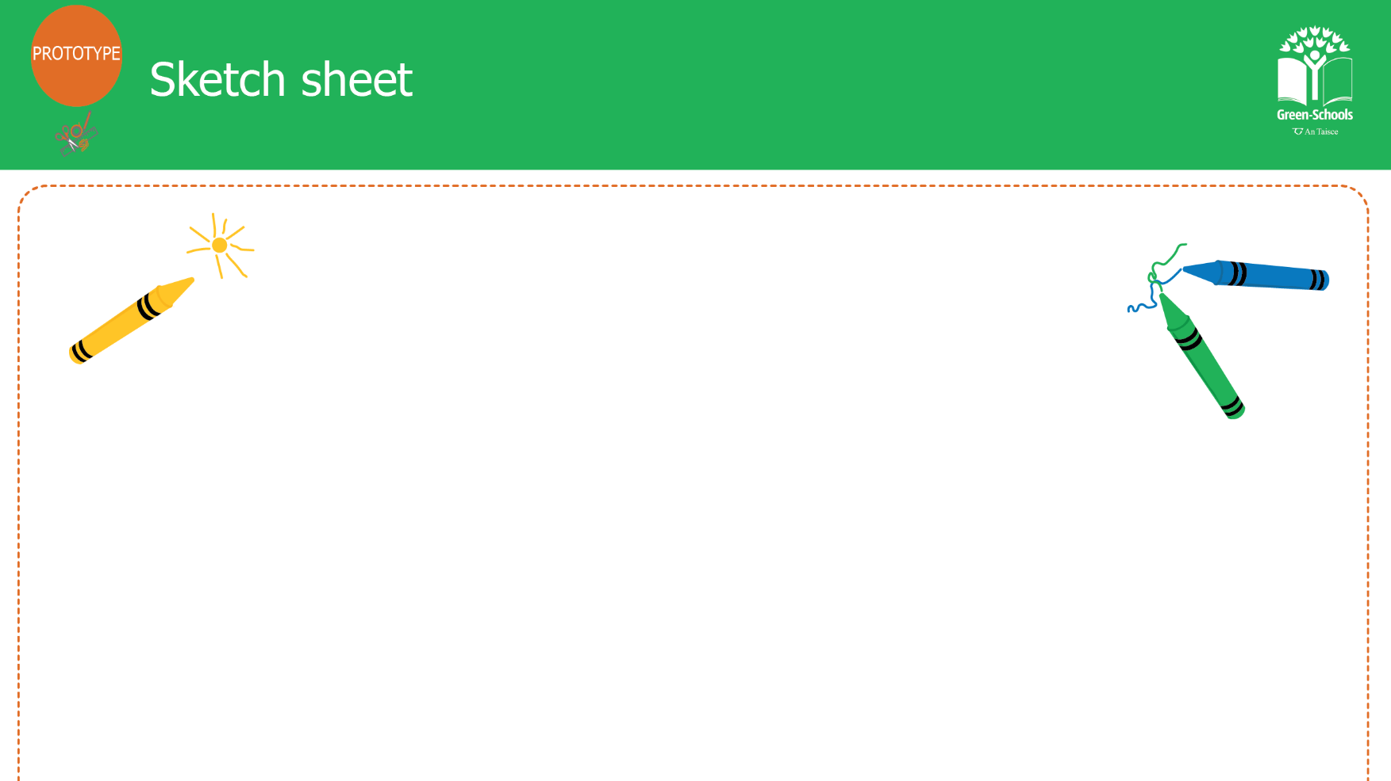

Slide 26
Fast Fashion Project
Module 5 - Build, present, and reflect
Notes:
Module 5 Build, present, and reflect (60–90 minutes)
Teams build a prototype of their solution, present it to the class, and complete a short individual
reflection.
What to do
● Give each team the prototype sketch sheet. Ask them to draw their solution first before
building anything - this helps them plan.
● Teams then build their prototype using whatever materials are available - recycled
cardboard, clay, LEGO, paper, fabric. If the solution is a campaign or an app rather than a
physical object, they can create a poster, a storyboard, or a simple sketch of how their campaign
would work.
● Each team presents their solution to the class and the Green-Schools Committee. They
should explain - who their character is, what problem they solved, what their solution is, and
how it works.
● The class gives feedback using two stars and a wish - two things they liked and one thing
they would suggest for improvement.
● Children then complete the student reflection survey individually. This takes about five
minutes.
Teacher notes
Children often want more time for prototyping than is available. It helps to set a clear time limit
at the start and to reassure them that a simple, well-explained prototype is just as valid as an
elaborate one. Pilot feedback showed that some children were surprised when their prototypes
turned out smaller than they had imagined, this is a good learning in itself.
The reflection survey (included separately) uses a simple before-and-after format. Children rate
themselves on five skills at the end of the project, thinking about how they felt before it started
and how they feel now. This takes about five minutes and gives you, and us, a record of what
children felt they gained from the experience.

Slide 27

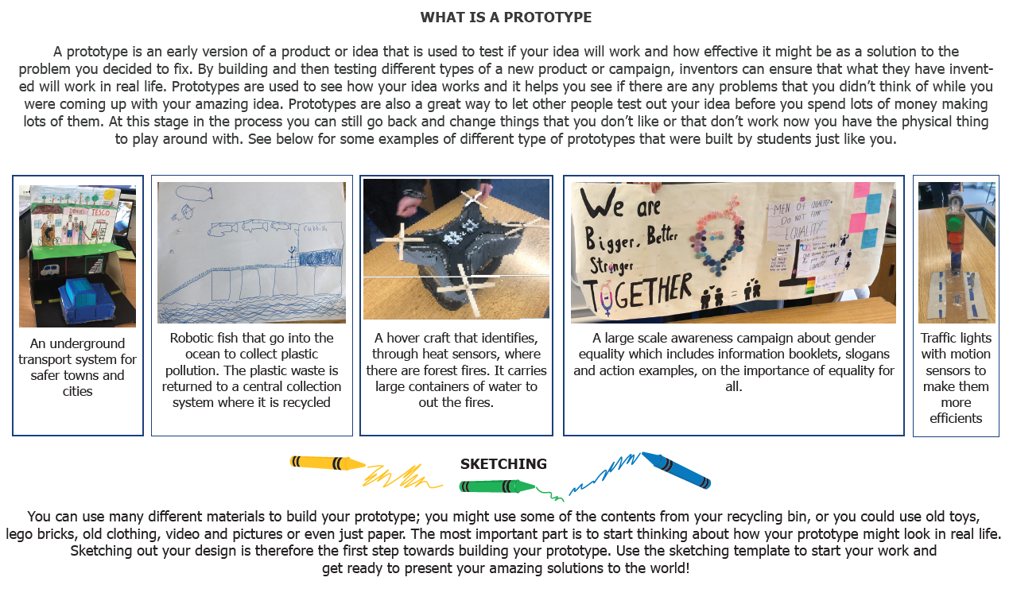
Prototyping

Slide 28
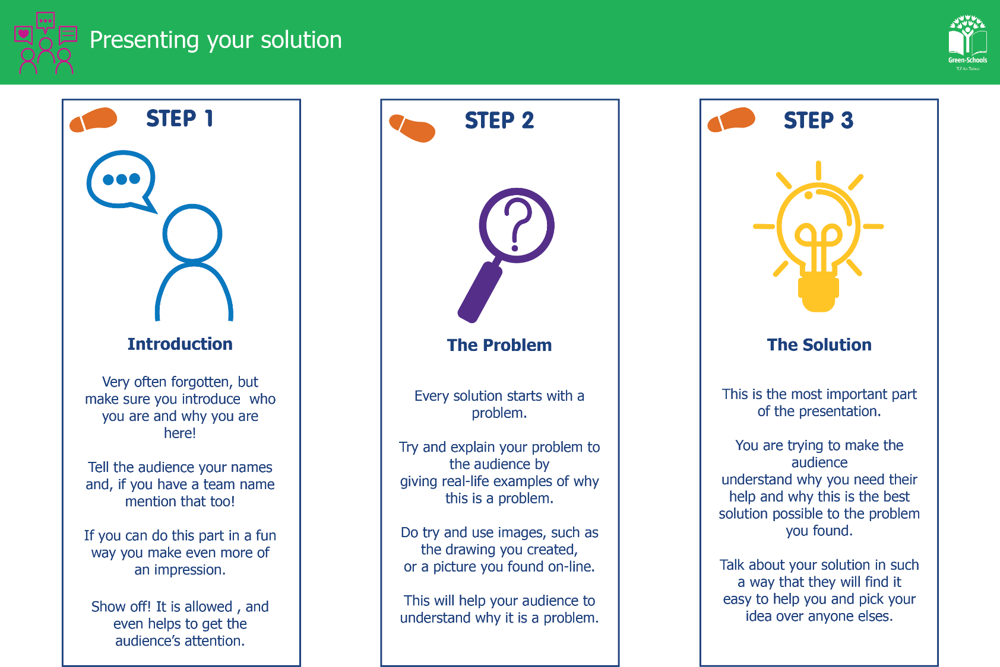
Notes:
Taking it further
Some classes will want to do something with their solution beyond the classroom. Here are a
few ideas -
● Share prototypes at a school assembly or with parents at an open afternoon.
● Write to a local councillor, business, or community organisation about the problem the
class identified.
● Choose one solution to actually try to implement - even a small version of it - in the
school or local area.
● Share the project with your Green-Schools Committee and see whether it connects to any
of your current flag topics.

Slide 29

Fast Fashion Project
Well Done!!!!
This resource is funded by Irish Aid at the Department of foreign affairs and trade. Irish Aid is the Government’s overseas
development co-operation programme which supports partners working in some of the world’s poorest countries.

