Slide 1

CLIMATE JUSTICE PROJECT
Working together for a just future
www.greenschoolsireland.org
Notes:
What this project is
The Climate Justice Project is an active learning project for post-primary students. It asks a
harder question than most climate education, not just what is happening to our planet, but who is
most affected, and why.
Climate change does not affect everyone equally. The people who have done least to cause it are
often the ones who face the worst consequences. That is the idea at the heart of climate justice,
and it is what this project asks students to grapple with, through research, debate, character
work, and design thinking.
Working in small teams, students explore the concept of climate justice, choose a character
whose life is shaped by climate impacts, define the specific problem that character is facing, and
design a solution. They build a prototype or campaign, present it, and reflect on what they
learned.
The project is designed to run across several class periods or compressed into a full project day. It
suits Junior Cycle classes across a range of subjects, and can be adapted for Transition Year.
What students will do
Over the course of the project, students will:
● Explore the concept of climate change and what makes it a justice issue
● Participate in a Climate Summit debate, arguing the case for different countries or
communities
● Examine climate impacts at a global, national, and local level
● Choose a challenge topic and a character whose life is affected by it
● Define the specific problem their character is facing
● Generate and develop ideas for possible solutions
● Build a prototype or campaign and present it to the class
● Reflect on their learning and on their own role in climate action
How long does it take?
The project works across five modules. Each module has a suggested time, but you can adjust to
suit your timetable.

Slide 2


Climate Justice Project
Module 1 – CLIMATE ACTION AND CLIMATE JUSTICE
Notes:
Module 1 Climate action and climate justice (60–80 minutes)
Students explore the science of climate change and are introduced to the concept of climate justice.
The idea that the people who have done least to cause climate change are often the ones who face
the worst consequences.
What to do:
• Open with the presentation slides on climate change. Give students time to discuss what they
already know and what questions they have.
• Introduce the concept of climate justice. The key question is not just "what is happening?" but
"who is it happening to, and why?" Prompt students to think about which countries and
communities are most exposed to climate impacts, and whether that maps onto who has
contributed most to the problem.
• Run the Climate Summit activity. Divide the class into groups and assign each group a country or
community. Each group prepares and presents a short argument, what climate impacts is their
country or community experiencing, what do they need, and what should others be doing about
it? Give groups ten minutes to prepare and three to four minutes each to present.
• As a class, debrief the Summit. What did students notice? Whose arguments were most
persuasive? Where did disagreements emerge?
• Move from global to local. Share the slides on climate impacts in Ireland, then open a discussion,
what climate impacts can students identify in their own area? Flooding, drought, biodiversity loss,
housing pressure? Ask them to be specific.
• Each team then selects a challenge topic to focus on for the rest of the project. This could be a
global climate justice issue, a national policy gap, or something they have seen in their own
community.
Teacher notes
The Climate Summit works best when groups feel genuinely invested in their assigned position, even
if it is not their own view. Encourage students to argue the case as strongly as they can. It is worth
allowing a few minutes for students to step out of role afterwards and share their own perspective.
The move from global to local is important. Students often feel climate change is happening
somewhere else. Grounding the issue in named local places, a flooded road, a disappearing beach, a
farm dealing with changed rainfall, shifts the conversation significantly.
There is no wrong challenge topic. Let teams choose the angle that feels most real to them. The
same topic will produce very different solutions across teams.

Slide 3

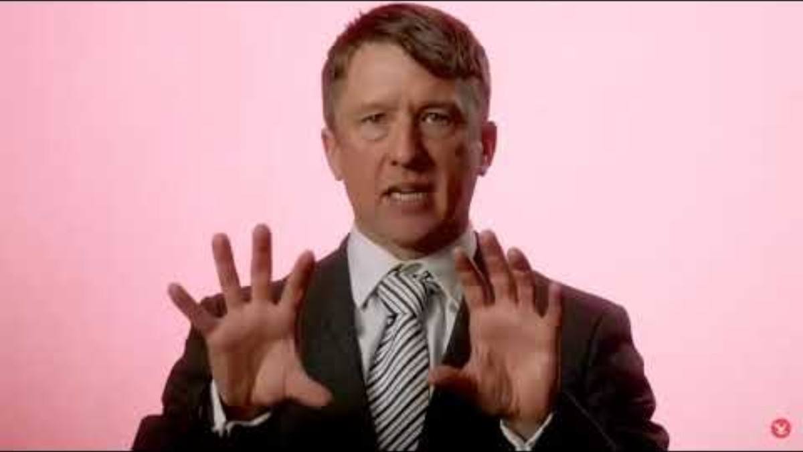
Climate Change

Slide 4
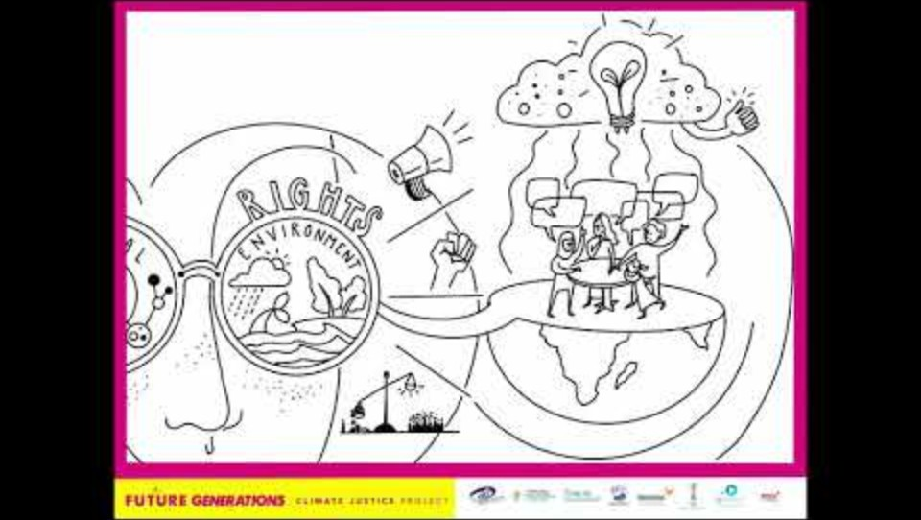
What is Climate Justice?
Climate Justice
Climate change affects everyone, but it doesn't affect everyone in the same way?
Notes:
Teacher Guide: Climate Justice
Explain that climate change does not affect everyone equally. Climate justice encourages us to think about fairness, responsibility, power and whose voices are included.
As students work through the project, keep these five questions in mind:
Who is affected?
Who has contributed to the problem?
Who has the resources to respond?
Who has the power to make decisions?
Whose voice is being heard?
Encourage students to return to these questions when exploring climate issues, discussing solutions and making decisions throughout the project.

Slide 5
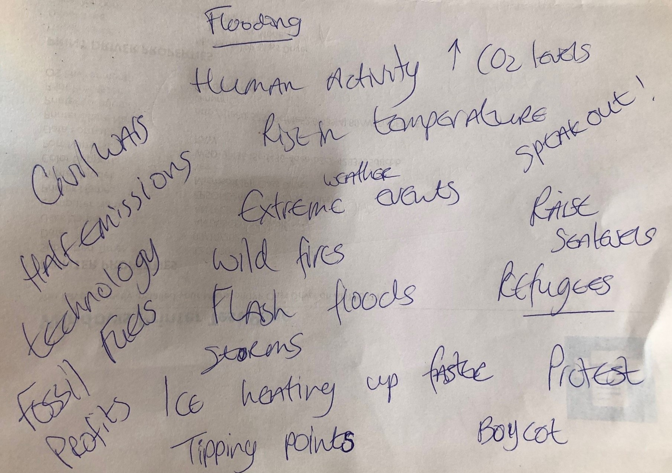
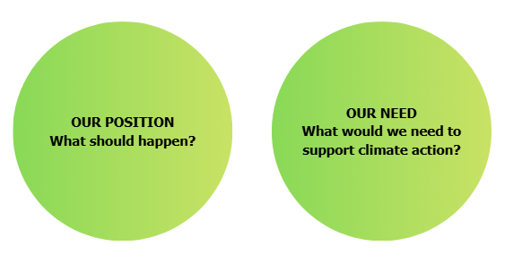
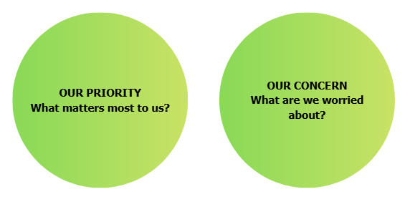
Climate Summit
As a group, discuss:​
Prepare your argument.​
Notes:
This is a role play mock-up of the Climate summit. Divide students into different roles and encourage them to step into the shoes of a climate stakeholder, understand their priorities, present their views, and negotiate with others to agree on climate action priorities.
The goal: understand different perspectives and explore what climate justice means in practice.
Examples of stakeholders: Oil executive, Irish traveller, Local farmer, Environmental NGO, Politician etc
Remind them that they are not speaking as themselves.. They are representing that particular character/ group and their arguments in the summit should reflect that.. They should be able to understand their priorities and make sure their voice is heard.
Some questions to ask after the summit
Did everyone agree?
Why did groups have different priorities?
Who seemed to have more influence?
Whose voice might have been missing?
Who might benefit from the decisions?
Who might be disadvantaged?
This is climate justice in action.

Slide 6
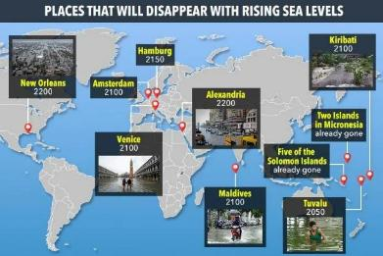
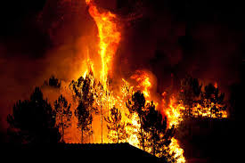
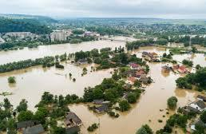
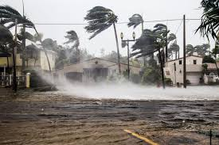
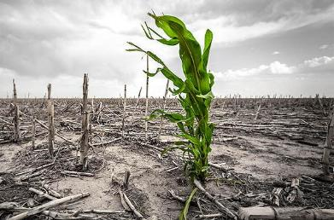
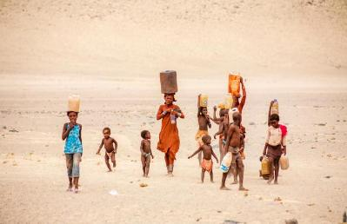
Climate Impacts at a Global Scale
Heatwaves
Forest Fires
Flooding
Hurricanes
MUD/Land Slides
Droughts

Slide 7
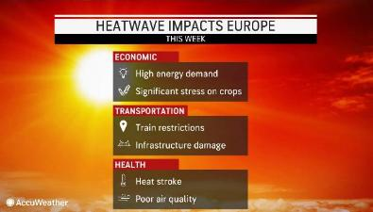
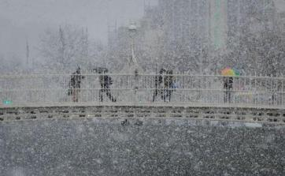
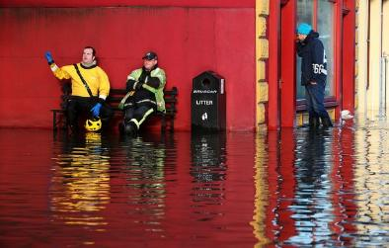
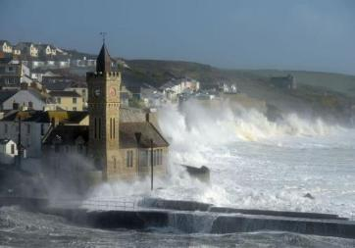
Climate Impacts In Ireland
Climate Impacts in Ireland …….
Heatwaves
Snowstorms
Flooding
Hurricanes
Weather reports found on RTE website and The Guardian website
Notes:
Basically, we will be getting dryer summers, more heat waves, more summer rain as well, stronger winter storms resulting in more flooding and the possibility, due to higher sea temperatures, of hurricanes developing over the Atlantic and impacting Ireland.
https://www.epa.ie/environment-and-you/climate-change/what-impact-will-climate-change-have-for-ireland/
What impact will climate change have on Ireland?
Climate science is clear - human activities are estimated to have caused approximately 1.0°C of global warming above pre-industrial levels with a likely range of 0.8°C to 1.2°C. At current levels of global greenhouse gas emissions, the world remains on course to exceed the Paris Agreement’s temperature thresholds of either 1.5°C or 2°C above pre-industrial levels.
Climate change not only means changes in the average climate such as temperature but also changes in the frequency and intensity of extreme weather and climate events. Though climate change projections, like all projections of the future, are subject to uncertainty, the latest climate modelling projections for Ireland are in broad agreement with previous research.
Observed and Projected Climate Change
Temperature Trend
Ireland's climate is changing in line with global trends, with a temperature increase of, on average, 0.8°C compared with 1900. By the middle of this century (2041 – 2060) the average annual temperatures are projected to increase by between 1–1.2℃ and 1.3–1.6℃ depending on the emissions trajectory. The number of warm days is expected to increase and heat waves are expected to occur more frequently.
Precipitation
Ireland has seen an increase in average annual national rainfall of approximately 60mm or 5% in the period 1981-2010, compared to the 30- year period 1961-1990. Significant reductions are expected in average levels of annual, spring and summer rainfall. Projections indicate a substantial increase in the frequency of heavy precipitation events in Winter and Autumn (approx. 20%).
Sea Level Rise
The rate of global sea level rise for 2006–2015 of 3.6 mm per year, is unprecedented over the last century, and about 2.5 times the rate for 1901–1990. Sea level is projected to continue to rise at this rate or greater. All major cities in Ireland are in coastal locations subject to tides, any significant rise in sea levels will have major economic, social and environmental impacts. Rising sea levels around Ireland would result in increased coastal erosion, flooding and damage to property and infrastructure.
Other Indicators
The last five-year (2015–2019) and ten-year (2010–2019) average temperatures are the warmest on record. Since the 1980s, each successive decade has been warmer than any preceding decade since 1850.
In Ireland, 2019 was the ninth consecutive year with temperatures above normal.
Ireland has seen a reduction in the number of frost days and shortening of length of the frost season.
The number of very intense storms is projected to increase over the North Atlantic region. Projections suggest that the winter track of these storms may extend further south and over Ireland more often.
Sea surface temperature in Irish waters has increased at a rate of approximately 0.6°C per decade since 1994, which is unprecedented in the 150-year observational record.
Future Impacts
The climate projections for the next century indicate that observed climate trends will continue and intensify over the coming decades. Adaptation refers to actions taken to reduce vulnerability and exposure to climate change impacts. The more we reduce global emissions, the less adaptation to the consequences of climate change will be required. However, some impacts are already unavoidable.
Predicted impacts include:
changes in wind speeds and storm tracks
increased likelihood of river and coastal flooding
changes in distribution of plant and animal species and in the phenology (the timing of lifecycle events) of native species
water stress for crops, pressure on water supply and adverse impacts on water quality
negative impacts on human health and wellbeing
More Information
For more climate related resources, please visit the ‘Climate Change & You’ section of the EPA website.

Slide 8


Climate Impacts at our Doorstep
Climate Change Impacts at our Doorstep
Can you think of some specific examples of climate change impacts within our locality?

Slide 9


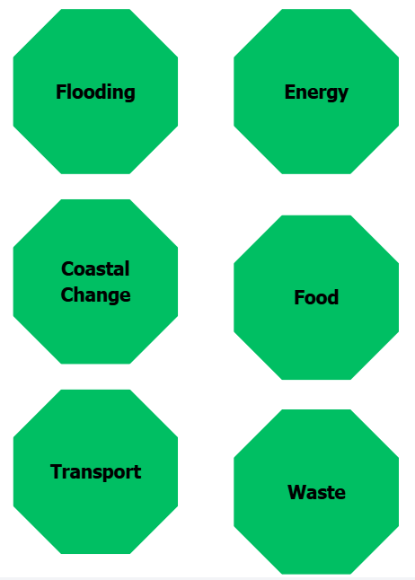
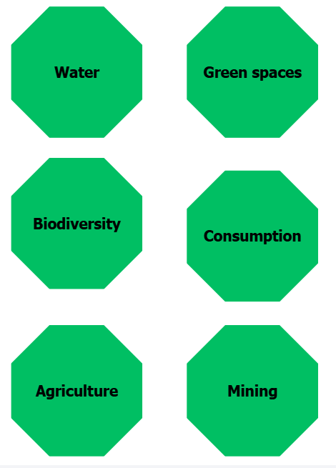
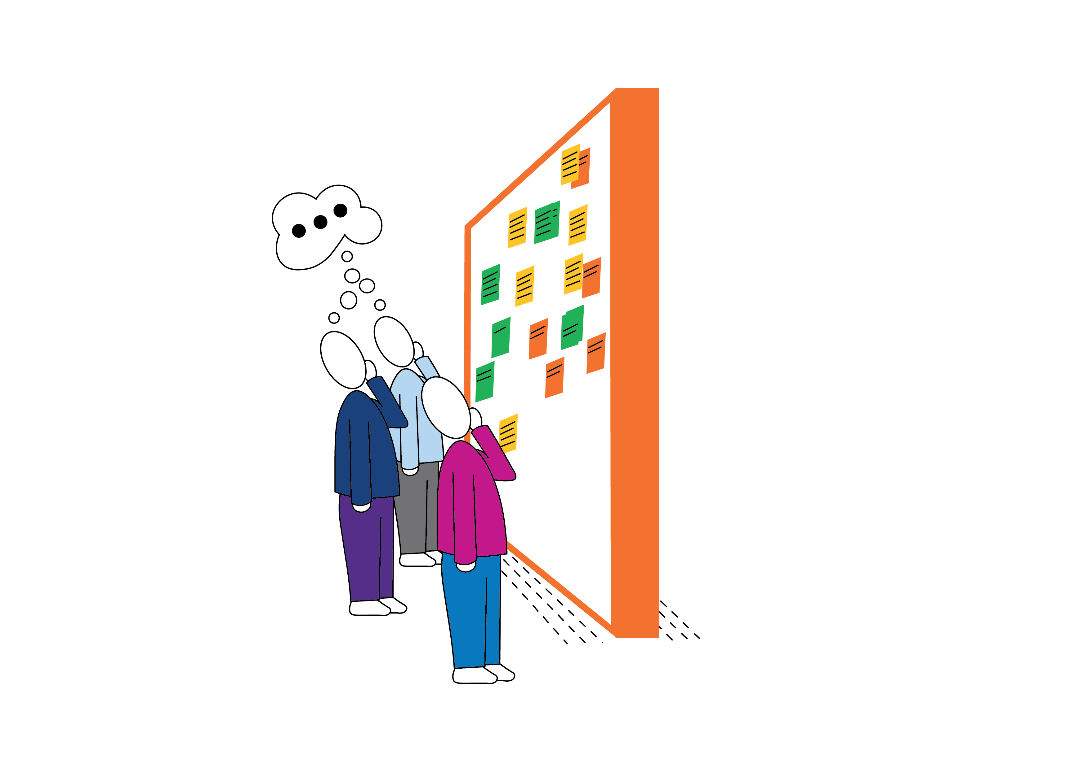
Selecting Your Challenge Topic
Selecting Your Challenge Topic
Notes:
Selecting a Challenge Topic
Introduce the challenge topics above and give students time to discuss in their selected groups which one they would like to explore:
Encourage teams to choose a topic that interests them and connects to their local community or wider climate issues.
Ask them to consider:
What interests us most?
Who is affected?
Why is it important?
How does it connect to climate justice?
Teams should agree on one challenge topic to investigate throughout the project.

Slide 10

Climate Justice Project
Module 2 - Choose and get to know your character
Notes:
Module 2 Choose and get to know your Persona (30–40 minutes)
Each team develops one persona whose life is affected by the climate justice challenge they have
selected. They then develop that persona fully before moving to solutions.
What to do:
• Give each team the persona development worksheet and let them develop their persona through
this activity.
• Once they have chosen, each team fills in the persona profile worksheet. Encourage them to give
their persona a name, a location, a daily routine, and a clear sense of how the climate challenge
is affecting their life. The persona should feel like a real person, not a placeholder.
• Teams can sketch their persona and, if time allows, present their persona to the class in a short
two-minute introduction.
Teacher notes
Persona work can feel unfamiliar at post-primary level, but it is worth keeping. The reason it works is
that it moves students from abstract awareness ("climate change is a problem") to specific empathy
("this person's crops are failing because the rains have changed, and here is what that means for
their family"). Solutions designed for a real person with a named problem are almost always stronger
than solutions designed for a category.
Encourage students to choose a character from a context different from their own. A student in
Dublin designing for a Kenyan smallholder farmer, or for a Pacific Island community facing sea level
rise, builds a different kind of understanding than one designing for someone in their own
neighbourhood. Both are valid, both will produce interesting work.
Do not give too much input at this stage. Let students build the personas themselves.

Slide 11


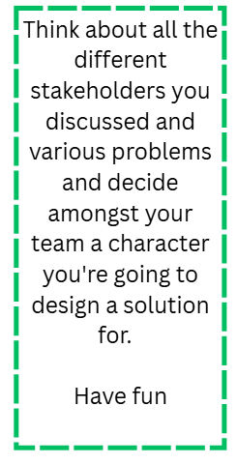
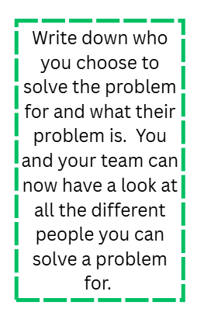
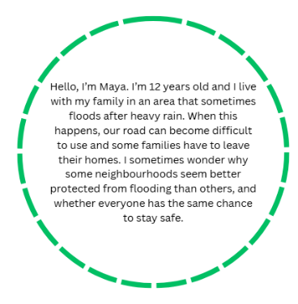
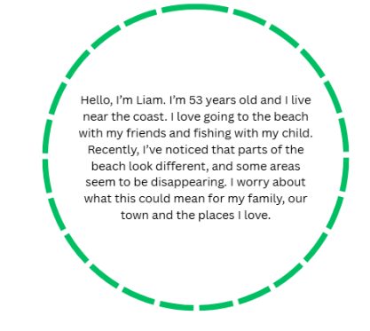
Who are we solving a problem for?
Notes:
Students now start to build their personas. The teams will work individually first. You can encourage them to either base their persona on one of the stakeholders they discussed, or they can mix them together, or their persona can be just from their imagination. They should be encouraged to have a bit of fun with this. Give them 10 minutes to develop their individual personas and another 10 minutes for the team to introduce their personas to each other. Now they are ready to develop their team persona – 10/15 minutes. Combining different individual personas, or they might have one favorite… it is totally up to them which persona they pick and develop.

Slide 12
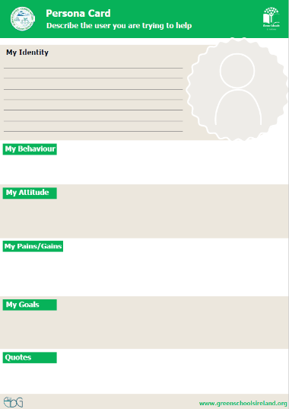
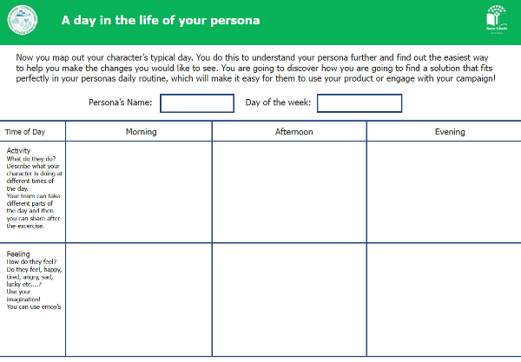

Who is your Persona?

Slide 13
Climate Justice Project
Module 3 – Define the problem
Notes:
Module 3 Define the problem
Each team writes a clear problem statement that captures exactly what their character is struggling
with and why.
What to do:
● Give each team the problem statement template.
● Ask them to complete each section - who their character is, what their character's problem
is, why they cannot solve it on their own, and how they will feel when there is a solution.
● Encourage teams to be as specific as possible. A good problem statement names the
character, names the problem, and says something about why it is hard to fix.
Teacher notes
Keep this short. The problem statement is a thinking tool, not a piece of writing to perfect. If a
team is spending more than 20 minutes on it, prompt them to move on, the brainstorming stage
will help them refine their thinking anyway.
Do not give too much input into what the problem should be. If a team's problem statement is a bit
vague, that is fine. They will sharpen it as they start generating ideas.

Slide 14

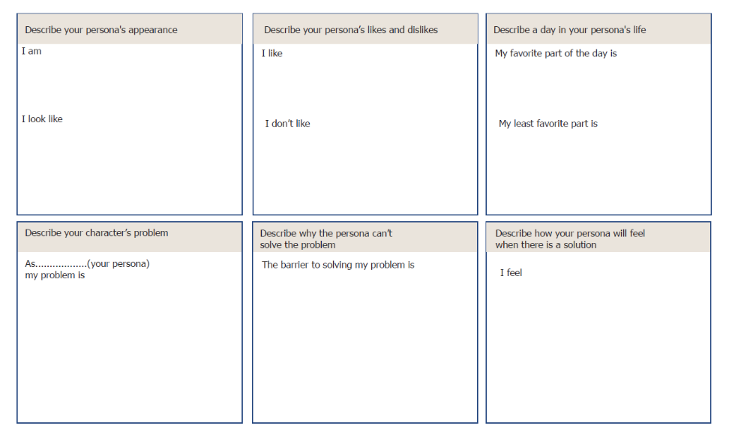
What’s your problem?
Tell your person’s story and discover what their exact problem is!

Slide 15
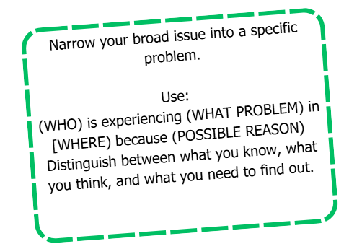
What’s your problem?
Tell your character’s story and discover what their exact problem is!
Notes:
Teacher Guide: Defining the Problem
Support students to move from their broad challenge topic to one clear and specific problem they want to investigate.
Use the sentence structure:
(WHO) is experiencing (WHAT PROBLEM) in (WHERE) because (POSSIBLE REASON).
Remind students to separate:
What we know - facts or information we are confident about.
What we think - ideas or assumptions that need to be explored.
What we need to find out - questions or information we need to investigate.
At this stage, the goal is to define a focused problem, not to find all the answers.

Slide 16
Climate Justice Project
Module 4 – Generate and choose a Solution
Notes:
Module 4 Generate and choose a solution
You may use slides 19, 20, 21, and 22 for some inspiration for the children if you feel they are stuck before they start ideating.
Teams generate as many ideas as possible, then work together to develop their best one.
What to do
You may start with the inspiration slides if you feel students might need that
Start with the A–Z ideation sheet. Give teams five minutes to write one solution idea for
each letter of the alphabet. Speed matters here so there is no time to overthink, encourage ‘silly’
ideas.
Then move to the Flower Power sheet. Teams write one idea in each petal. Give ten
minutes.
Gather all ideas (on the worksheets or on sticky notes) and display them so the whole team
can see everything. Give the team ten minutes to look through and vote on their favourite.
If it is hard to pick one, teams can combine two or three ideas. They then use the idea
brainwriting sheet (slide 24) to develop their chosen idea further (fill in the brainwriting sheet in a clockwise direction, following the arrows on the sheet!).
Ideation warm-ups (optional)
If your class needs to warm up their creative thinking before the A–Z activity, try one of these -
● Crazy 8s - fold a sheet of paper into 8 rectangles. Each child sketches a different idea in
each box, one minute per box, no talking.
● Yes, and - one child shares an idea, the next responds with "Yes, and..." and adds
something. Keep going around the team, building the idea together. No saying "no" or "but".
Teacher notes
The goal at the ideation stage is quantity, not quality. Silly ideas are welcome. The more ideas on
the table, the better the final solution is likely to be. Encourage children to keep going even when
they feel stuck.
The solution shopping step (reviewing all ideas together before picking one) is worth protecting.
Children often vote for the most familiar idea rather than the most interesting one. Encouraging
them to look for the surprising idea, or to combine two, tends to produce more inventive solutions.

Slide 17
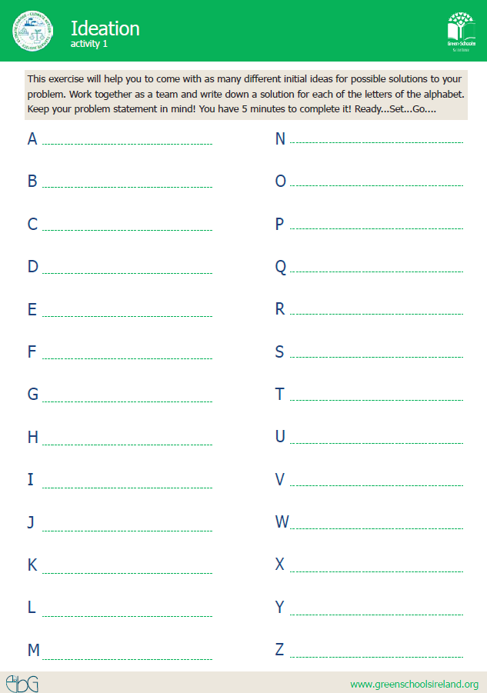

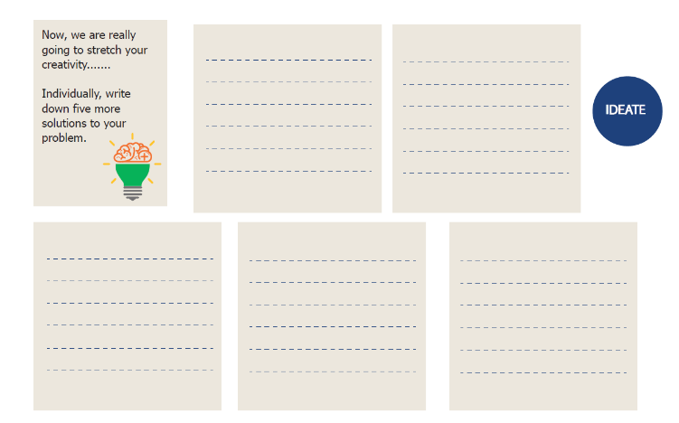
IDEATING A SOLUTION

Slide 18
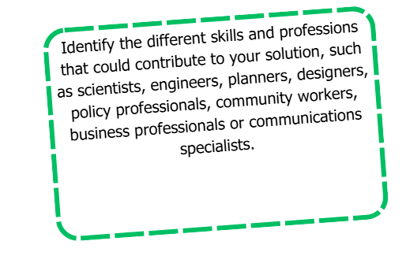
Notes:
Encourage students to think beyond their own ideas and identify the different skills, knowledge and professions that could help address their chosen problem.
They might consider people such as scientists, engineers, planners, designers, policymakers, community workers, business professionals or communications specialists.
Remind students that solving real-world problems often requires different people working together, with each bringing a different perspective or skill.

Slide 19
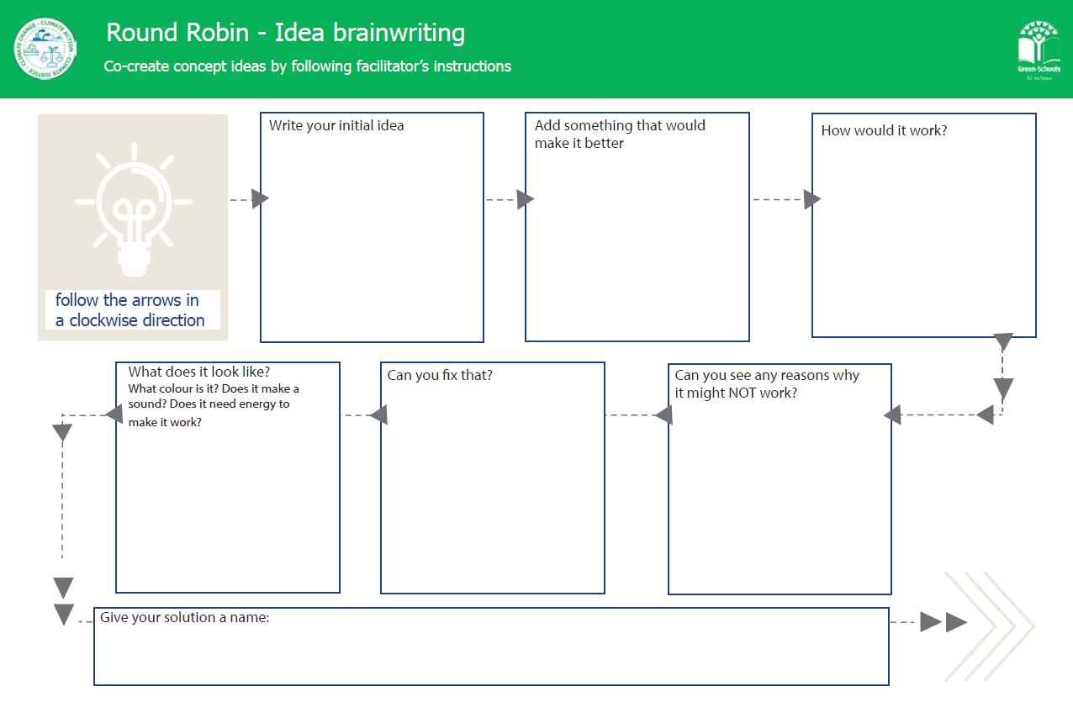

Slide 20
Climate Justice Project
Module 5 - Build, present, and reflect
Notes:
Module 5 Build, present, and reflect
Teams build a prototype of their solution, present it to the class, and complete a short individual
reflection.
What to do
● Give each team the prototype sketch sheet. Ask them to draw their solution first before
building anything - this helps them plan.
● Teams then build their prototype using whatever materials are available - recycled
cardboard, clay, LEGO, paper, fabric. If the solution is a campaign or an app rather than a
physical object, they can create a poster, a storyboard, or a simple sketch of how their campaign
would work.
● Each team presents their solution to the class and the Green-Schools Committee. They
should explain - who their character is, what problem they solved, what their solution is, and
how it works.
● The class gives feedback using two stars and a wish - two things they liked and one thing
they would suggest for improvement.
● Children then complete the student reflection survey individually. This takes about five
minutes.
Teacher notes
Children often want more time for prototyping than is available. It helps to set a clear time limit
at the start and to reassure them that a simple, well-explained prototype is just as valid as an
elaborate one. Pilot feedback showed that some children were surprised when their prototypes
turned out smaller than they had imagined, this is a good learning in itself.
The reflection survey (included separately) uses a simple before-and-after format. Children rate
themselves on five skills at the end of the project, thinking about how they felt before it started
and how they feel now. This takes about five minutes and gives you, and us, a record of what
children felt they gained from the experience.

Slide 21
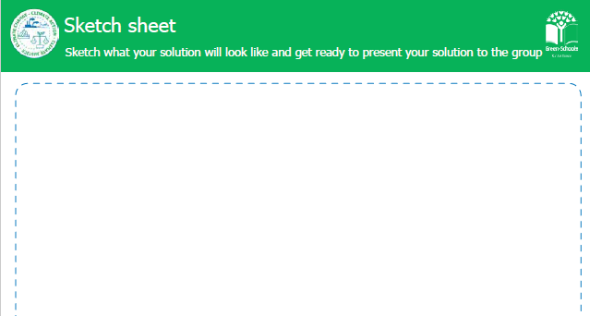

Slide 22
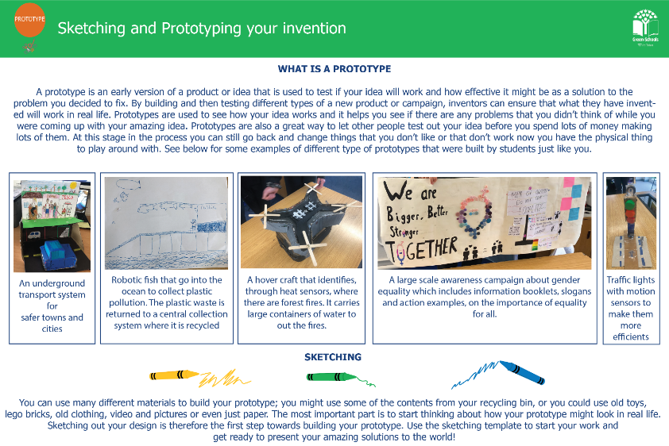

Slide 23

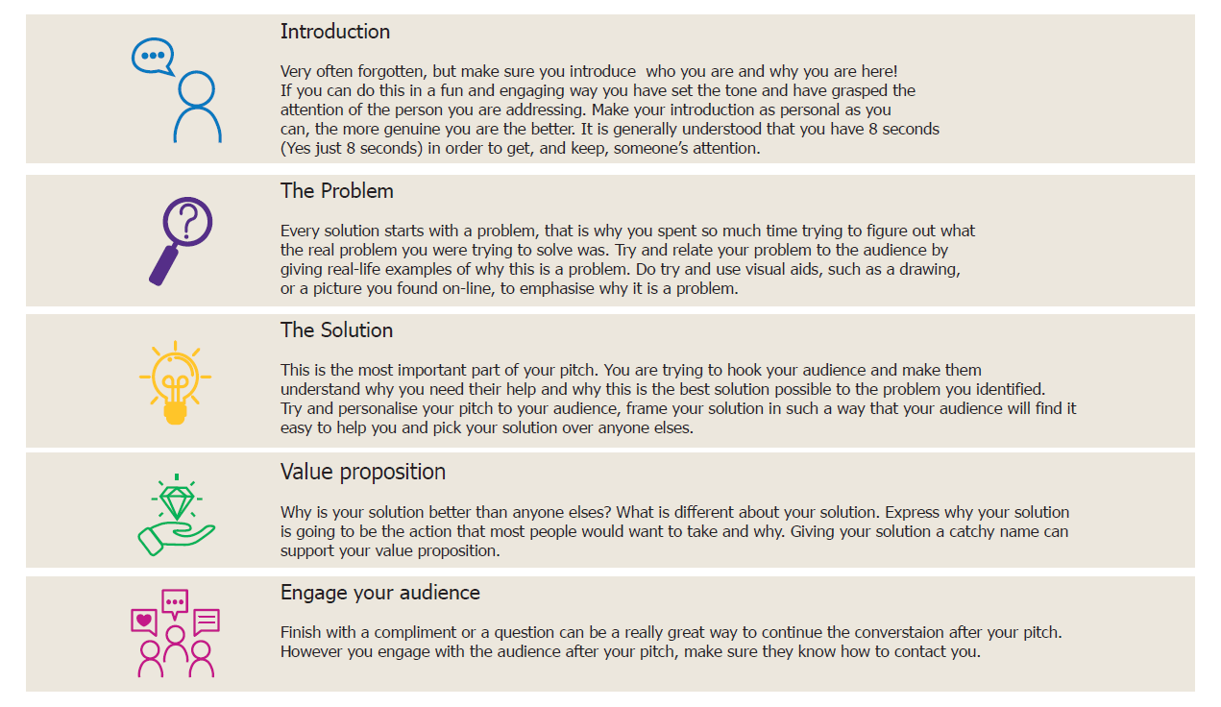
Presentation Skills
Some important features you need to take into account when pitching your ideas!
Notes:
Taking it further
Some classes will want to do something with their solution beyond the classroom. Here are a
few ideas -
● Share prototypes at a school assembly or with parents at an open afternoon.
● Write to a local councillor, business, or community organisation about the problem the
class identified.
● Choose one solution to actually try to implement - even a small version of it - in the
school or local area.
● Share the project with your Green-Schools Committee and see whether it connects to any
of your current flag topics.

Slide 24


Climate Justice Project
Well Done!!!!
This resource is funded by the ESD Grant offered through the Department of Education and Youth.

