Slide 1
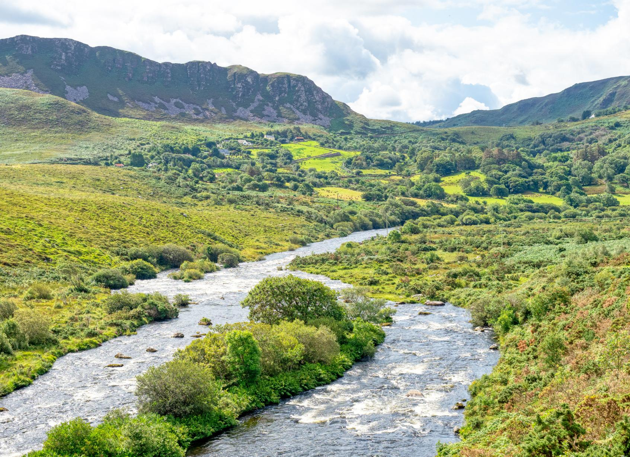


WATER LEARNING SERIES (PART 4)
Wild Water
Exploring and protecting water in nature
Notes:
Welcome to Part 4: Wild Water. We are now following our water drop back outdoors to explore water in nature.
Ireland is surrounded by water and has an incredible network of rivers, lakes, wetlands, estuaries and coastal waters.
Today we will look at why these places matter, some of the pressures they face, and what we can do to help protect them.

Slide 2
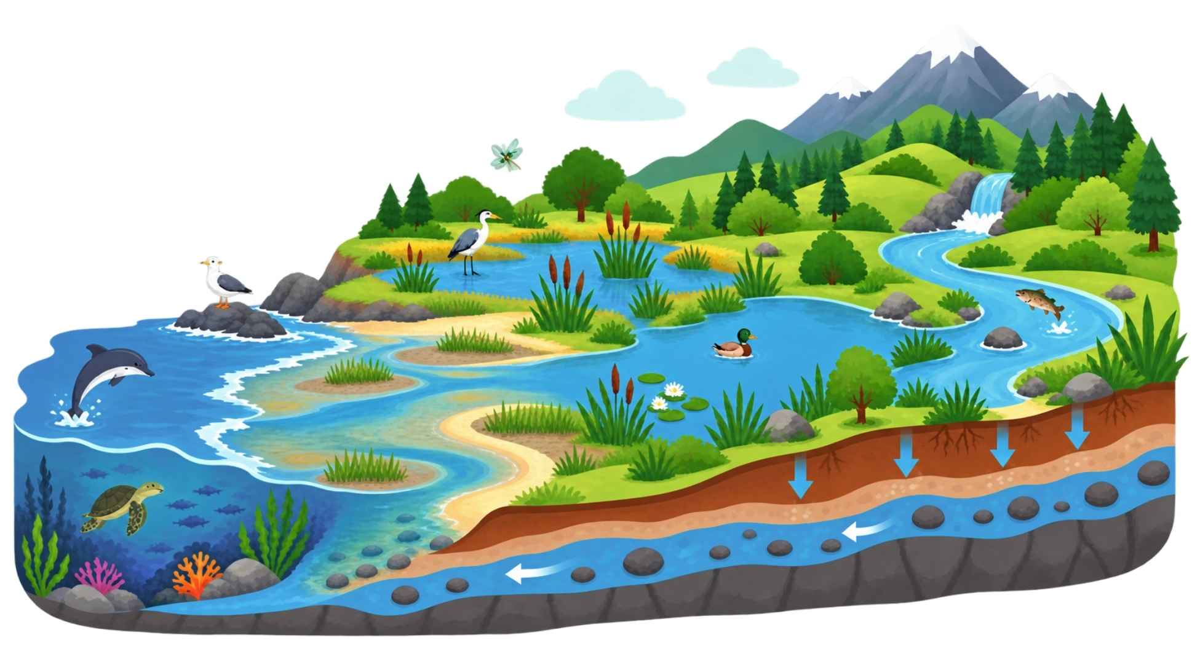
Water is Life
Wetlands & bogs
Rivers
Lakes
Oceans & seas
Estuaries
Groundwater
Notes:
Water is much more than something we drink or use at home. It is part of the living systems around us.
Think about all the different places our water drop might travel: through a river, into a lake, through a wetland or peatland, underground as groundwater, into an estuary, and eventually out to the ocean.
Each of these environments supports different plants and animals, while also helping water move, store and cycle through the landscape.

Slide 3
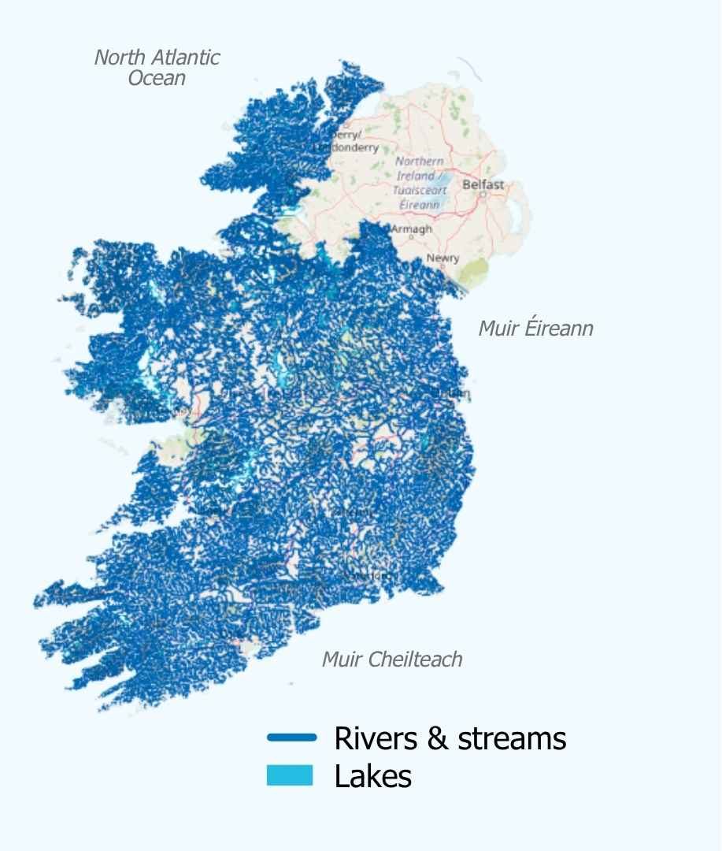
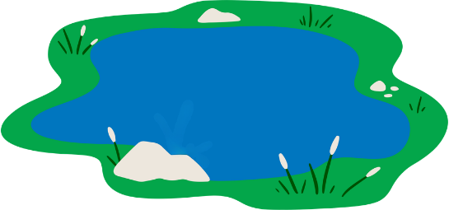
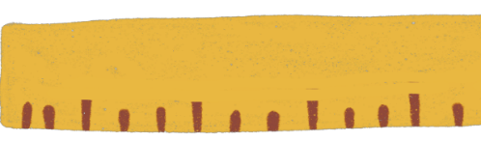
The Waters of Ireland
more than
73,000 km.
12,000
lakes
of river channels
more than
1.5 million hectares
of land covered by bogs and peatlands.
of land covered by peatlands and bogs
Notes:
We are so lucky in Ireland to have a huge variety of freshwater and marine environments. The scale of our waterways can be easy to overlook because we see only the part that is closest to us.
We have thousands of lakes to a vast network of rivers and streams, alongside many peatlands and bogs.
These places are not just scenery. Rivers, lakes and peatlands help move, store and clean water. Healthy peatlands can also hold extra water during heavy rain, helping to reduce flooding.
[Ask the group]: which type of water environment is closest to where you live or go to school?

Slide 4



Quiz Time!
How many species of whales and dolphins can be found in Ireland’s coastal and marine waters?
What county in Ireland has the most lakes?
Ireland has lost what % of its historical wetlands?
Donegal
5
10%
Cavan
12
30%
Galway
24
60%
Mayo
31
90%
Notes:
Let’s test what uou know about Ireland’s waters.
[Give everyone a moment to choose an answer before revealing it. Encourage people to make a guess rather than worrying about getting it right.]
Answer key:
Question 1: Cavan
Question 2: 24
Question 3: 90%

Slide 5

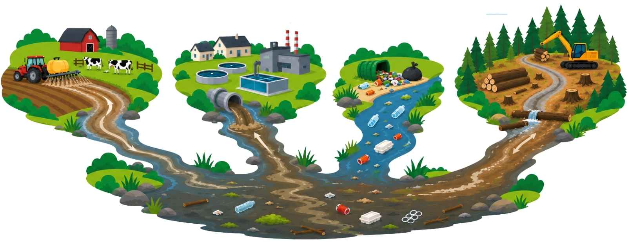
Invisible pollution
Ecosystem Pressures:
Some of the most dangerous water pollution can’t be seen, smelled or tasted—but can still harm our health and the environment.
Pollution
Main causes of water pollution in Ireland
Agricultural runoff
Domestic & industrial wastewater
Solid & plastic waste
Forestry runoff
(some of which is chemical waste)
Notes:
Major sources of water pollution are agricultural runoff, domestic and industrial wastewater, solid and plastic waste, and forestry runoff.
There are still places in Ireland where raw sewage is directly discharged into the environment. Gross!
But not all pollution is easy to spot. Some of the most dangerous pollution can be difficult to see, smell or taste, but it can still affect people, plants, animals and whole ecosystems, which is why we have to treat our drinking water.

Slide 6
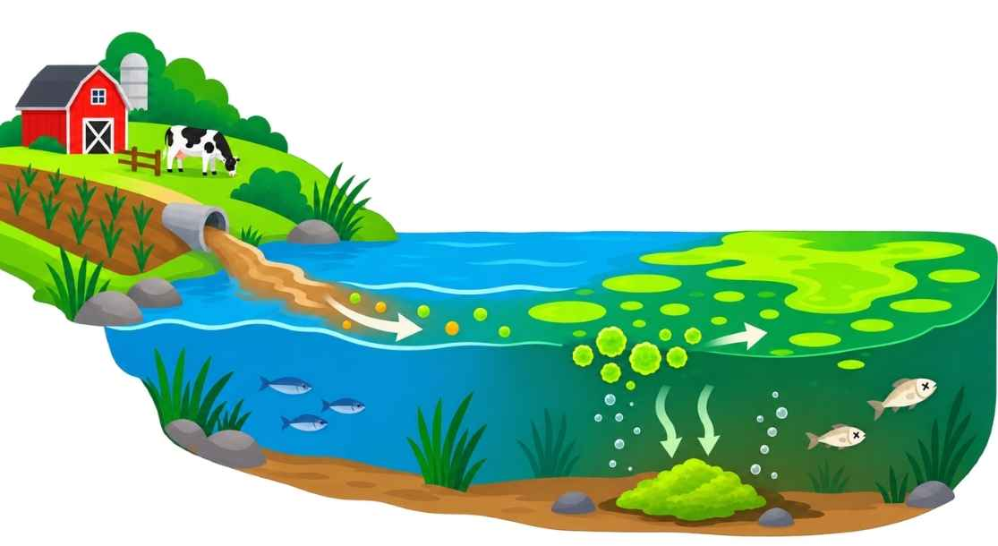
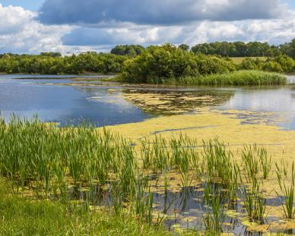
Impacts of Water Pollution
Nearly half of Ireland’s surface waters are unhealthy or at-risk.
Eutrophication
Eutrophication in Ireland
Waste & fertilizer runoff & leaching
Abundance of nutrients causes algae bloom
Algae blocks sunlight
Nitrogen &
Phosphorous
Lack of oxygen suffocates fish
The main water quality issue in Ireland is excess nutrients from agriculture and waste water causing eutrophication.
Plants can’t make energy or release oxygen into water
Decay
Look out for eutrophication on your next outing!
Bacteria use up oxygen to break down decaying matter
Notes:
According to the EPA, nearly half of Ireland's surface waters are unhealth or at risk.
One key impact of pollution is eutrophication.
When too many nutrients, particularly nitrogen and phosphorus, enter the water from sources such as fertiliser and wastewater, they can cause algae to grow rapidly. The algae can block sunlight, making the plants in the water die off and preventing them from photosynthesizing.
When that algae and other organic matter decay, bacteria use up oxygen. If oxygen levels fall too low, fish and other aquatic life can struggle to survive.
On your next visit to a river or lake, keep an eye out for signs of excess algae and think about what might be happening in the wider environment.

Slide 7

Is your local river a good place to release a fish pet?
Why or why not?
Notes:
Here is a question to discuss: is your local river a good place to release a fish you no longer want as a pet? Why or why not?
Drumroll, please...
Your local river is NOT a good place to release a fish pet.
Something that seems harmless at first can affect the balance of an ecosystem, particularly if a species is not naturally found there.

Slide 8
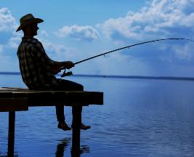
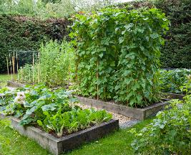
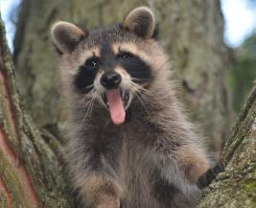
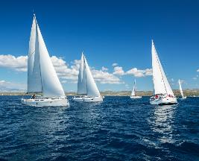
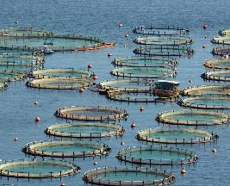
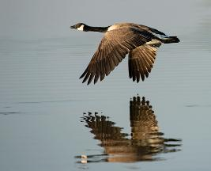
Ecosystem Pressures:
Invasive Species
Alien species:
Species that do not naturally occur in an ecosystem, usually introduced by people. The opposite of native species.
Invasive species:
Alien species that thrive in their new habitat and have a negative impact on native species and ecosystems. They can displace or even kill off native species.
How do they get here?
Live bait from fishing
Garden plants
Release of exotic pets
Boating & sailing
Aquaculture
Natural spread
Notes:
What we move, release or carry between places can have consequences for water ecosystems.
Let's talk about alien species and invasive species.
An alien species is a species that does not naturally occur in an ecosystem, usually because it has been introduced by people.
Some alien species become invasive species. These species can thrive in their new environment and negatively affect native species and ecosystems. They may compete with native species, displace them, or even kill them.
There are many ways species can arrive, including live fishing bait, garden plants, exotic pets, boats and sailing, aquaculture and natural spread.

Slide 9
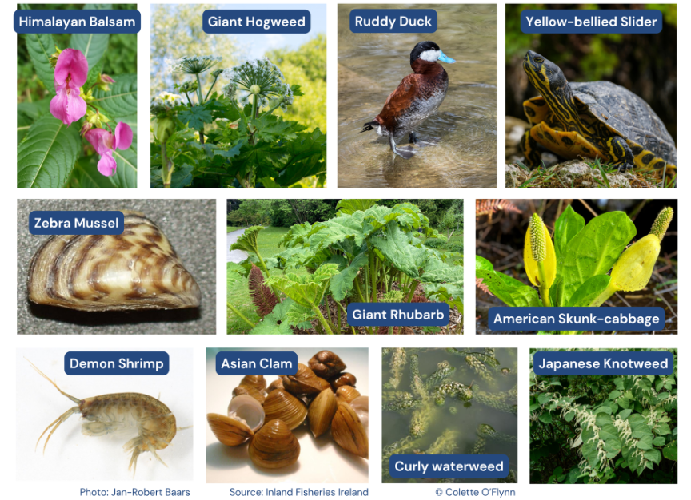
Invasive Species to Look Out For
Here are some invasive species you might see at your local river or lake.
Notes:
Here are some invasive species that you may encounter around local rivers and lakes.
There are many more types of invasive species here in Ireland, but this is a good place to start getting familiar with some.
If you are unsure whether something is an invasive species, do not disturb it just to get a closer look.
Learning what is present in your local area is an important first step in protecting biodiversity and reporting concerns appropriately.
You can report invasive species at invasives.ie.

Slide 10







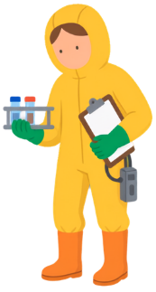
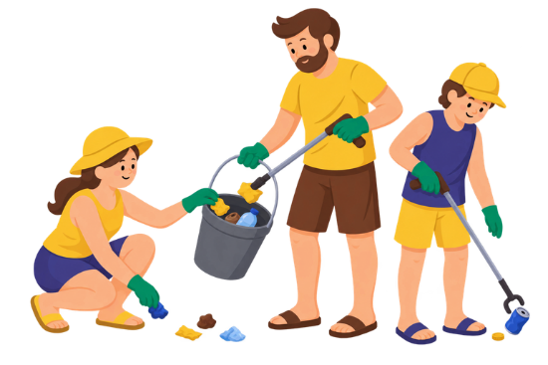
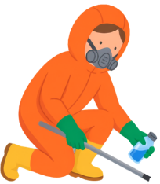

Become a Water Guardian
Adopt your local river or lake and:
Learn more about its history & folklore
Assess water quality
Study biodiversity & report invasives
Your help matters!
About 25% of Ireland’s rivers and streams are not currently monitored by the EPA.
Pick litter
Notes:
There are lots of ways to become a Water Guardian for a local river or lake.
You could study biodiversity, learn about invasive species, assess water quality, pick litter, or learn about the history and folklore of your local waterbody.
Around a quarter of Ireland’s rivers and streams are not currently monitored by the EPA. That makes local observation and community involvement especially valuable.
Your local waterbody can become an outdoor classroom – somewhere to learn, notice change and take positive action.

Slide 11





Community Outreach
Partnership Idea
River Basin Management Sevice
Real impact happens when more people are brought along.
  Works on behalf of Ireland's 31 local authorities to protect and restore good water quality through catchment assessments and community engagement.
  They are the main funders for river-based projects.
Who can you involve?
Visit https://riverbasin.ie/
to learn more.
Parents
Community groups
Local authorities
Neighbours
Notes:
Protecting water is not something one person or one school has to do alone.
Real impact happens when more people are brought along. More people = more brain power and more helping hands.
Think about who you could involve: parents, neighbours, community groups,sports teams and local authorities.
You can also look for opportunities to connect with the River Basin Management Partnership.
The partnership works with Ireland’s local authorities on catchment assessments and community engagement, and can be a useful connection for river-based projects.
[Ask the group]: who could you invite to get involved in your own local water action?

Slide 12
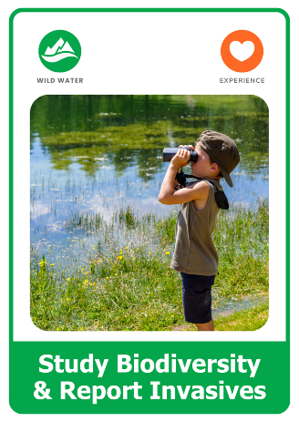
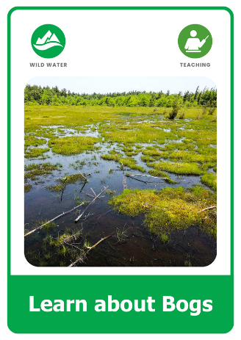
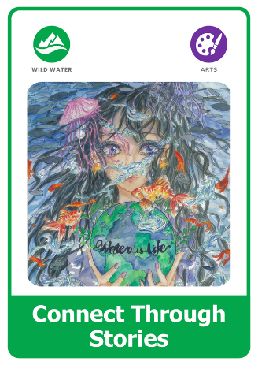
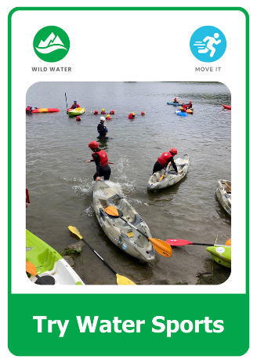
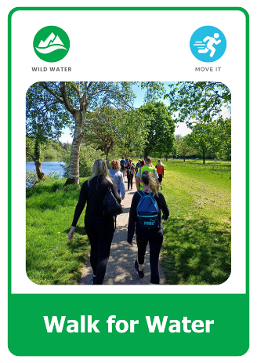
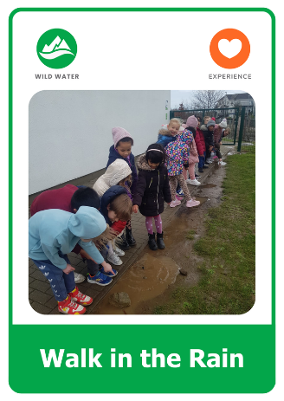
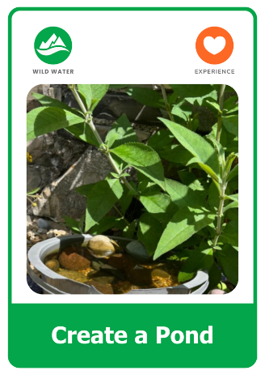
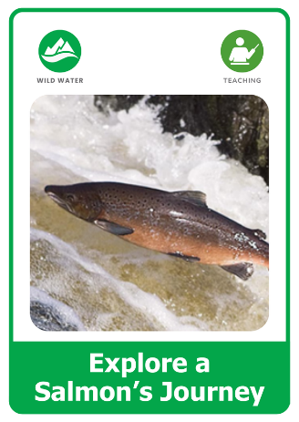
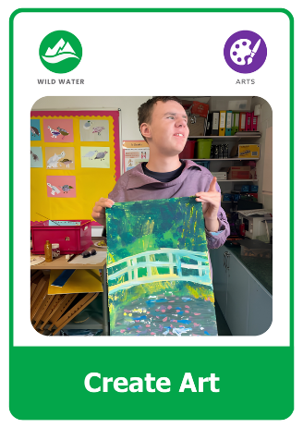
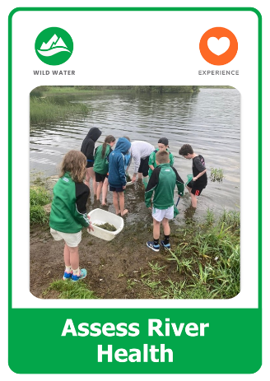
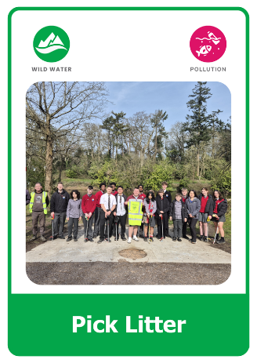
What Will You Do?
Explore the Green-Schools Water Action Cards.
Choose an action. Get others involved. Make a difference.
Notes:
Now it is time to turn the learning into action.
Explore the Green-Schools Water Action Cards and choose something you can do with your school or community. It could be learning more about your local river, checking water quality, picking litter, studying biodiversity or another action that connects people with water.

Slide 13


Keep Learning
Continue your journey with the other lessons in the Water Learning Series:
Water on Earth
Start your water learning journey.
Everyday Water
Learn how we use water every day.
Hidden Water
Discover the water we can't see.
Find more resources, activities, competitions, and inspiration at:
greenschoolsireland.org/water.
Need support or have questions? Contact us at:
water@greenschoolsireland.org
Notes:
This is the end of Wild Water, but there is plenty more to explore.
Most importantly, keep looking at water with new eyes. Notice what is around you, learn about your local waterbody, and think about what you can do to help protect it.

