Slide 1
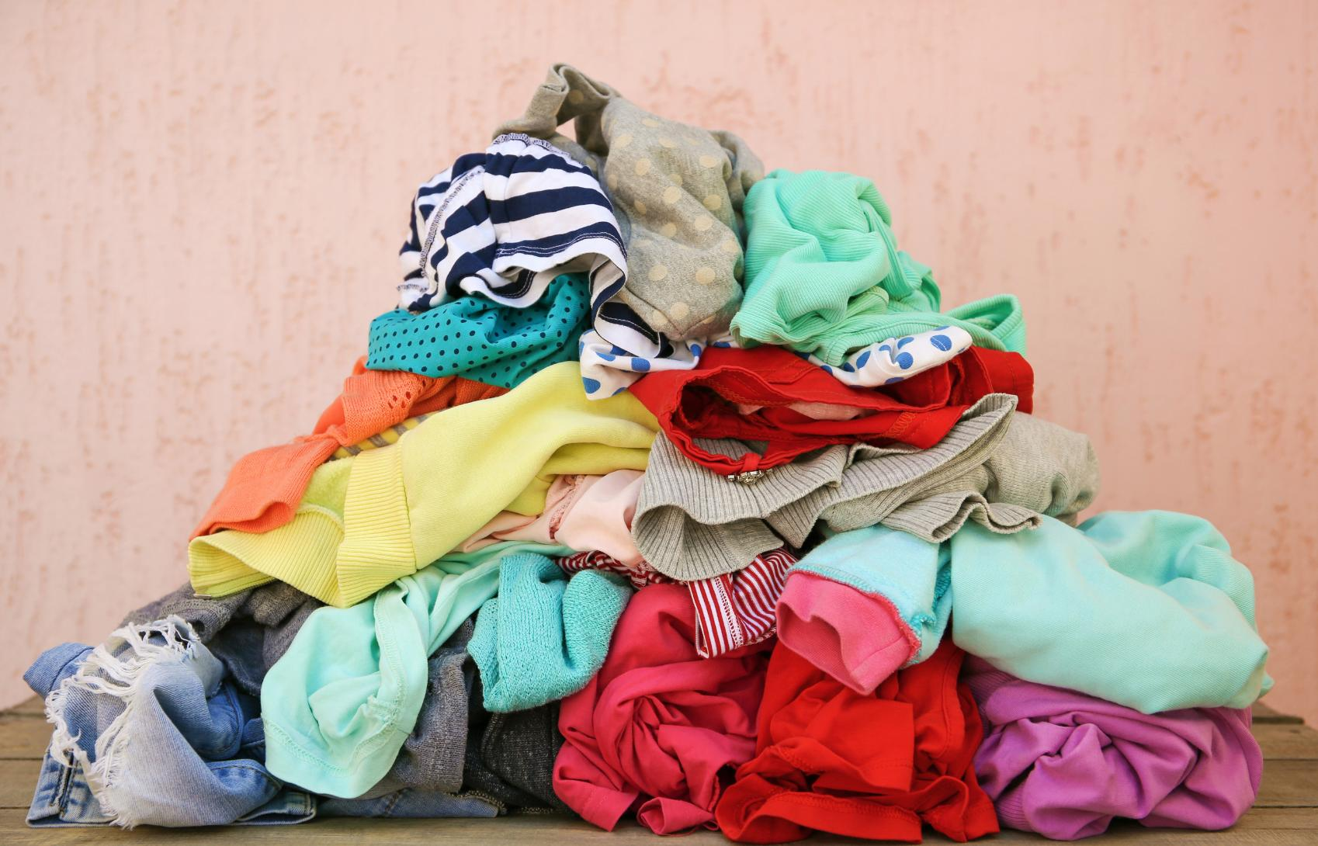


WATER LEARNING SERIES (PART 3)
Hidden Water
The invisible water behind everyday items
Notes:
When we think about water use, we often picture taps, showers and toilets. But there is another, much bigger part of our water footprint hiding behind the things we buy, eat and use every day.

Slide 2
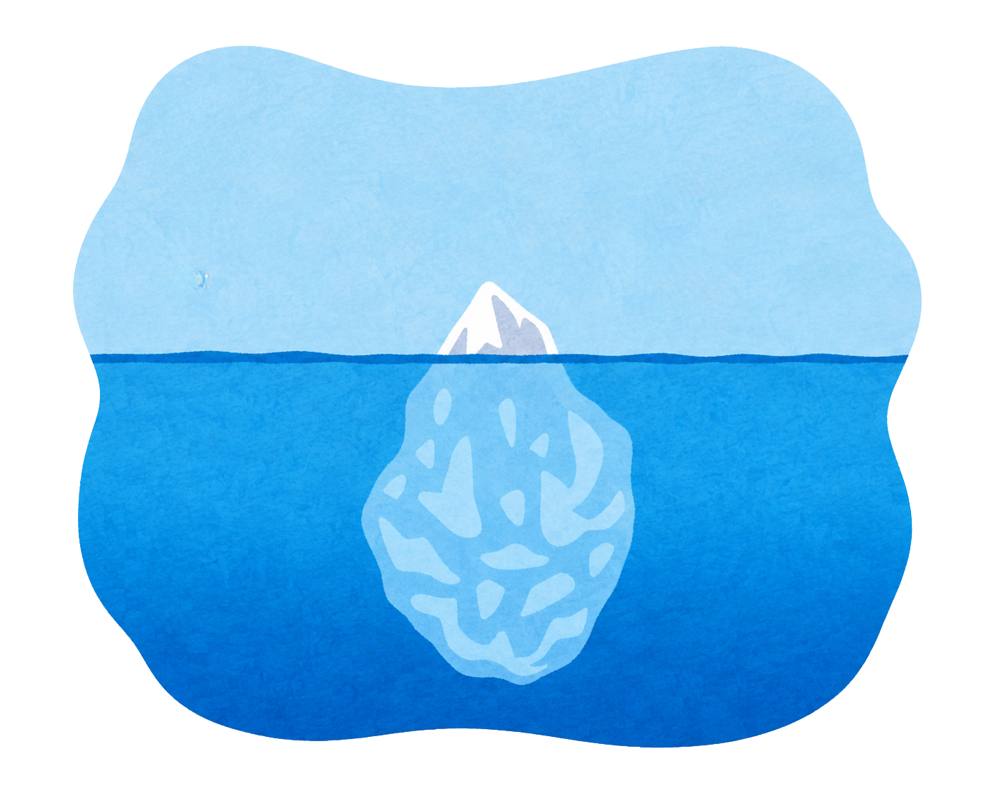


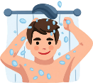
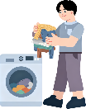




What is HiddenWater?
drinking water
brushing teeth
Direct Water
showering & bathing
washing clothes
Hidden Water (a.k.a. “Virtual Water” or “Secret Water”) is the water you use without even knowing it.
It refers to the hidden water used to make and transport the things we buy, eat, and use every day, from start to finish.
producing clothes
growing food
cooling data centre servers
Hidden Water
making phones
making plastic
producing cars
Notes:
Start by asking: when you use water, what do you picture? Most of us probably think about drinking, showering or brushing our teeth.
Hidden Water, also called Virtual Water or Secret Water, is the water used to make and transport the things we buy, eat and use every day. It is there from when the resources are first extracted to when we buy and use a product.
So, a T-shirt is not just a T-shirt. Food is not just food. Each product has a water story behind it.
As we go through this presentation, think about where our water drop might be travelling to make the things in our lives.

Slide 3
Hidden Water in Daily Life
Direct Water
(100-150 litres)
3%
A person’s daily water use:
Hidden Water
“Hidden Water” makes up the majority of our daily water use.
3,600 litres
(up to 3,500 litres)
97%
Notes:
You might remember from our last presentation that each person in Ireland uses 133 litres of water every day. In reality, that is only a person's direct water use.
The majority of our daily water use can be hidden water.
When we take into account Hidden Water, a person uses 3,600 litres of water a day. 97% of that is Hidden Water and only about 3% is from direct water use.
That means the water we see coming from a tap is only a small part of the story.

Slide 4
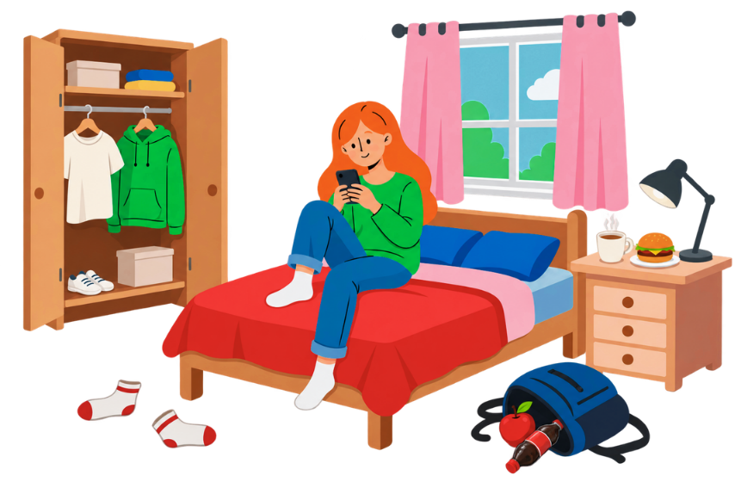
How Much Water is Hiding in Your Stuff?
Cup of coffee
Jumper
250 litres
3,350 litres
Hamburger
Cotton t-shirt
2,498 litres
2,700 litres
Jeans
Apple
7,250 litres
95 litres
Pair of socks
Soda
375 litres
98 litres
More than half of young adults are buying themselves new things to wear “at least” a few times a month, according to new research for the EPA.
The EPA estimates that households wasted more than 200,000 tonnes of food in Ireland in 2024.
Notes:
A lot of our water footprint is connected to the products we choose to buy and consume.
Let’s look at some everyday items and imagine the water behind them. A cup of coffee, a pair of socks, jeans, a hamburger, an apple or a cotton T-shirt all have different water footprints.
The important point is not to memorise every number. It is to notice that ordinary things can require surprisingly large amounts of water to produce.
[Ask the group]: Which item surprised you most? What might happen to the water used to make something if we buy it and then barely use it, or throw it away?

Slide 5








The More We Consume, The More Water We Use
BUY NOW!
Notes:
Hidden Water gives us another way to think about consumption. The more things we buy and replace, the more water is needed somewhere along the production chain.
This is not about never buying anything. It is about becoming more aware of what sits behind our choices and asking whether we really need something, whether we can use it for longer, or whether we can get more use from something we already have.

Slide 6
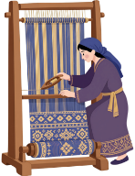



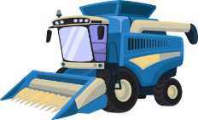

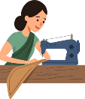

Fashion
The fashion industry is the second most water intensive industry in the world after agriculture.
What’s all that water for?
Crop farming
Harveting & ginning
Transport to spinning mills
Spinning, weaving, & dyeing
Garment manufacturing
Global distribution
Use & care at home
The Pollution Problem
20%
of industrial water pollution
globally comes from the treatment and dyeing of textiles.
Notes:
Take clothing as an example.
Water is involved long before a jumper reaches a shop.
Cotton has to be grown and harvested. It is then processed, spun, woven and dyed. The garment is manufactured, transported around the world, and eventually washed and cared for at home.
There is also a pollution story here. A whopping 20% of global industrial water pollution is linked to textile treatment and dyeing
So when we think about a piece of clothing, we can ask not just ‘How much does it cost?’ but also ‘What resources and water went into making it?’

Slide 7


The Throwaway Economy
Take
Make
Use
Waste
Food Waste in Ireland
Textile Waste in Ireland
Irish restaurants and food services have the worst food waste rates in the EU by capita.
Ireland has the second most textile waste in Europe.
The good news is that Irish households have one of the lowest levels of food waste.
Textile Waste
Notes:
The same idea applies to the way we use and dispose of things.
The linear model is: take, make, use and waste. Resources are taken from the Earth, turned into products, used for a relatively short time, and then discarded.
The good news is that there are opportunities to break this cycle. We can waste less, keep things in use for longer and find new uses for things we no longer need.

Slide 8
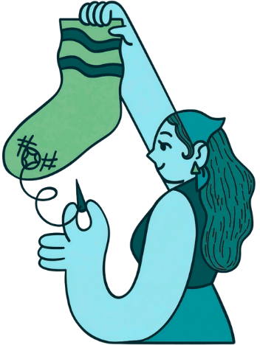
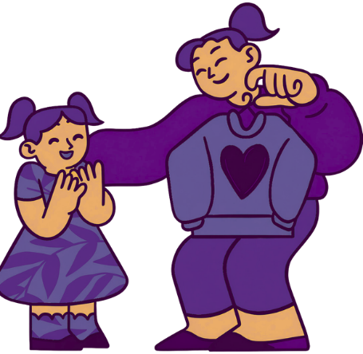
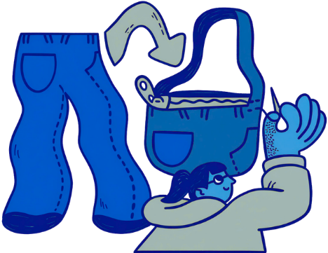
Don’t Toss It...
Repair it
Share it
Change it into something new
Notes:
Before throwing something away, pause and ask: could someone else use it? Could I repair it? Could I turn it into something new?
Repairing, sharing and reusing all help us get more value from the resources and water already used to make something.
This is a simple shift in thinking: instead of seeing an item as waste, get creative and see it as a resource that might still have another life.

Slide 9
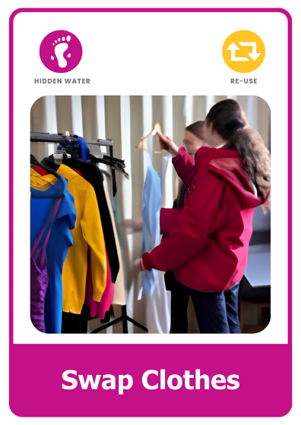
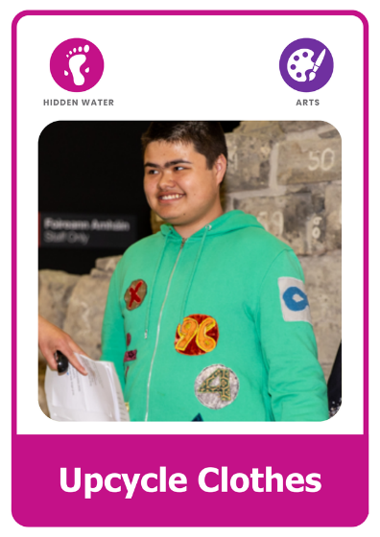
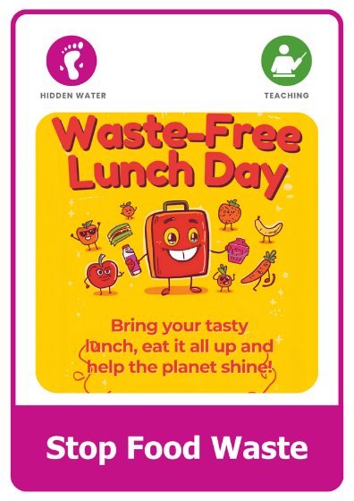
What Will You Do?
Explore the Green-Schools Water Action Cards.
Choose an action. Get others involved. Make a difference.
Notes:
Hidden Water can feel like a huge global issue, but our everyday choices can still make a difference.
Choose an action that feels achievable. Get other people involved, and think about how you can make the connection between everyday choices and water more visible.
The aim is not perfection. It is to notice, make a choice, and take action.

Slide 10


Keep Learning
Continue your journey with the other lessons in the Water Learning Series:
Water on Earth
Start your water learning journey.
Everyday Water
Learn how we use water every day.
Wild Water
Explore rivers, lakes, wetlands, and wildlife.
Find more resources, activities, competitions, and inspiration at:
greenschoolsireland.org/water.
Need support or have questions? Contact us at:
water@greenschoolsireland.org

