Slide 1
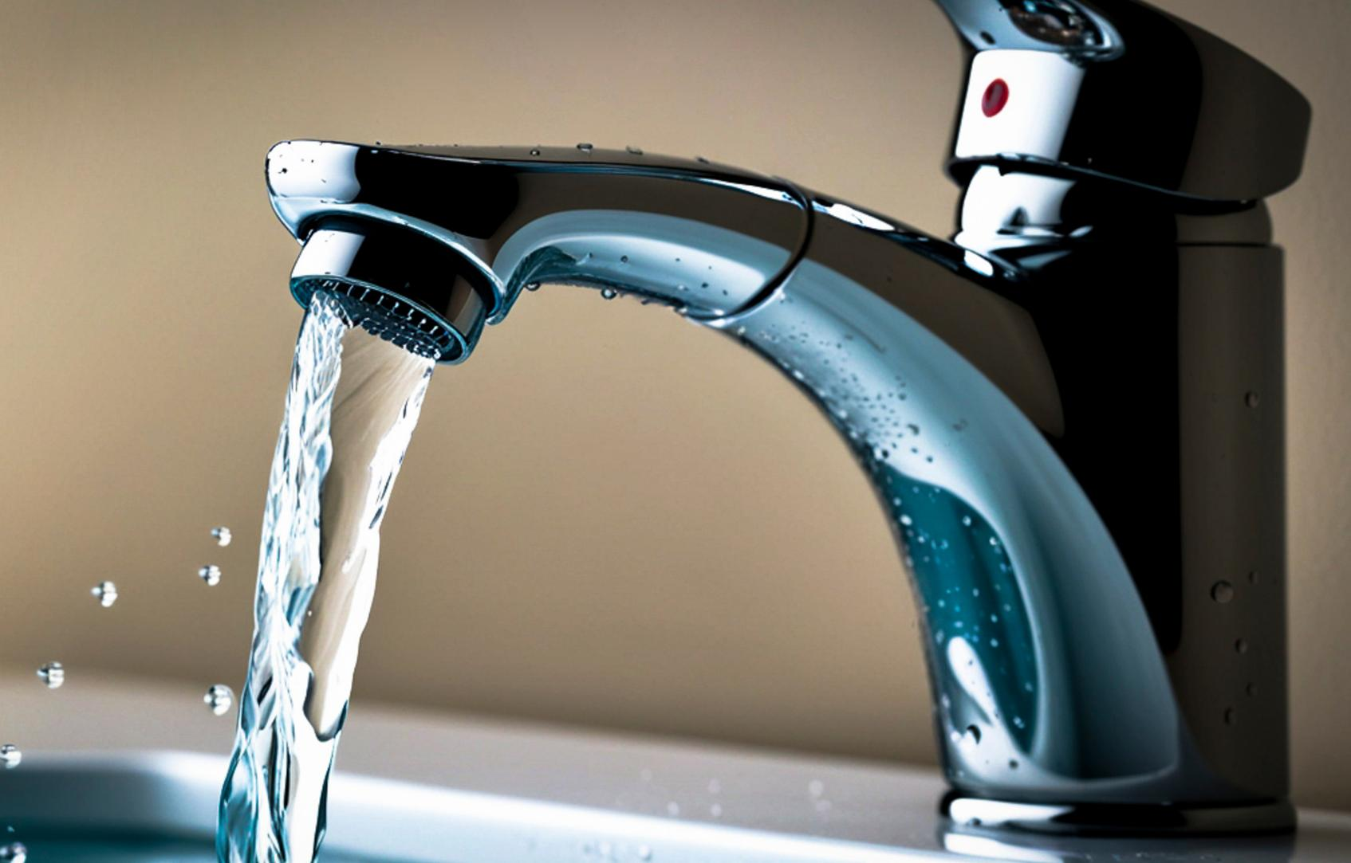


WATER LEARNING SERIES (PART 2)
Everyday Water
The journey of water through our daily lives
Notes:
Now follow that drop as it becomes “everyday water” – the water that comes from taps, showers and water fountains, and the water that disappears down drains and toilets.

Slide 2
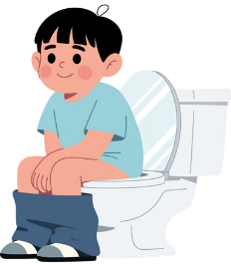
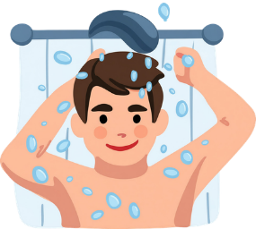
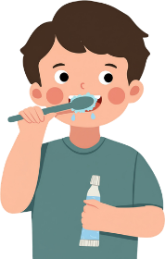
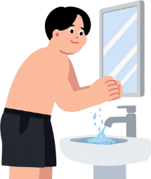
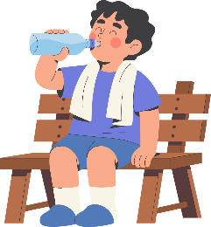
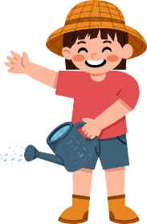
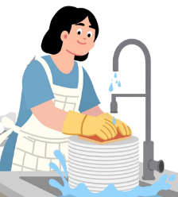
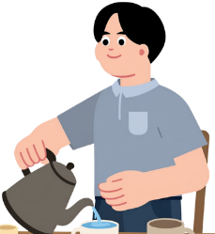
How Do You Use Water Every Day?
Every drop of water in our homes is treated to drinking-water standard before we use it.
(Even for washing and flushing!)
Notes:
Picture your morning. Maybe you flush the toilet, wash your face, have a shower, fill a bottle. The water from your kitchen tap, shower and toilet tank has all been cleaned to drinking-water standard – at least before we use it to wash and flush!

Slide 3
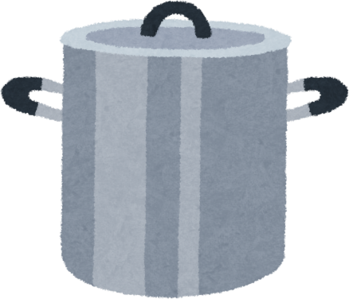
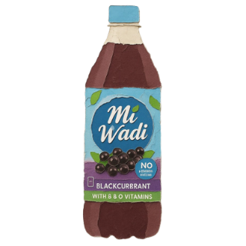
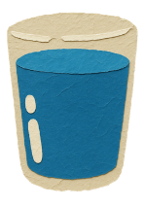
A Person’s Daily Water Use
133
or
or
litres
532
133
13
glasses of water
bottles of MiWadi
large cooking pots
Notes:
On average, one person in Ireland uses about 133 litres of water every day. That is equal to 532 glasses of water, 133 bottles of MiWadi, or 13 large cooking pots, for just one person, in one day.
Of course, we're not actually drinking 532 glasses of water, so where is all of it going?
Guess where your water drop is most likely to be used in your home.

Slide 4
What's Using All That Water?
44
Toilets
litres
Baths/
Showers
39
litres
Washing Machines
27
litres
15
Tap/Sinks
litres
4
Dishwasher
litres
Notes:
Most water is used for:
-Flushing toilets
-Showers and baths
-Washing clothes in the washing machine

Slide 5
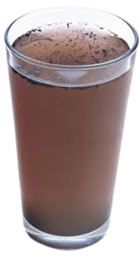
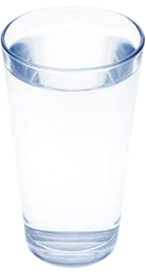
The Journey of Water
From River to Tap
Before it reaches your tap, Uisce Éireann treats water to make it safe to drink.
Untreated water
Treated Water
Notes:
Our water drop does not start life in a tap. In Ireland, it usually starts in a river or lake. Before it reaches homes and schools, Uisce Éireann cleans and treats it in a water treatment plant so it is safe to drink.

Slide 6
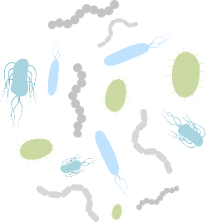
From River to Tap: The Journey Begins
Not safe to drink!
What’s in the water?
Bacteria
Chemicals
Plant bits
Water is piped from the source to the next part of its journey.
Notes:
At the start, the river water may look brown from peat soils and can contain bits of plants, bacteria and sometimes chemicals from farms and roads, so it is not safe to drink yet.

Slide 7
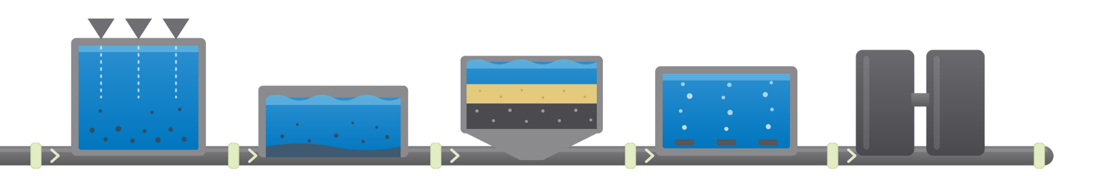
From River to Tap:
Water Treatment
Did you know?
It takes up to 3 days to make river and lake water safe to drink. After use, it's treated again before returning to nature. Clean water takes work!
Coagulation
Filtration
Treatment
Chlorination
Settling
Notes:
The water drop goes through several stages:
Screens remove big things like leaves, twigs and bits of rubbish.
Chemicals are added so very small particles stick together and sink.
The water passes through filters of sand and gravel to trap soil and many microbes.
Finally, disinfectants such as chlorine and sometimes UV light are used to kill harmful germs.

Slide 8
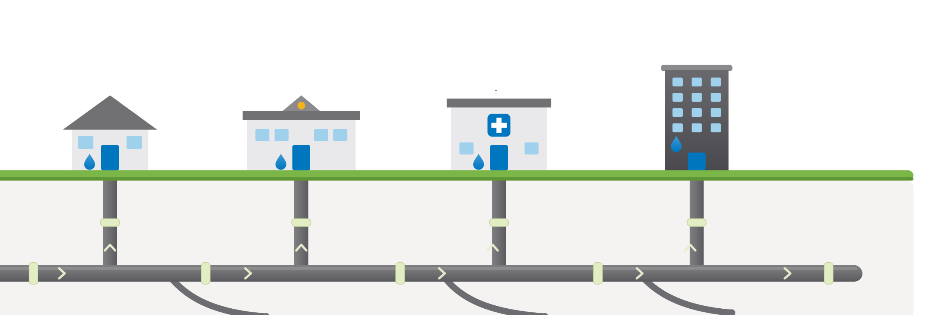
From River to Tap:
The Underground Journey
Businesses
Homes
Schools
Hospitals
Notes:
Now our drop is clear and safe to drink. It travels through a huge network of underground pipes to homes, schools, hospitals and businesses. If you could see underground, it would look a bit like a map of veins in a body, delivering “fresh blood” (clean water) everywhere.

Slide 9


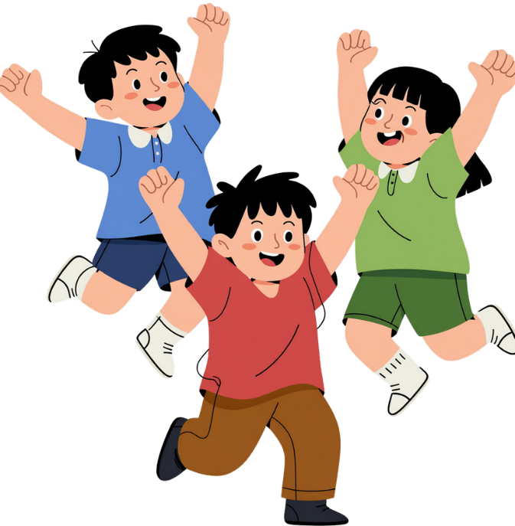
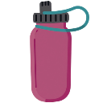
That’s All, Folks...
...Until You Flush!
Notes:
That's the end of water's journey...or is it?

Slide 10
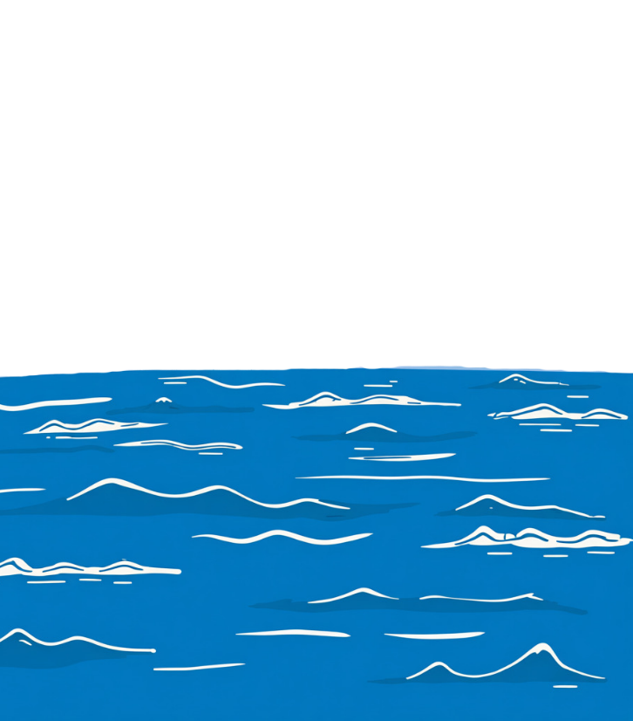
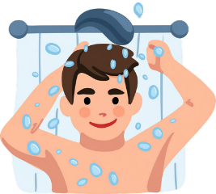
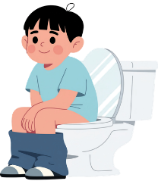
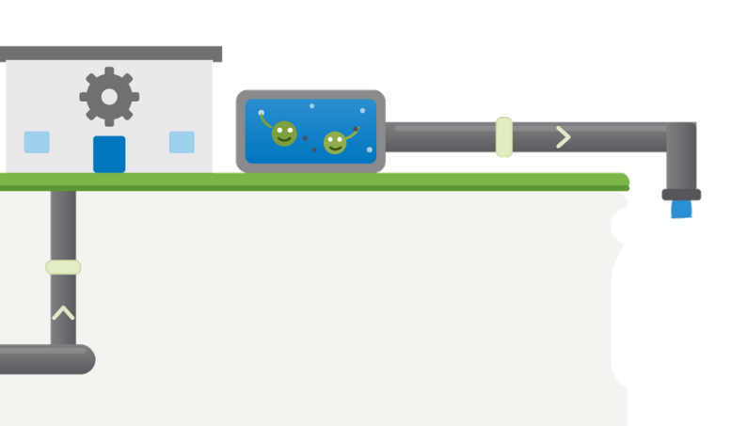
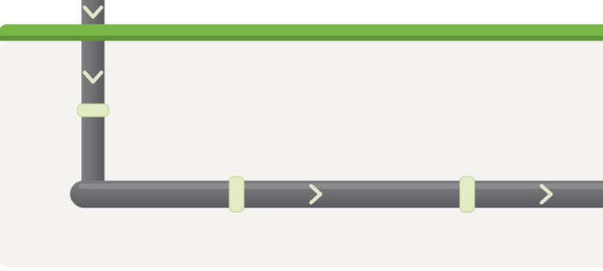
The Journey Continues:
Down the Drain
Learn More!
Watch this short clip from Uisce Éireann.
“From Drain to Sea”
Wastewater Treatment Plant
The water is now safe for rivers, lakes, and the sea!
Notes:
Now follow our drop as it becomes “used water”. After you wash your hands, shower or flush the toilet, the water disappears down the drain. But it does not vanish. It travels through a different set of underground pipes to a wastewater treatment plant.
Here, machines and helpful microorganisms remove poo, food scraps, dirt, oils and many germs from the water. Step by step, the water is cleaned so that when it is released into a river, lake or the sea, it will not harm nature.

Slide 11
Activity
Question 1
What you’ll need:
Why does it matter to conserve water?
  Post-its or scrap paper with tape
  A big board for brainstorming
What you’ll do:
Question 2
Write the two questions on the board.
Brainstorm individually or in groups.
Record your answers on post-its and put them up on the board.
Share and discuss as a group.
How can you conserve water?
Notes:
Let's take a break from the presentation for a short activity.
You'll get two post-its. On each post-it, write your answer to each of these questions:
1. Why does it matter to conserve water?
2. How can you conserve water?
After you're done writing, stick your post-it on the board.

Slide 12


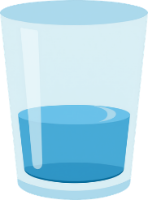

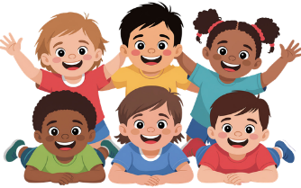


Why Does it Matter to Conserve Water?
Limited Supply
Save Money
Help Life
Protect for Tomorrow
What else can you think of?
Notes:
So, why does it matter to conserve water?
Reasons to save water:
Cleaning and pumping water costs money and energy, including for schools. Using less means less cost and less energy used overall.
Even though your parents do not pay direct water charges now, wasting water still uses public money that could be used for other things.
Rivers, lakes and wetlands are home to many plants and animals. They need enough clean water left in nature to survive; we cannot take it all.

Slide 13

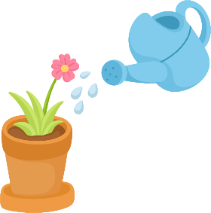

Reuse water.
Repair a leaking pipe.
Wash clothes on full load
How
Can You Conserve Water?
Clean driveways and sidewalks with a broom instead of a hose.
Turn off the tap—avoid wasting running water when possible.
Small Changes
Learn More!
Switch to a water efficient toilet.
Visit Uisce Éireann’s website to learn more about how to conserve water.
Water your plants during the coolest part of the day.
Turn off shower when soaping.
Click here.
Take shorter showers.
Harvest rainwater.
Notes:
Those are all great reasons for why we should save water, but what can we do in our daily lives to conserve it?
Some way you could save water in your day are:
Take shorter showers; showers usually use less water than baths.
Fix dripping taps and leaky toilets quickly so drops do not become buckets.
Collect rainwater in a water butt for watering plants – most plants love rainwater.
Only run washing machines and dishwashers when they are full.

Slide 14
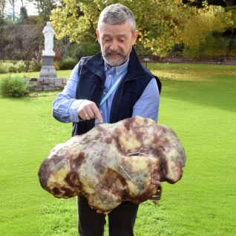





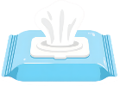

Fatbergs
Protect Pipes, Protect Water
If oils and wipes mix together, they can form a horrible lump called a “fatberg” that blocks sewer pipes. Gross!
Did you know?
Run a campaign at your school!
Think Before You Flush
Think Before You Pour
TBYP campaign
Only flush the 3 PS:
Pee
TBYF campaign
Poop
Paper
Notes:
Our water drop also needs us to keep pipes and rivers clean.
Never pour cooking oil or grease down the sink – when they cool down, they harden and stick to pipes.
Remember the 3Ps for toilets: only pee, poo and paper go down. Wipes, cotton buds and other items go in the bin.
If oils and wipes mix together, they can form a horrible lump called a “fatberg” that blocks sewer pipes.

Slide 15

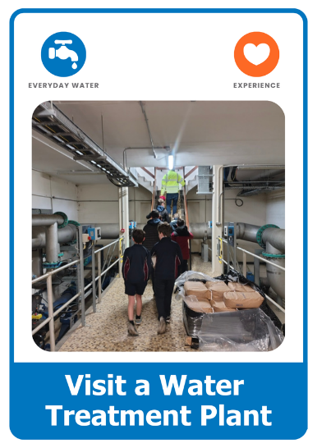
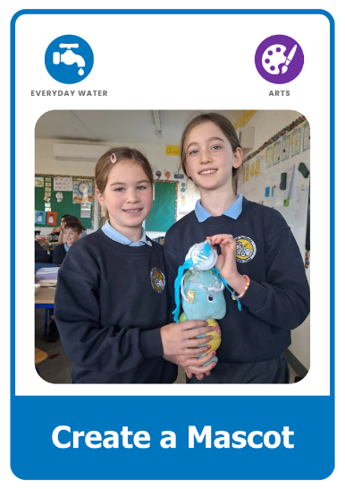
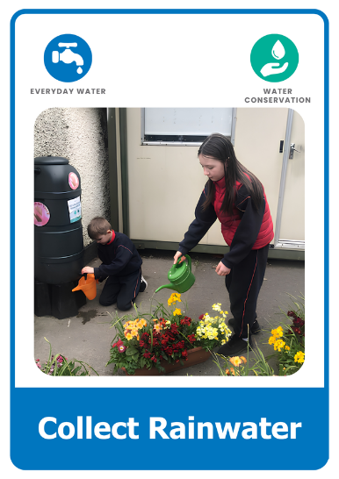
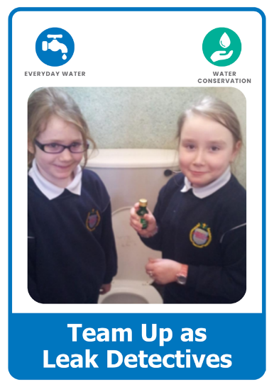
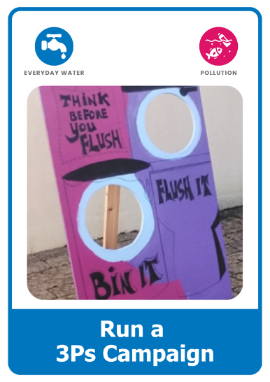
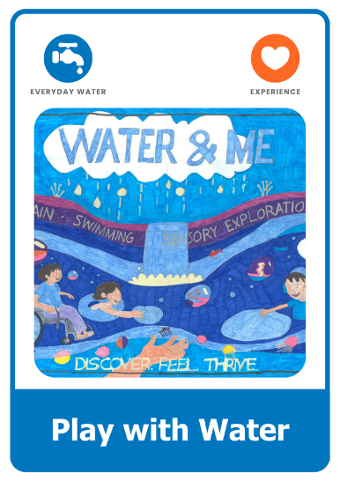
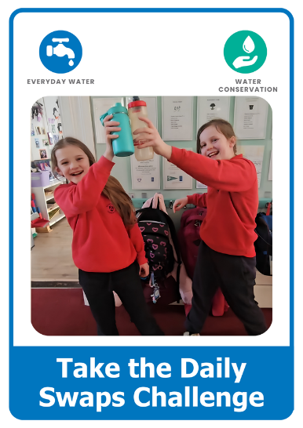
What Will You Do?
Explore the Green-Schools Water Action Cards.
Choose an action. Get others involved. Make a difference.

Slide 16


Keep Learning
Continue your journey with the other lessons in the Water Learning Series:
Water on Earth
Start your water learning journey.
Hidden Water
Discover the water we can't see.
Wild Water
Explore rivers, lakes, wetlands, and wildlife.
Find more resources, activities, competitions, and inspiration at:
greenschoolsireland.org/water.
Need support or have questions? Contact us at:
water@greenschoolsireland.org

