Slide 1
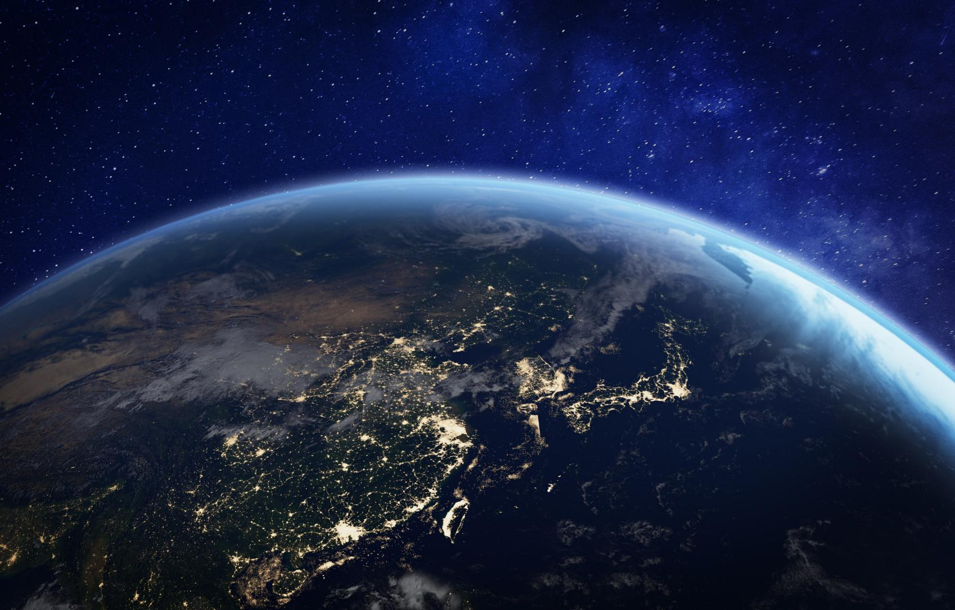


WATER LEARNING SERIES (PART 1)
Water on Earth
An introduction to our planet’s most precious resource

Slide 2
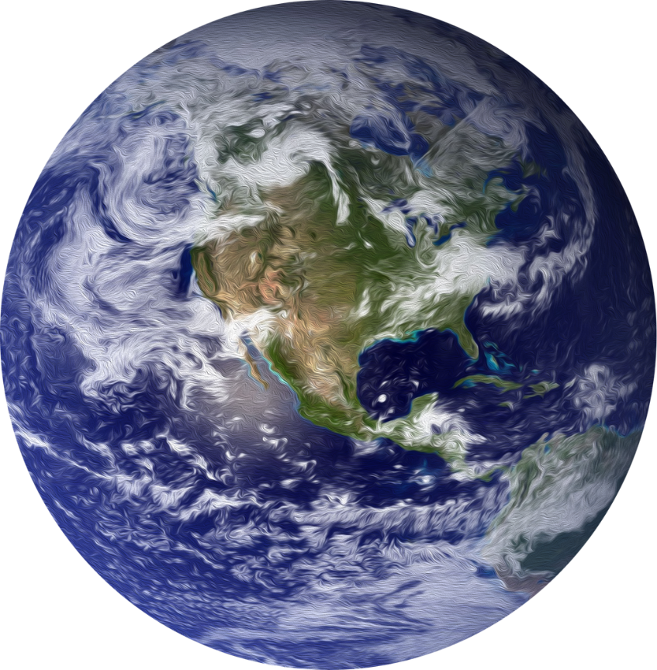
Blue Planet
More than
70%
of Earth’s surface is covered by water.
That is why Earth is nicknamed,
“The Blue Planet”
Notes:
Imagine zooming out into space and looking back at Earth. What colour does it look like? Over 70% of Earth’s surface is covered in water, so people call it the Blue Planet.

Slide 3
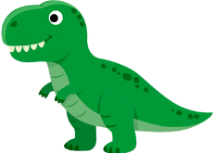
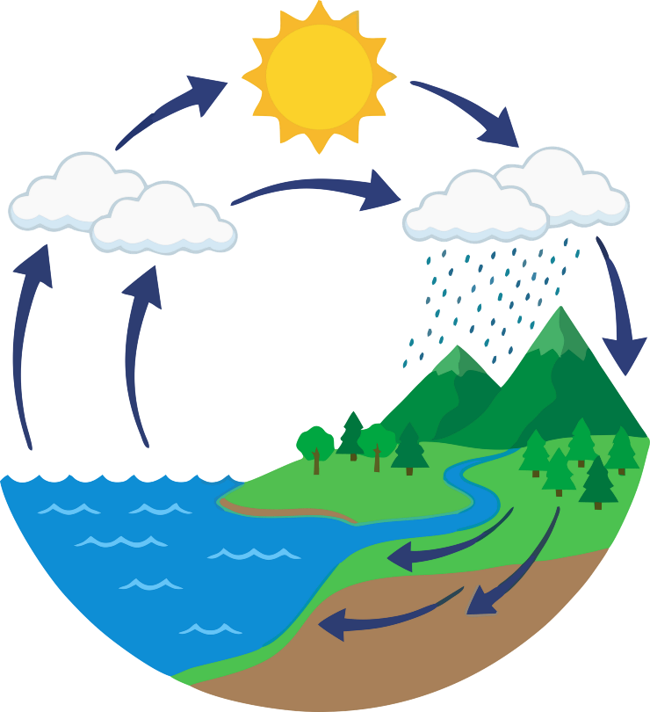

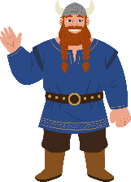

Water Cycle
Earth doesn't make new water – it recycles it.
The water we drink today is
4.5
billion
years old.
(That’s as old as the Earth!)
Notes:
Now imagine a drop of water. That drop is as old as Earth itself, around 4.6 billion years. It has been travelling around our planet again and again in the water cycle.
Maybe, you could give the water drop a name?
On a sunny day, our water drop evaporates from the sea and floats up into the sky as part of a cloud. Later, it falls as rain, lands on a hill, runs into a stream, races through a river and finally returns to the sea.

Slide 4
Freshwater: A Limited Supply
2.5%
Only
of water on the planet is freshwater.
97.5%
is saltwater.
Notes:
But here is a twist in the story: most of Earth’s water is salty ocean water. Only a tiny bit is freshwater, and even less is easy for us to reach. That small amount of freshwater is what we all rely on to drink, wash, grow food and make things. Every plant, every animal and every person depends on clean freshwater to stay alive.

Slide 5
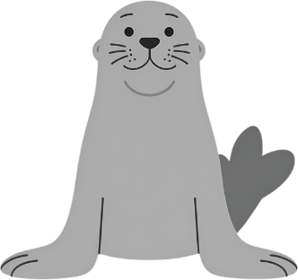
Locked Away in Ice
...and of that freshwater,
70%
is locked away in ice caps, glaciers, and snow!
About
Notes:
Of the small amount of freshwater on Earth, most of it is locked away in ice: in ice caps, glaciers, and snow.

Slide 6
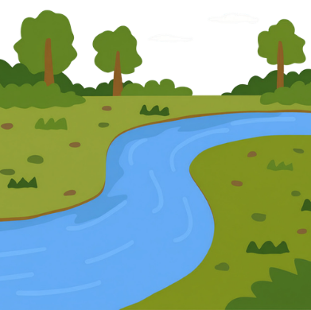
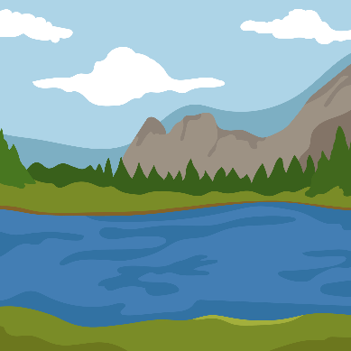
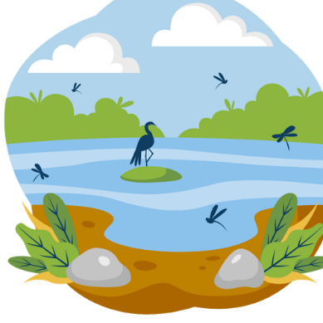
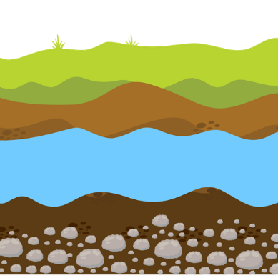
Precious Freshwater
1%
makes up important freshwater ecosystems and is easily accessible.
Only
Rivers
Lakes
Wetlands
Underground
Notes:
A freshwater drop might be in a river, a lake, a wetland, or hidden underground between rocks and soil.

Slide 7
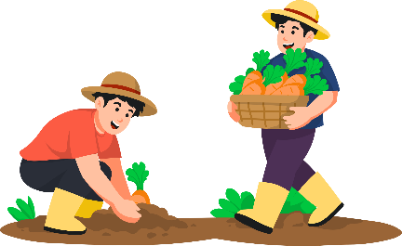


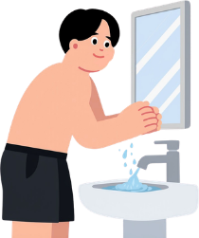
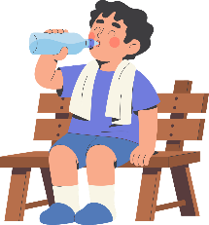

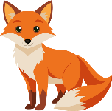

A Precious Resource
Hidden Water
A tiny amount of freshwater supports life on Earth – and we all have to share it.
Everyday Water
Wild Water
Notes:
Let’s take a moment to consider the preciousness of our freshwater resources.
The tiny amount of accessible freshwater we have is essential for all life on Earth. Despite how limited freshwater is, it supports everything from the smallest plants to the largest animals, including us. We have a responsibility to protect it for all living things.
[Pause for a moment to let this sink in.]
Think about how interconnected our lives are with this precious resource. Whether it's for drinking, growing food, or making clothes, every drop counts.
As we continue on our learning series, we will explore the water we use daily and uncover the hidden water we often overlook.

Slide 8


Keep Learning
Continue your journey with the other lessons in the Water Learning Series:
Everyday Water
Learn how we use water every day.
Hidden Water
Discover the water we can't see.
Wild Water
Explore rivers, lakes, wetlands, and wildlife.
Find more resources, activities, competitions, and inspiration at:
greenschoolsireland.org/water.
Need support or have questions? Contact us at:
water@greenschoolsireland.org

