Slide 1
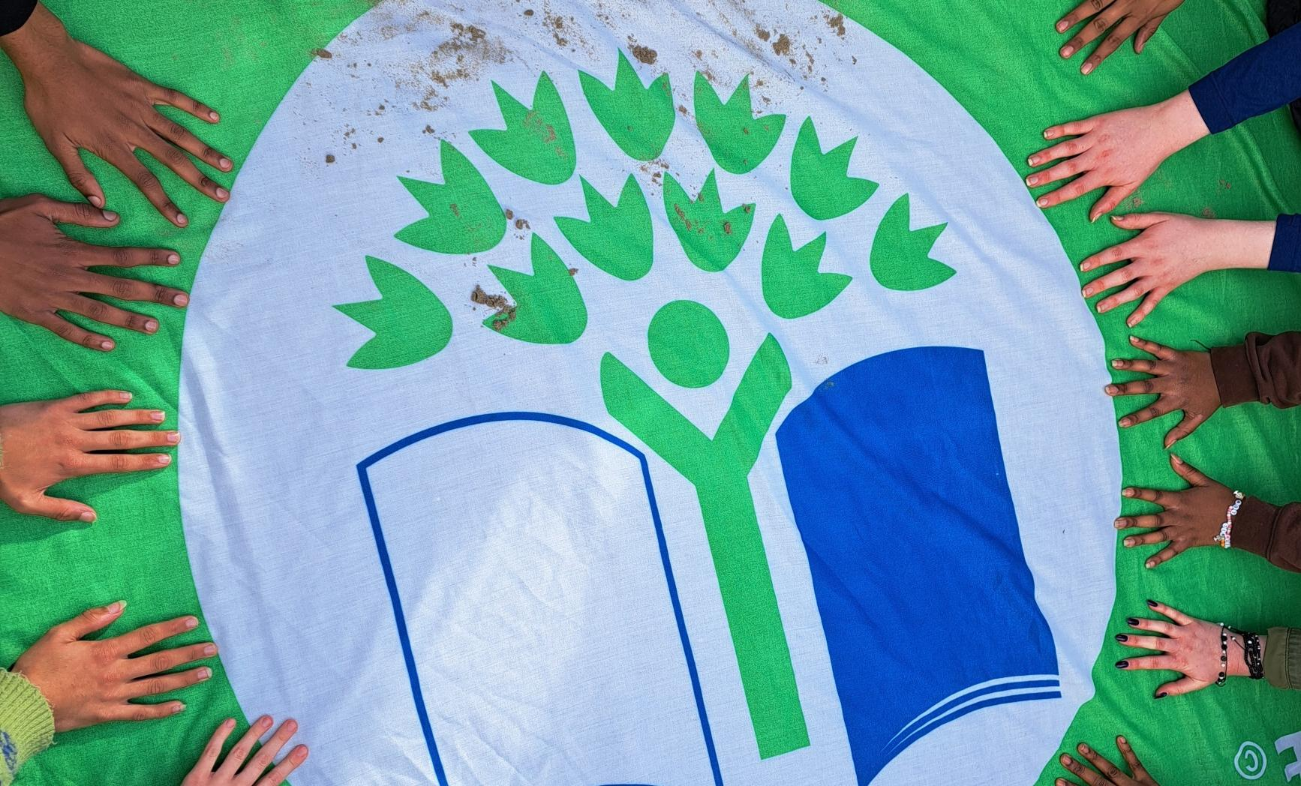

GREEN-SCHOOLS​
WATER​
Application Renewal Clinic
3 March 2026

Slide 2

MAJOR STEPS TO GETTING YOUR WATER FLAG
1.
2.
3.
4.
Be on your second year of the Water Theme.
Complete or have a plan to complete the Seven Steps.
Organise renewal visit.
Submit application.
Applications are typically due in March of each year.

Slide 3

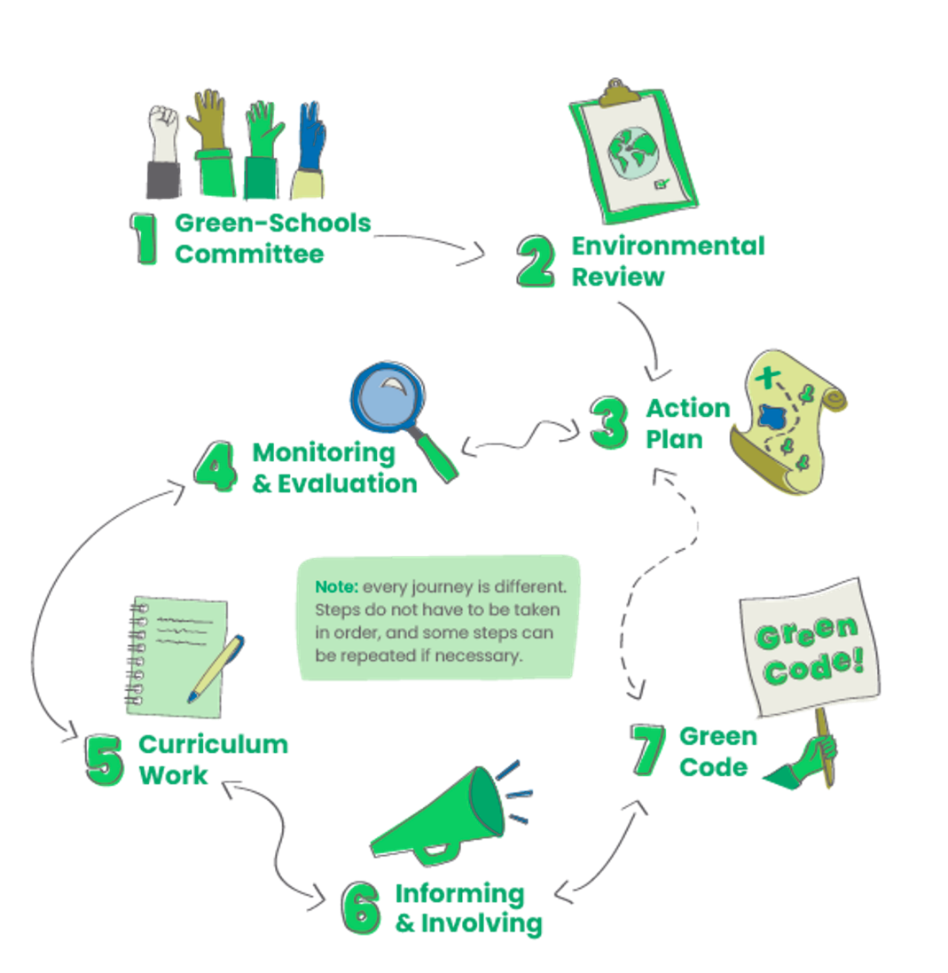

THE
SEVEN
STEPS

Slide 4

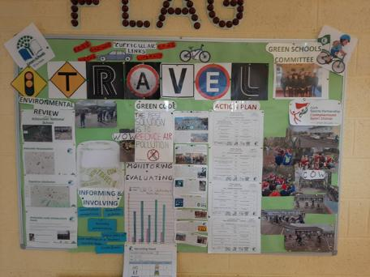
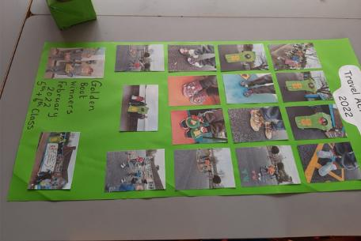
ORGANISING A RENEWAL VISIT
Pro-Tip:
This is great practice for completing the application form, as the questions during the visit align with the forms.​
A renewal visit is your chance to showcase and celebrate your school's work on the Water theme! You also need to plan to organise a renewal visit before submitting your application.
During the visit:
  We encourage students from the Green-Schools Committee to share their experiences, if they feel comfortable.​
  Students can prepare posters, slideshows, or even organise a tour of the school to highlight their work.
To book a renewal visit, please contact your Environmental Awareness Officer whose details can be found here.

Slide 5

ABOUT THE APPLICATION
So, your school is ready to apply for its Water Flag. What’s next?
Deadline for 2025/2026 Academic Year: 20th March 2026
Please have the following ready to upload with the form:
  Minutes of your Green-Schools Committee Meetings.
  Action Plan with future targets.
  Examples of Curriculum Links.
  Photos (if you have many photos, add them into a Word Document or PowerPoint, then save as PDF).
Submit your application using the online form here.

Slide 6
MEASURING WATER USAGE:
CHALLENGES & SOLUTIONS
Common challenges:
  Inaccessible water meters or shared meters.​
  Unmetered water systems.
  Difficulty reducing water usage despite efforts.
  Focus on monitoring for leaks and addressing water wastage where possible.
  Application form: If you do not have the figures for water usage fill in zero and explain the reason for this as we can pass this information onto our funders. ​
  Renewal visit: Again, explain why you don’t have the figures, as the person conducting the renewal visit may not be aware of your school’s situation. ​
  Even if significant reductions aren’t feasible, raising awareness on the importance of water is the key message. There are other impactful action your committee can take, such as:
    Running water conservation campaigns
    Organising “Walks for Water”
    Hosting swap shops
Solutions:

Slide 7
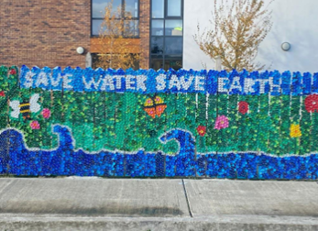
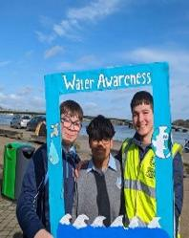
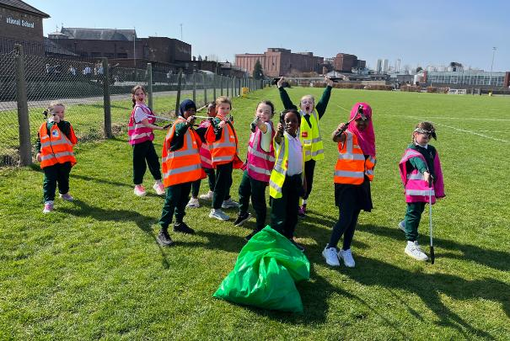

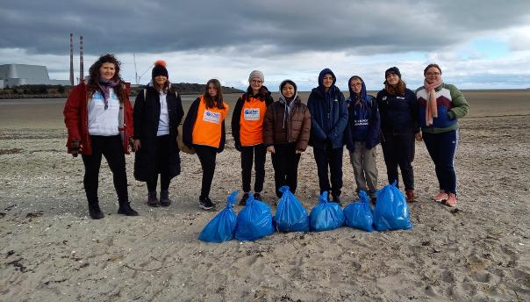
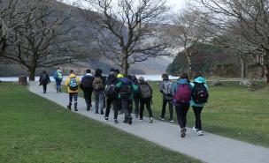
ACTION DAY IDEAS​
  River/Lake/Beach clean-ups​
  Walk for Water​
  River quality testing​
  Tree planting​
  Arts​
  Mindfulness​ activities
  Games​
  Swap shop
  Link up with LAWPRO, Anglers’ group…​
Need more inspiration? Check out our Action Ideas for Water resource.

Slide 8
UPCOMING EVENTS & OPPORTUNITIES (2026)​
Walks for Water
Video Competition
Cork, Galway, Dublin, Wicklow mid-April
11th March
International Day of Action for Rivers
World Water Day
Earth Day
14th March
22nd March
22nd April
Water School of the Year Awards
Application Deadline
TLDR Competition
20th March
15th April
13th May (primary)
14th May (secondary)

Slide 9


THANK YOU!
QUESTIONS?
Email us at water@greenschoolsireland.org

Slide 10

GREEN-SCHOOLS​
Is your school ready to apply for the water flag?
WATER​
The answer is yes if:
You are in at least your second school year of working on the Water theme.​
Your school continues to maintain its work on Litter & Waste (and Energy if applicable)​
You’re on track to complete the Seven Steps of the Green-Schools programme for Water by the end of the school year. ​
You have carried out all Essential Actions of your Environmental Review (Step 2):
  Calculated Water Usage figures for Year 1 and Year 2​.
  Completed leak tests.
  Carried out a water audit.
You plan to organise a renewal visit before submitting your application. ​
To check your progress, use our Seven Steps checklist.
  For more details and ideas, refer to the Water Handbook. ​

Slide 11
COMMONLY ASKED QUESTIONS
  Can I apply after 1 year? No, you need 2 years at least to complete the programme.
  Can I apply if missing some water usage figures? Yes, just explain the reason for this.
  Can I apply if we have not saved water? Yes, explain the reason and putemphasis on the other work you have completed.
  Can I apply if we have not carried out our Action Day yet? Yes, simply share your plans for it.
  Can I apply late? We encourage you to submit on time as we have limited time to review all the applications before the awards begin in May. ​
  Can I defer applying if we are not ready? Yes, please email us to let us know and we can update this on our database.
  Is there a separate application to renew for previous themes? No. You apply for the Water flag and explain how you’re maintaining your previous theme(s) in the same form.
  Am I automatically moved on to the next theme once I’m awarded the Water Flag? If successful, yes, and you will be nobilified by May.
  What is the next theme? It is usually Travel.

