Slide 1
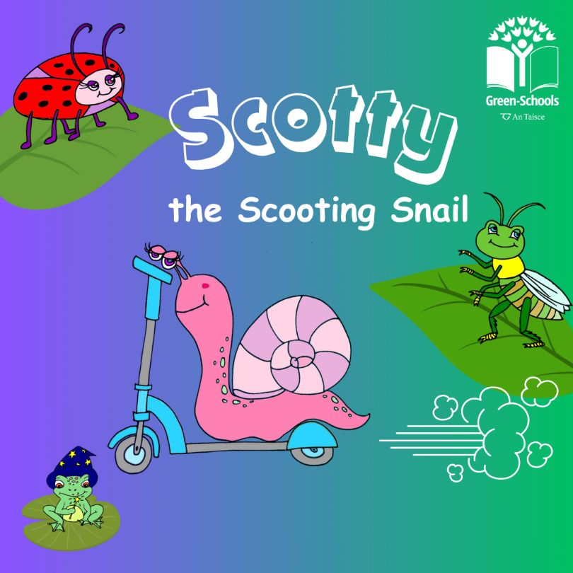

Slide 2
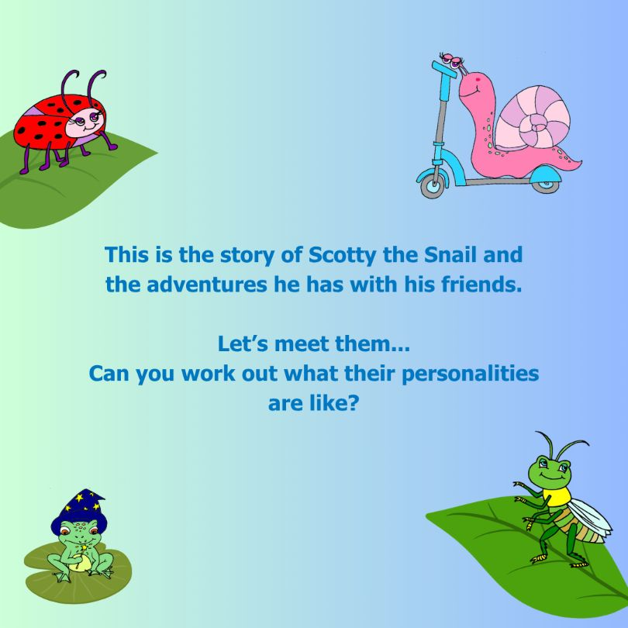

Slide 3
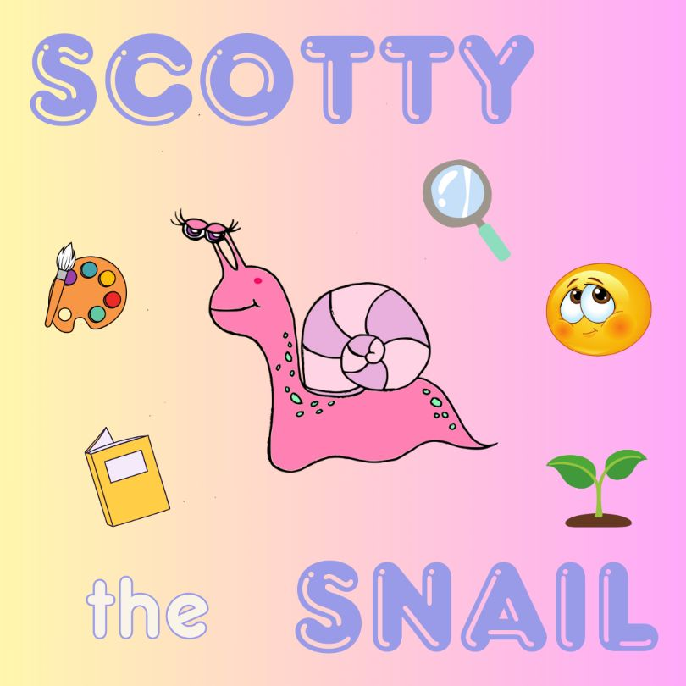

Slide 6
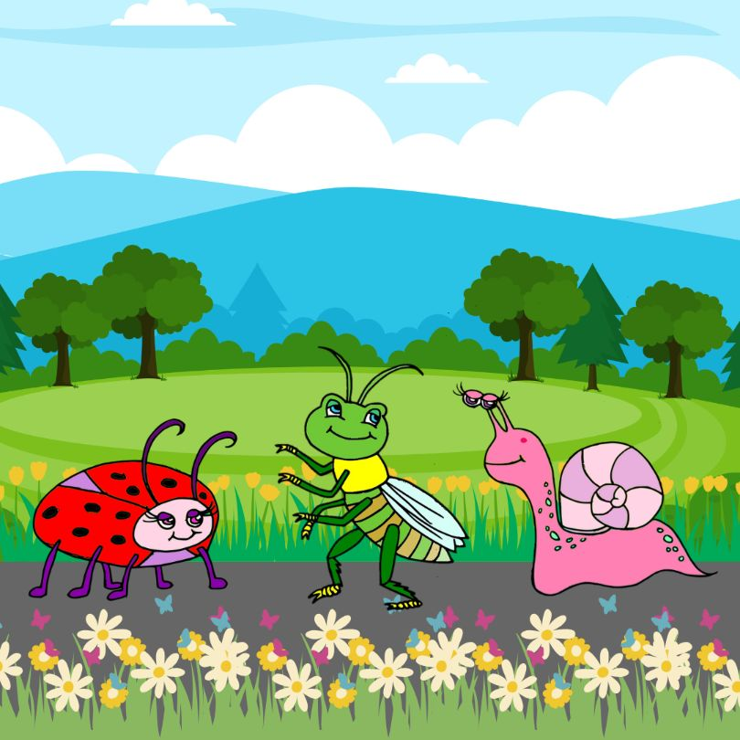
It was a fresh summer’s day in the garden, and Scotty was admiring the morning dew with his friends.

Slide 7
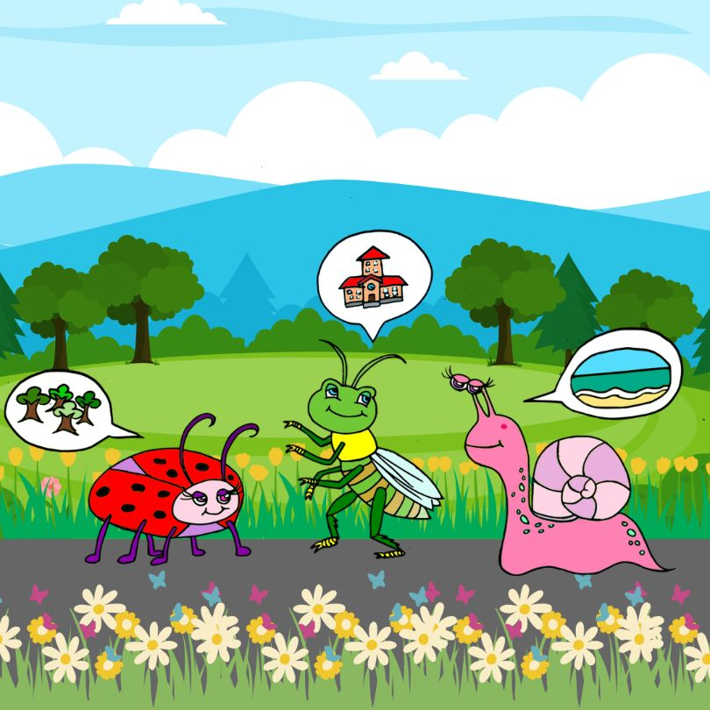
They thought how they had never explored beyond the hedges! “What is out there?” they all wondered.

Slide 8
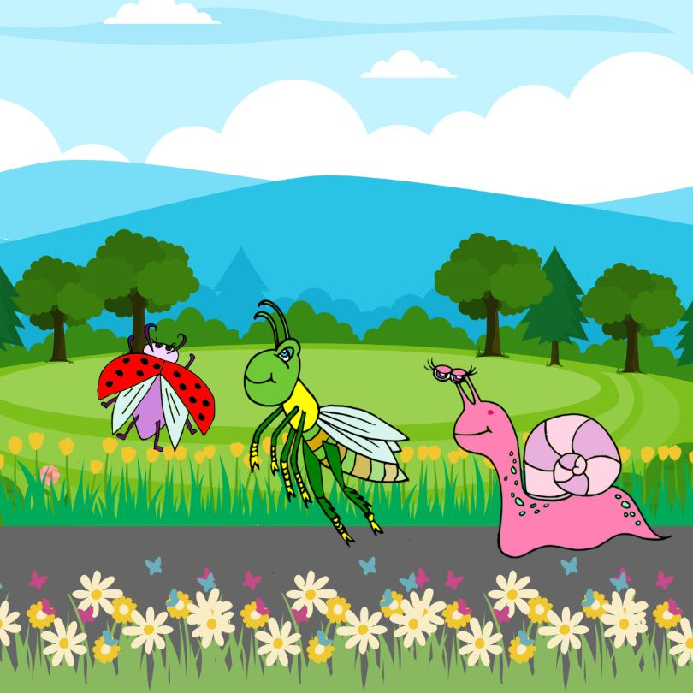
They had to find out, so they set off towards the hedges.

Slide 9
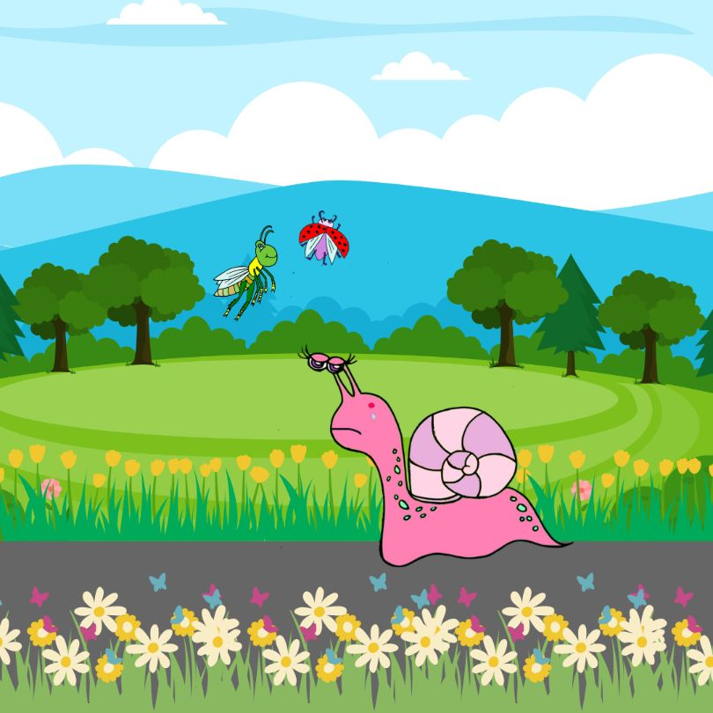
Soon enough, Gabby and Lizzie were far off into the distance. Scotty looked at his friends and thought they must have superpowers, they were moving so fast. Scotty felt sad that he could not keep up.

Slide 10
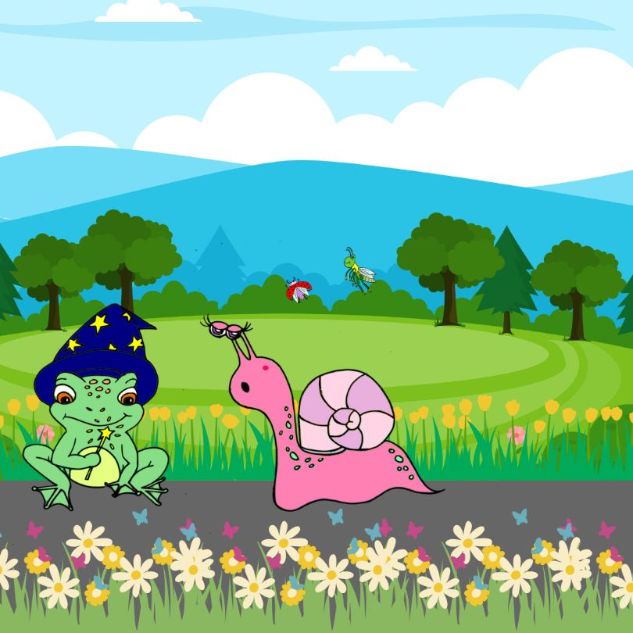
Suddenly, a frog appeared! “HELLO!” croaked the frog. “I am Merlin, your froggy godfather, and I am here to help!”. Scotty was stunned!

Slide 11
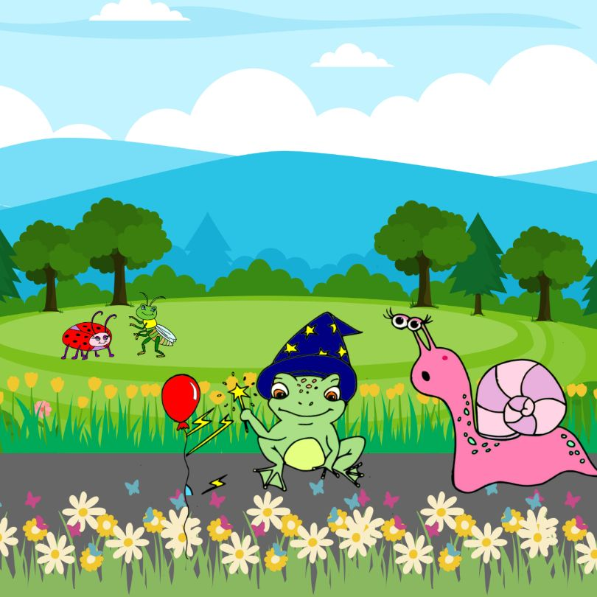
Scotty said, “I wish I could explore with my friends, but I’m too slow and I’m a bit scared.”
“Don’t worry,” said Merlin “I can find a way for you to keep up.”He waved his wand, bright flashes shot out and a balloon appeared.

Slide 12
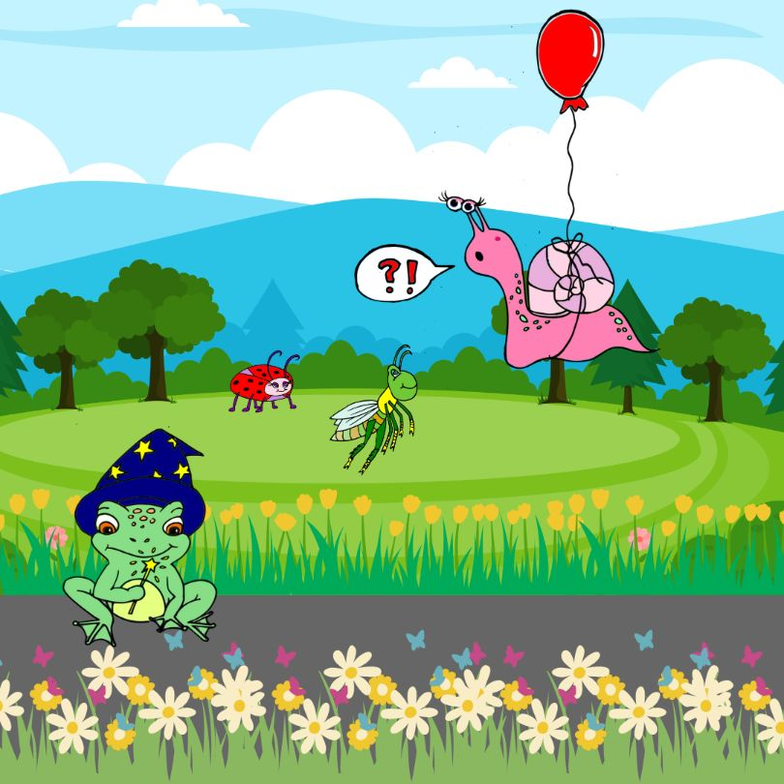
Merlin tied the balloon around Scotty’s shell, and he started to rise towards his friends.
He rose towards the trees but then… ‘BANG’, a sharp twig popped the balloon!

Slide 13
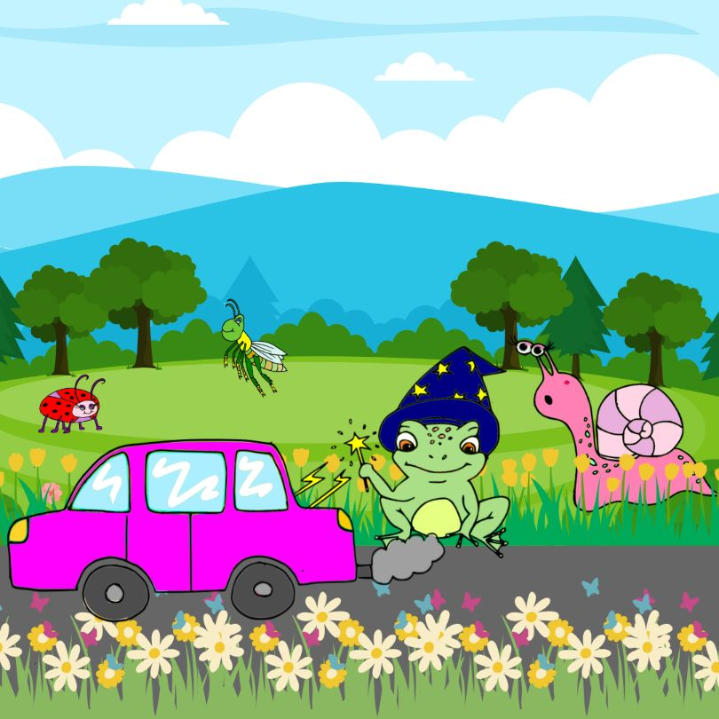
Merlin tried again and waved his wand. This time, a bright purple, shiny car appeared and everyone jumped in.

Slide 14
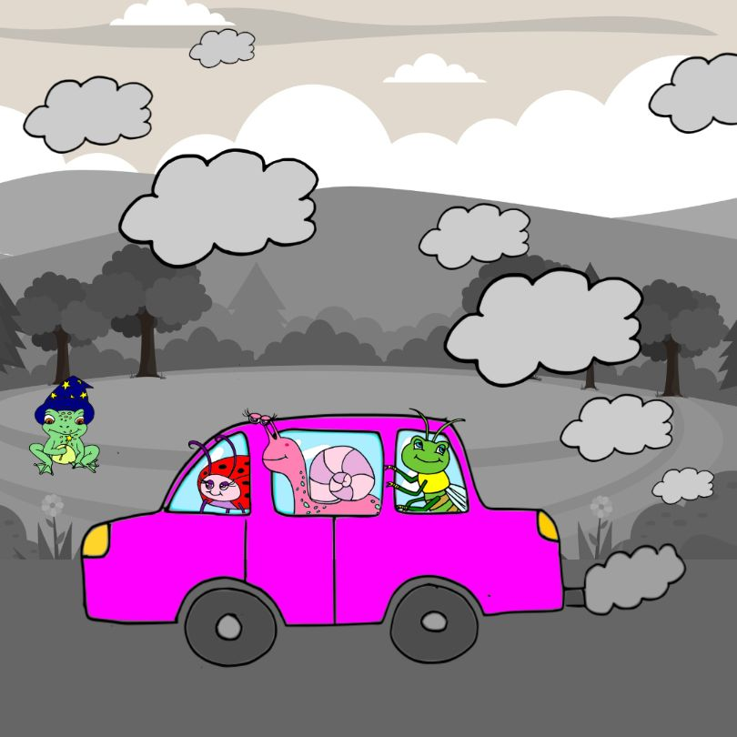
As they drove off, a thick cloud of black smoke poured out of the exhaust. Merlin explained, “The car is a great way for you all to go on adventures, but it runs on fuel and the gases pollute our environment.”

Slide 15
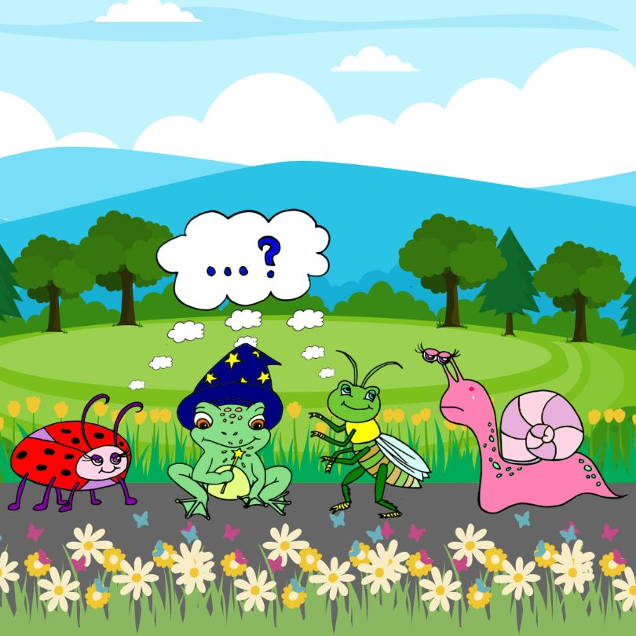
Scotty’s friends were determined think of another way to travel, so they put their heads together. They didn’t want to pollute their garden and wanted something that was fast, fun and kinder to the environment.

Slide 16
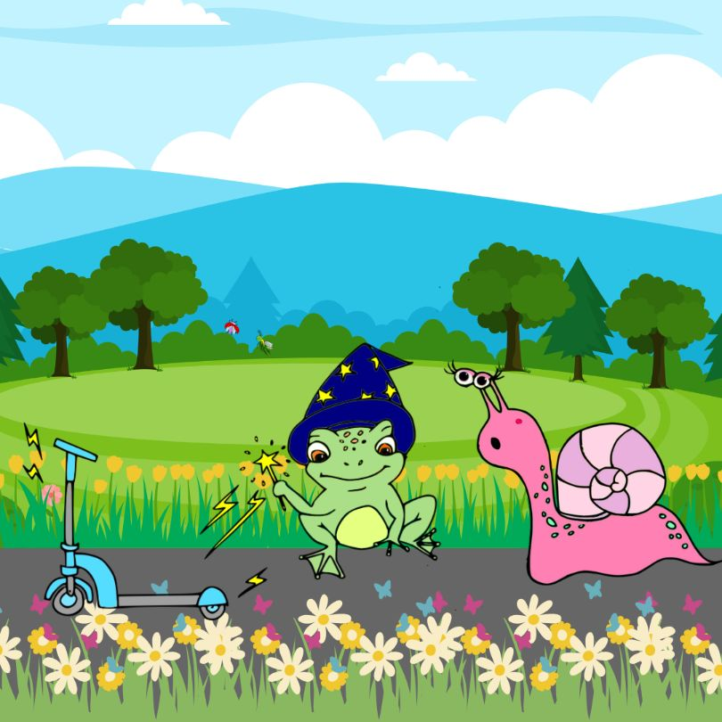
“I’ve got it!” said Merlin. He waved his wand again, and a beautiful, blue scooter appeared.

Slide 17
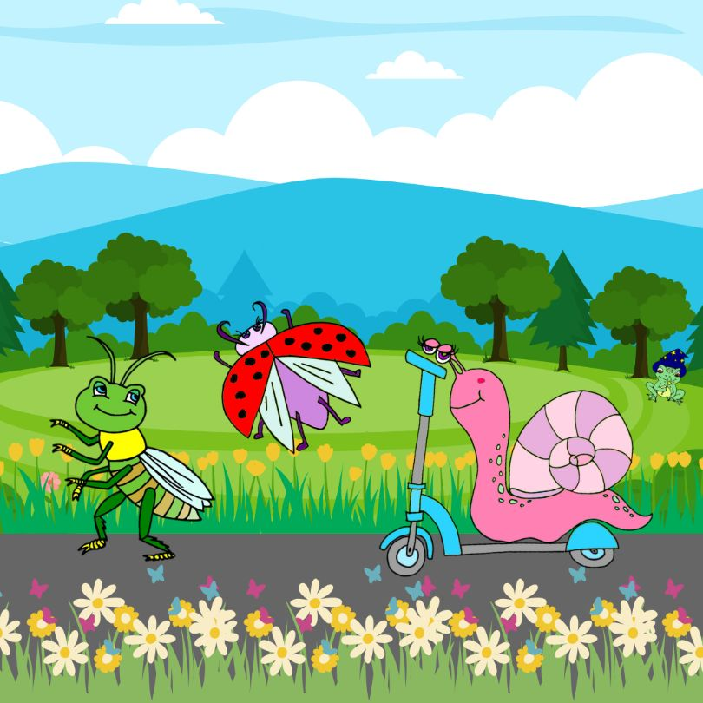
Scotty was so excited and hopped onto his new vehicle. They all zoomed off together towards the edge of the garden.

Slide 18
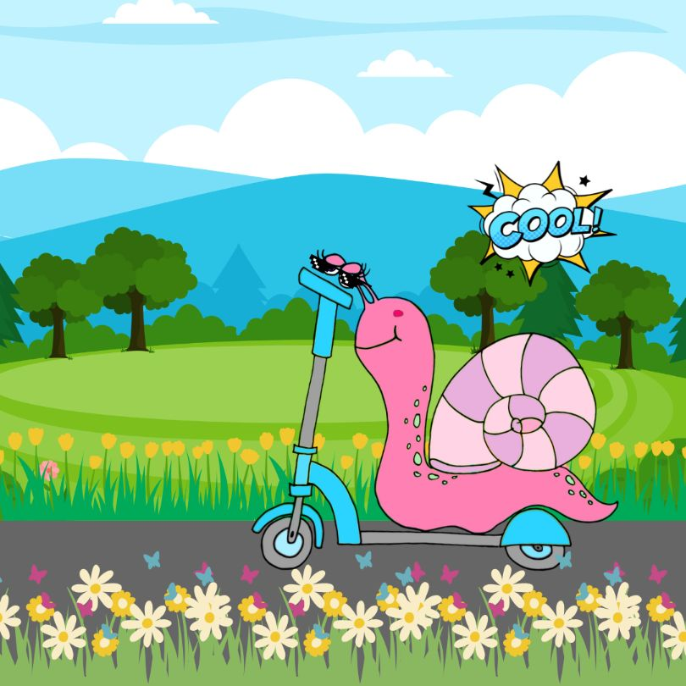
As Scotty scooted, he felt fast and brave. With his scooter, he felt he had his own superpowers!
Now, he was Scotty, the Scooting Snail, and he felt cool!

Slide 20
