Slide 1
National Walk to School Week
Green-Schools Travel

Slide 2
What is it all about?
National Walk to School Week
is where students all over the country will be trying to walk to school if they can

Slide 3
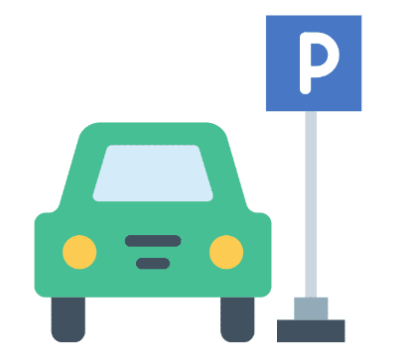
If you live too far to walk to school
You could park away from the school and walk the rest
ark & Stride

Slide 4
Is walking good for you?
Walking is good for you!
Notes:
Ask student if they think walking is good for them and if they can list 3 reasons why it might be

Slide 5
Walking is good for you!
Walking to school gives you time to chat with your friends
Notes:
Walking to school allows you to talk to your friends, feel more connected to your community, and gives you stronger understanding of your local area

Slide 6
Walking is good for your heart!

Slide 7
Walking is good for your bones!
Walking regularly helps to increase your bone density and strength

Slide 8
Walking improves your mood
The more active you are, the happier you are likely to feel!

Slide 9
Less cars means safer streets
Walking reduces traffic

Slide 10
Walking is good for the planet!
Walking doesn’t produce carbon emissions

Slide 11
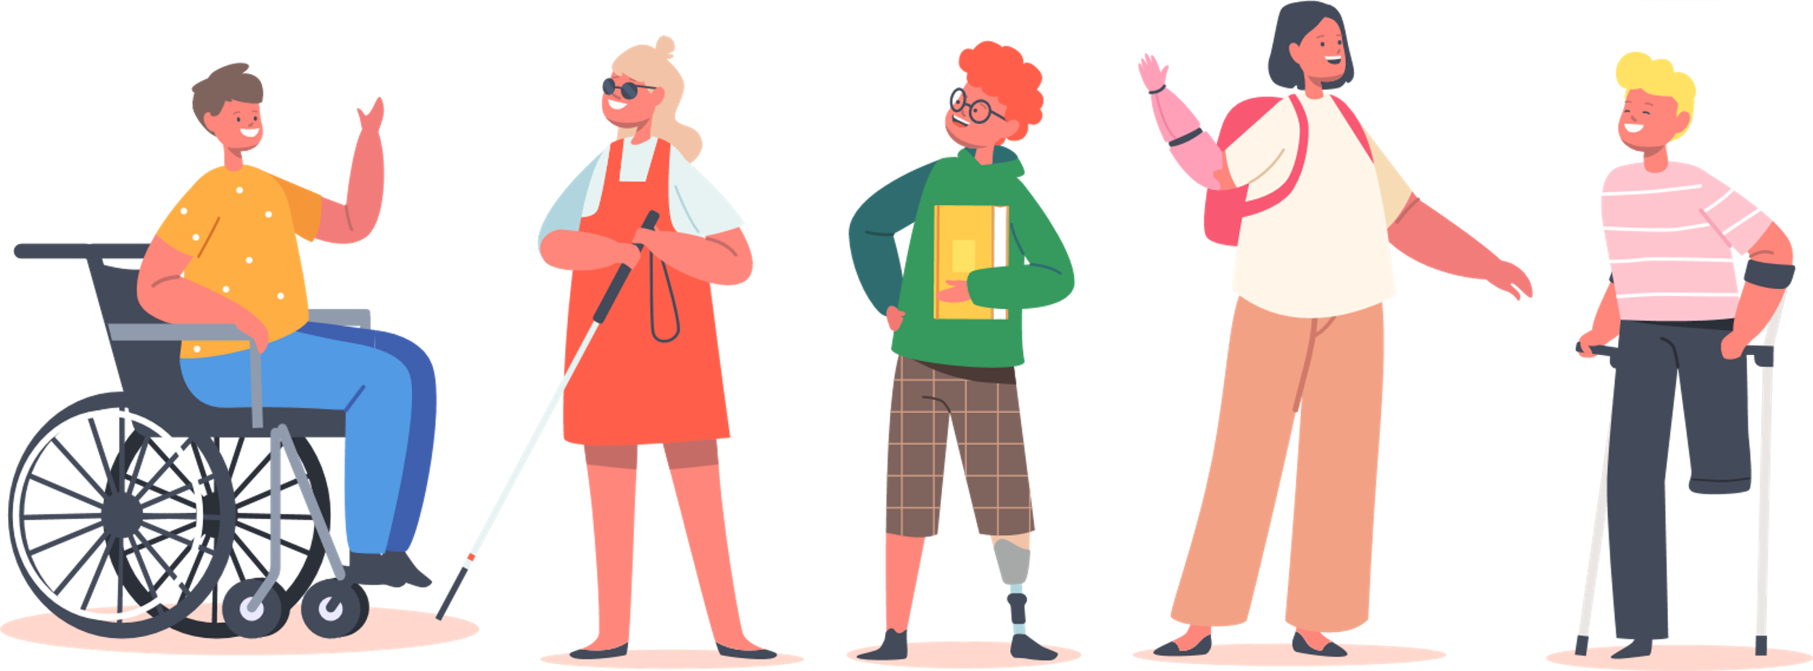
National Walk to School Day
Wednesday
October 4th 2022
Taking part is easy, all you need to do is walk (or wheel) or park & stride to school!

