Slide 1
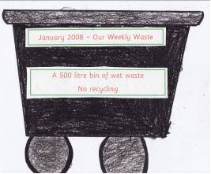


Environmental review Litter and Waste
Your review is one of the first steps in your Green-Schools programme
You should undertake your review before you draw up your action plan
and before you implement any litter/waste reduction measures

Slide 2
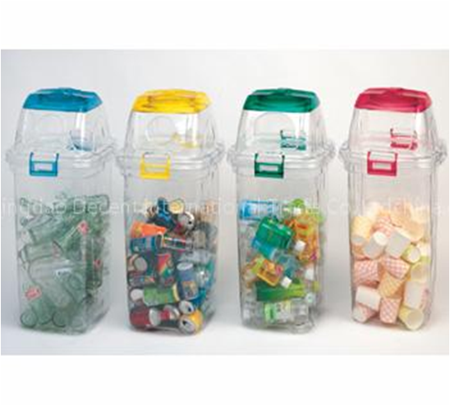

Waste ; items we have no further use for, they may be useful to someone else so we may be able to pass them on for reuse (clothing to charity shops) or recycling (paper, plastic, cans).

Slide 3
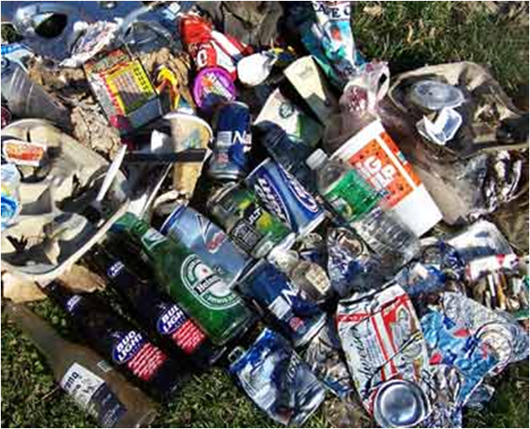
      Litter; “waste in the wrong place”- if it’s in the bin its waste, if it’s on the ground its litter

Slide 4
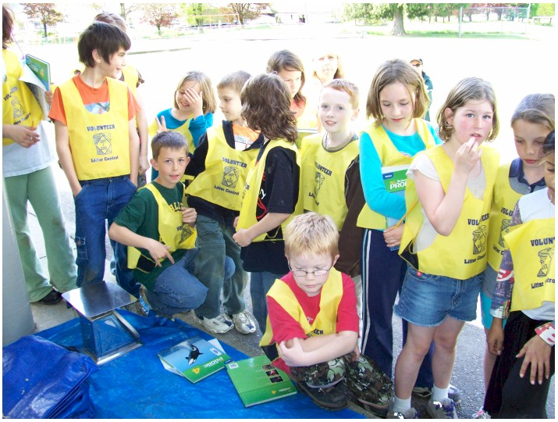
Litter Review – how to do it!
Materials required
Graph paper
Pencil
Markers
Ruler
Gloves or litter picker
Bags/bin

Slide 5
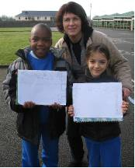
Procedure
Divide school and school grounds into different areas for different groups of students to carry out a review on that area e.g. classrooms, hall, yard, garden
Assign a group of students to each area
Students draw a map of the area
Students collect litter and mark on the map where litter was found, different types of litter can be marked on the map with different colour pens

Slide 6
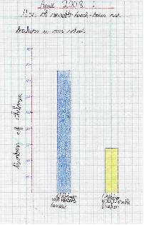
Get students to quantify how much litter was found in each area by calculating weight or number of different types of litter
Students draw bar, pie charts or pictogram to represent their findings

Slide 7
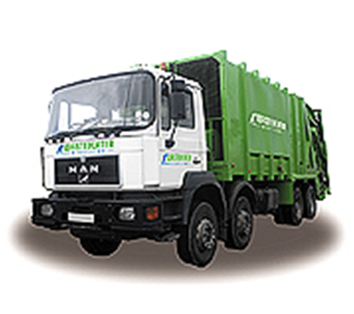
Waste Review
Contact your waste service provider – they can often provide weights get the weight records for as many months as possible (best been for a year) and get students to calculate the average monthly or weekly weight of waste produced and the weight of weight produced per person in the school daily/weekly or monthly.(it may also be possible to get different weights for recyclables’ and landfill waste)

Slide 8
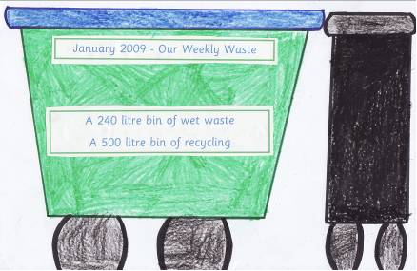
If your bin weights are not recorded by your waste collection company weigh your waste daily or weekly for a period and calculate the average, a bathroom scales can be used.

Slide 9
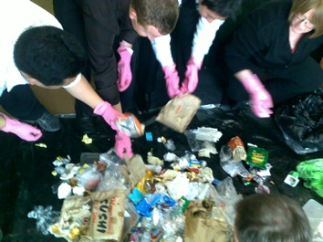
Do a bin survey i.e. empty the bin onto a plastic sheet and get students (wearing Gloves) to separate waste into different items e.g. cans, papers, plastic, graph your results

Slide 10
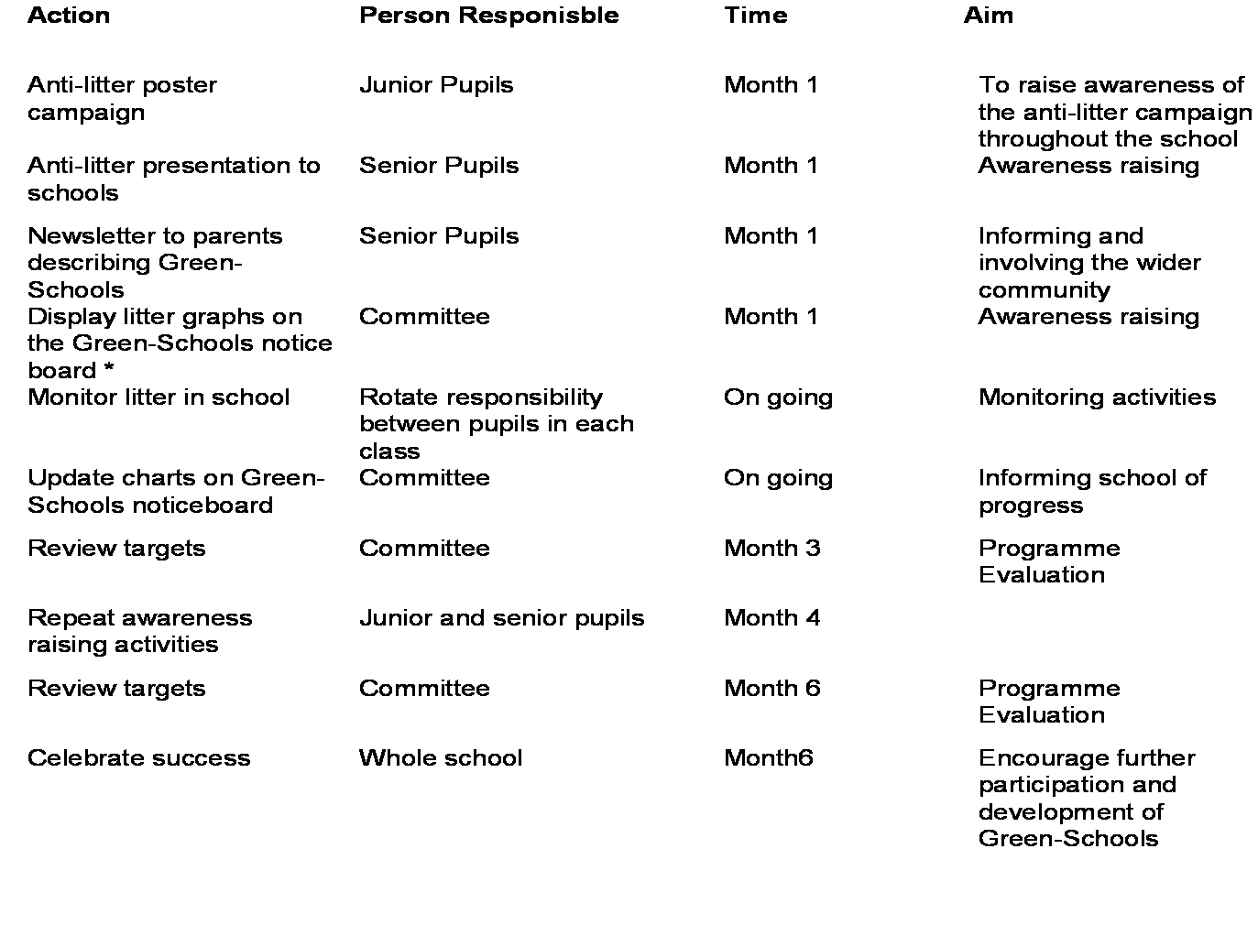
The information gained from your litter and waste review will show you where your main problems are with litter and waste and will be used in drawing up your action plan.

Slide 11
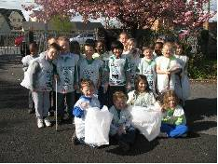
The reviews will also help you decide on your targets i.e. the reductions in the amount of litter and waste you are going to aim for.

Slide 12
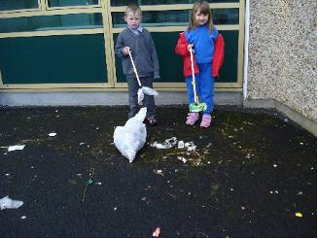
You will repeat your litter and waste survey a number of times throughout your Green-schools programme (Monitoring and Evaluation) to check you are reaching your targets and to make amendments in your programme where necessary,

